Slide 1
Treatment Planning K. Chavez
Jeff Henneberg DDS
Inland Empire Perio Study Club
3/8/19
Mentor Surgery – Shaun Whitney DDS

Slide 2
Initial Visit 8/29/18
CC: Wants to replace missing tooth with an implant if possible, and wants to know all the possibilities.

Slide 3
Medical History
Healthy 21 year old female student
No allergies noted

Slide 4
Dental History
Congenitally missing #10
Presented with composite bonding #7,8,9 to close central diastema and to bond #10 pontic in place
Gingivitis
Caries risk – low

Slide 5
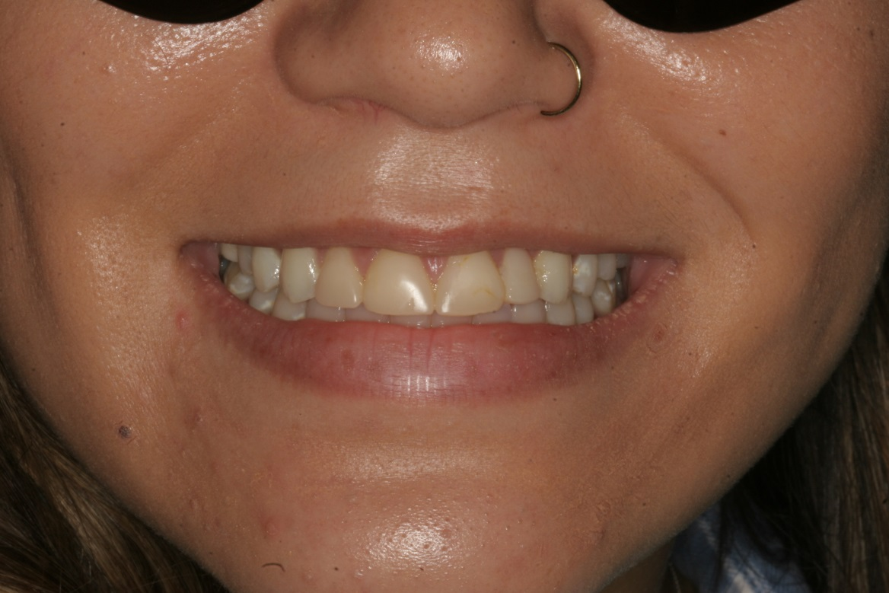
Photos

Slide 6
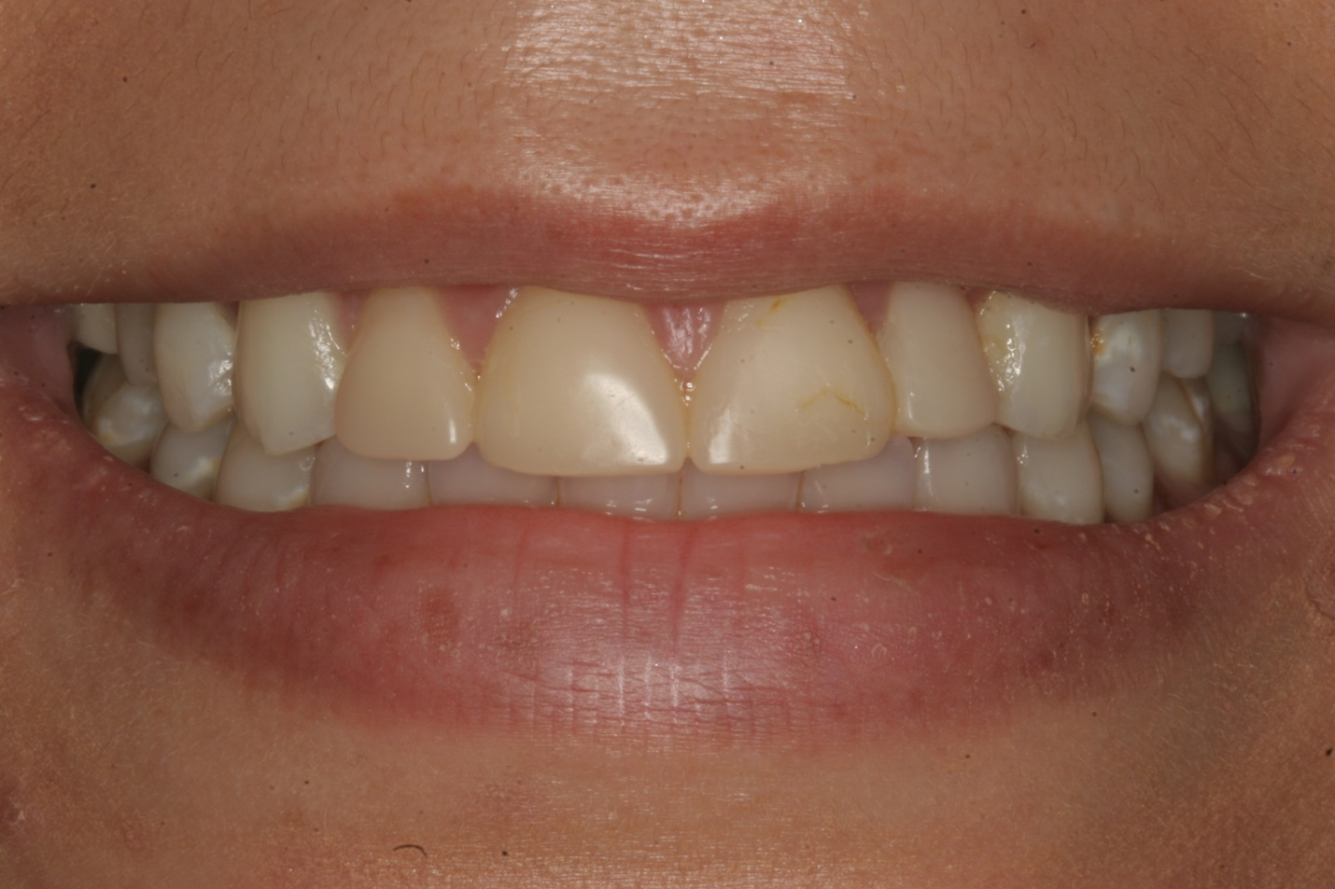

Slide 7
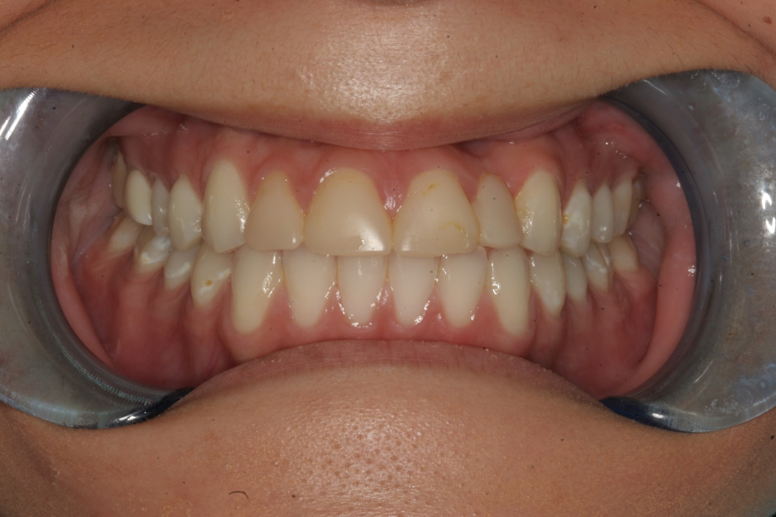

Slide 8
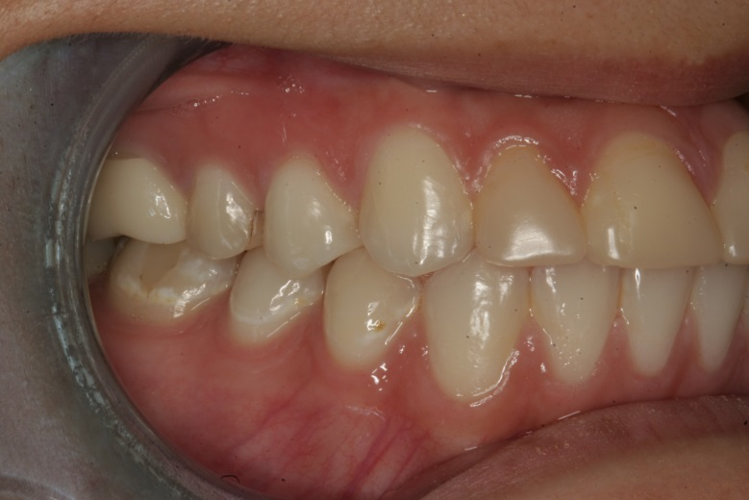
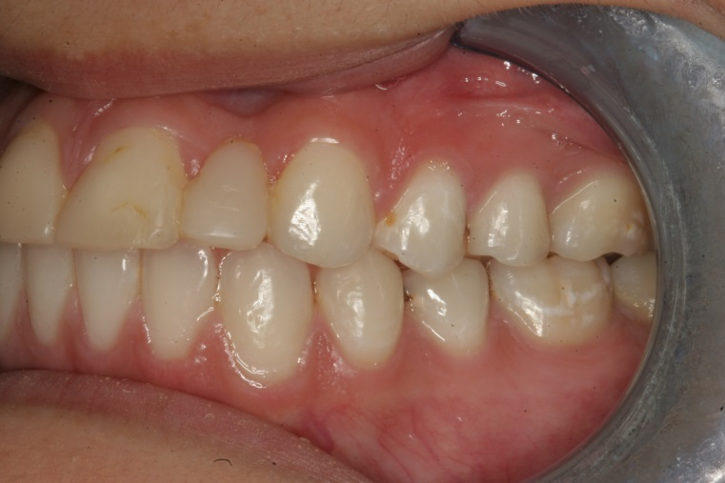
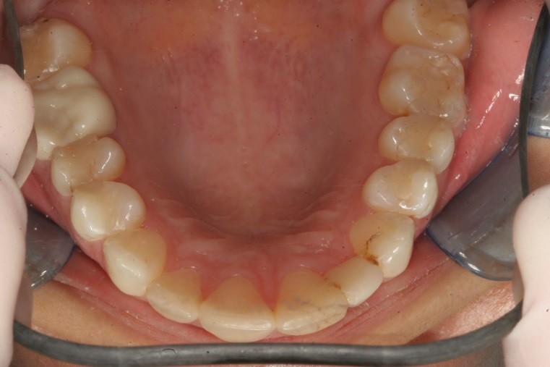
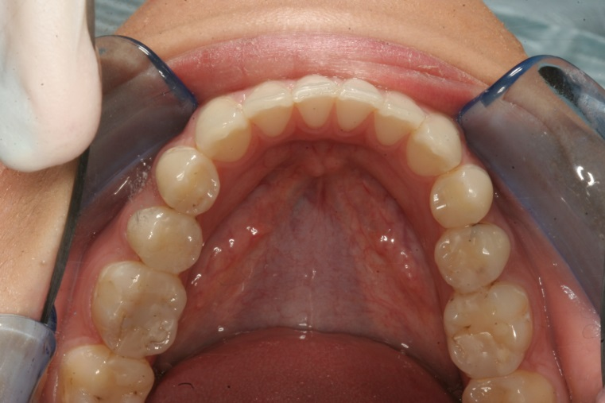

Slide 9
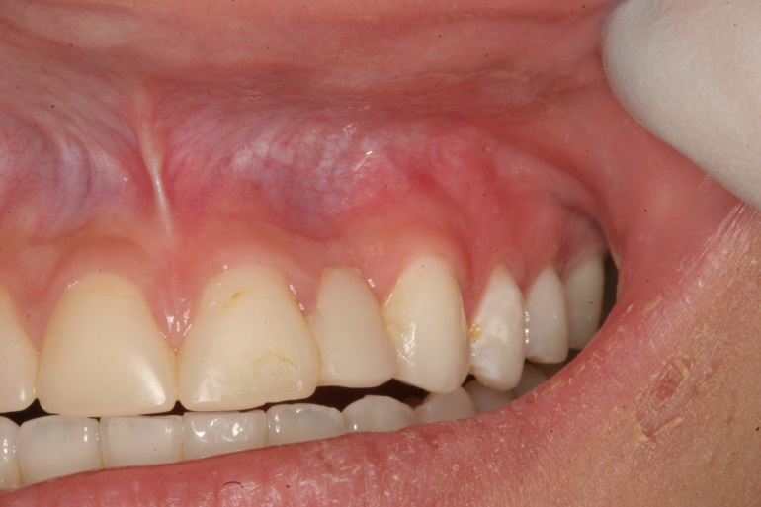
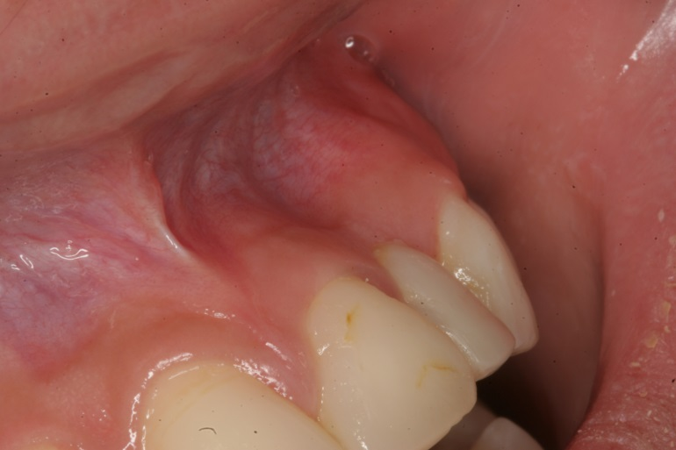

Slide 10
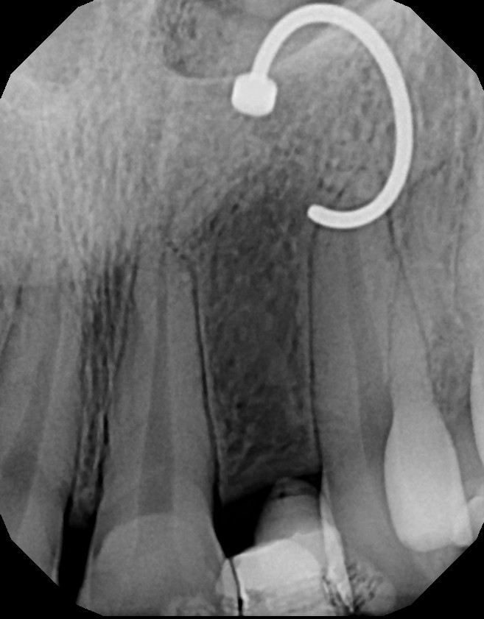
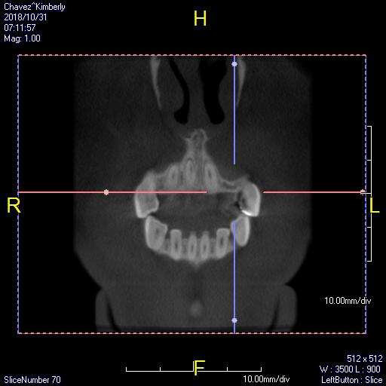
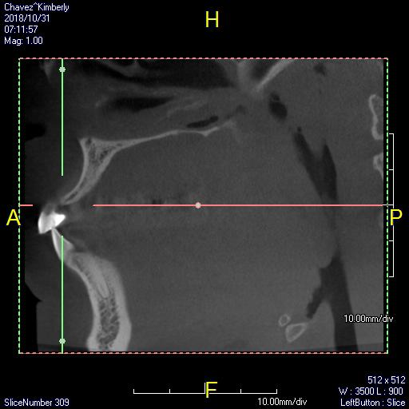
CBCT and PA

Slide 11
Options
Fixed #9-10, veneer #6,7,8,11
Fixed without the canines
Grafting – bone and tissue?
Implant?

