Slide 1
OrAL Pathology
March 16, 2018
Shaun M. Whitney, DDS
Inland Empire Periodontal Study Club

Slide 2
Roadmap
Normal/Healthy Oral Cavity
Acute Gingival Diseases
Vesiculo-erosive Lesions/Desquamative
Benign Growths
Carcinoma In-situ
Dental Pain/Abscesses

Slide 3
Normal/Healthy Oral Cavity

Slide 4
Normal/Healthy Oral Cavity

Slide 5
Floor of Mouth

Slide 6
Tongue

Slide 7
Normal/Healthy Oral Cavity
Firm/Pink gingiva
No caries
No palpable masses
No swelling
No sinus tracts

Slide 8
Necrotizing Periodontal Diseases
Necrotizing Ulcerative Gingivitis (NUG)

Slide 9
NUG Clinical Features
Pain
Interdental (soft tissue) cratering
Most characteristic finding is necrotic punched out papillae, covered with a gray pseudomembrane
Gingival Bleeding

Slide 10
NUG Clinical Features
Lymphadenopathy
Increased salivation
Fever and malaise
Fetid odor
All of the above may occur

Slide 11
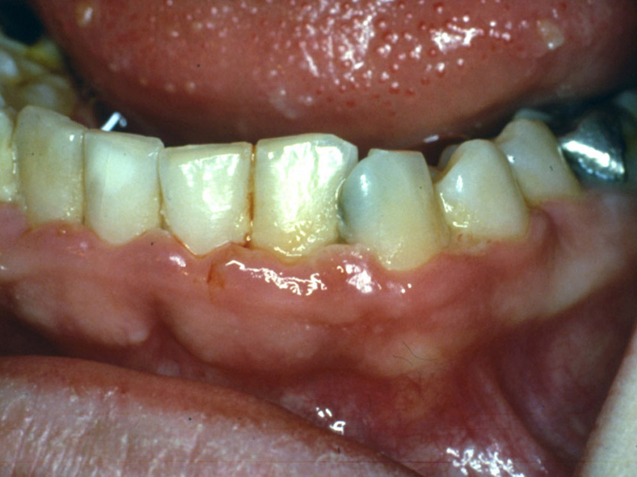
Notes:
h:\TMP_FacStaffTransfer\Assad\2297_Assad\Page 2-06.jpg

Slide 12
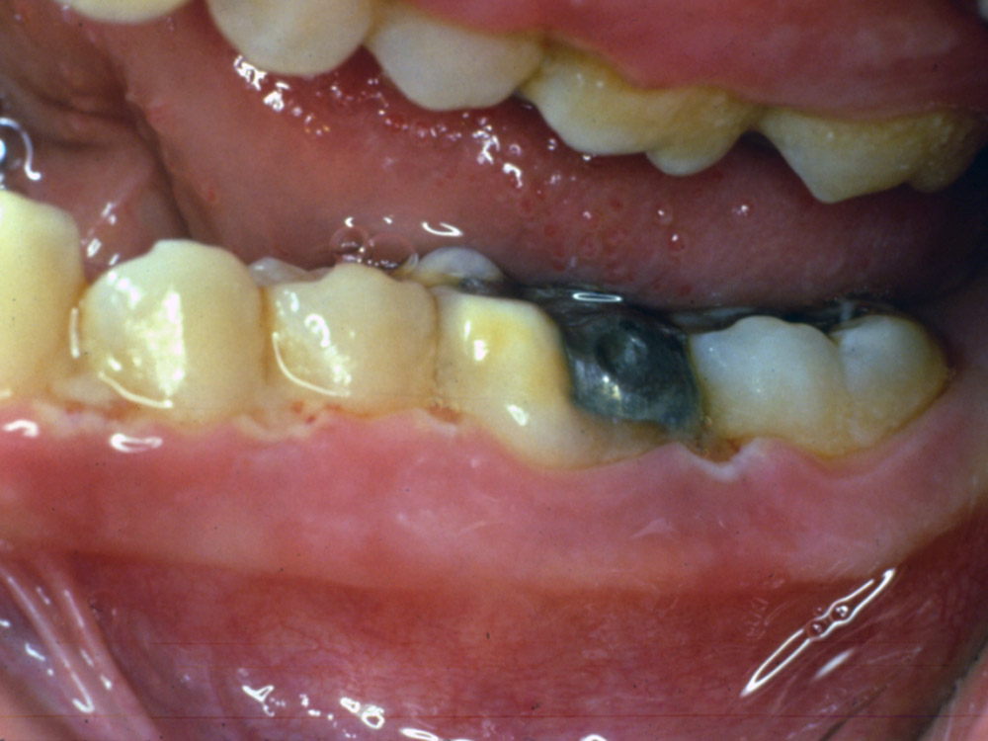
Notes:
h:\TMP_FacStaffTransfer\Assad\2297_Assad\Page 2-08.jpg

Slide 13
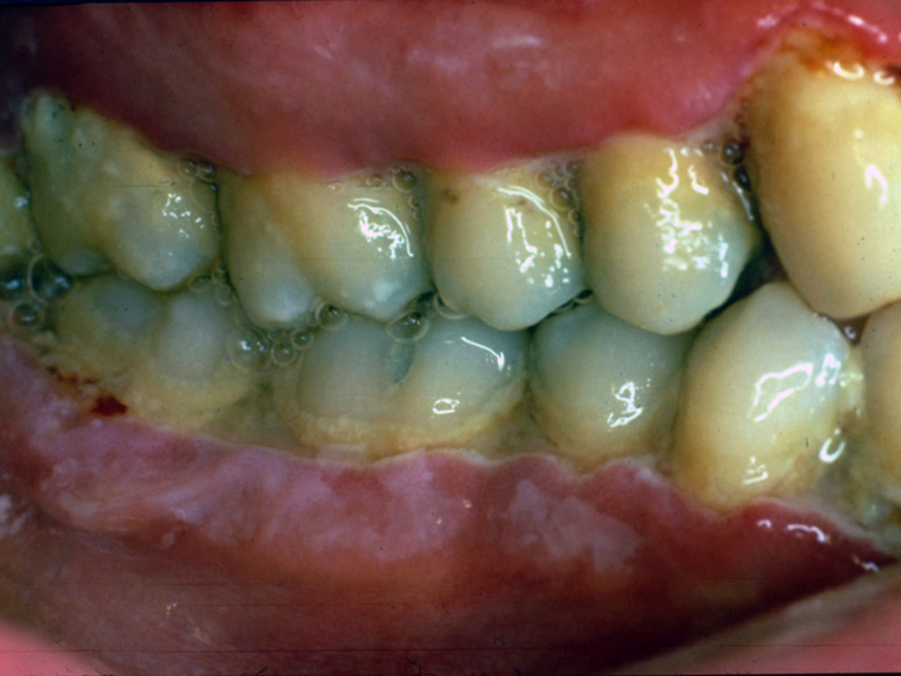
Notes:
h:\TMP_FacStaffTransfer\Assad\2297_Assad\Page 2-07.jpg

Slide 14
Acute Herpetic Gingivostomatitis
Etiology
HSV type I
Equal in males and females
Most common < age 6
Can be seen in adolescents and adults but MOST common below age of 6

Slide 15
Herpetic Gingivostomatitis Oral Signs
Diffuse involvement of gingiva and oral mucosa
Vesicles/ulcers
Usually 7-10 day course

Slide 16
Gingivostomatitis Oral/Systemic Symptoms
Generalized soreness of mouth
Herpes labialis may accompany intraoral disease
Common to find lymphadenopathy
Fever and malaise
May follow debilitating disease
Anxiety, stress, or exhaustion may predispose

Slide 17
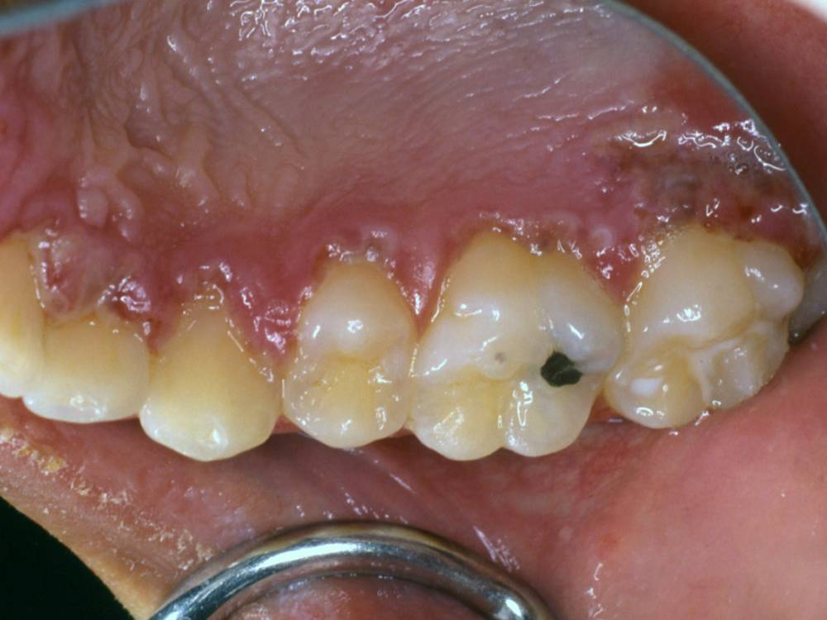
Notes:
h:\TMP_FacStaffTransfer\Assad\2297_Assad\Page 2-10.jpg

Slide 18
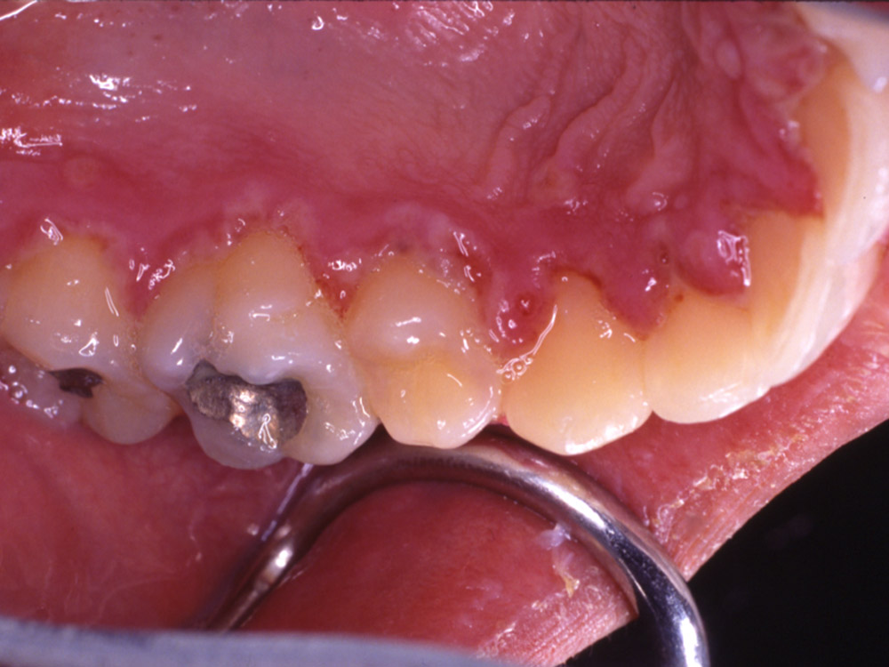
Notes:
h:\TMP_FacStaffTransfer\Assad\2297_Assad\Page 2-12.jpg

Slide 19
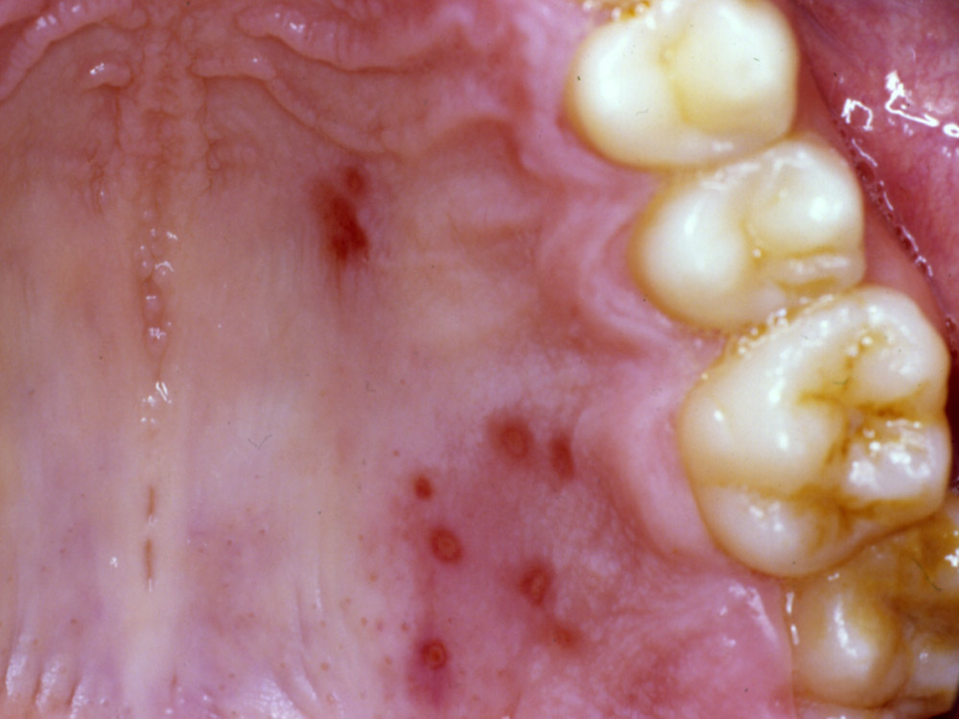
Notes:
h:\TMP_FacStaffTransfer\Assad\2297_Assad\Page 2-16.jpg

Slide 20
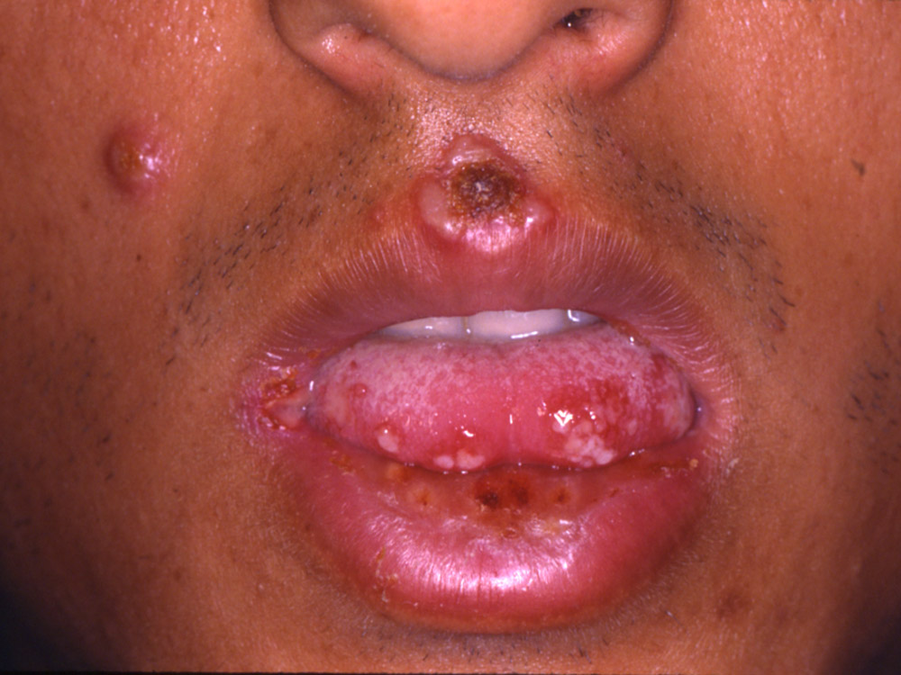
Notes:
h:\TMP_FacStaffTransfer\Assad\2297_Assad\Page 2-14.jpg

Slide 21
Gingivostomatitis
Recurrent herpes labialis- virus ascends through the sensory and autonomic ganglia
Resides in the trigeminal ganglion
Activated by overexposure to sunlight, trauma, fever, or stress

Slide 22
Herpes Labialis

Slide 23
Treatment
Generally palliative care only
Acyclovir if detected prior to vesicle formation
Xylocaine mouth rinse
Hydration
Patient education
Lysine?

Slide 24
Desquamative Gingivitis Oral Mucous Membrane Diseases
Desquamative Gingivitis-NOT a specific disease entity, a gingival response associated with a variety of conditions
Dermatoses- Lichen planus, BMMP, Pemphigus, Erythema Multiforme, Lupus Erythematosus

Slide 25
Lichen Planus
Common, chronic dermatosis
Middle aged and older females
Hyperkeratosis
Autoimmune etiology
Oral lesions-most common are reticular and erosive, both follow a chronic course that waxes and wanes
No cure!

Slide 26
Notes:
h:\TMP_FacStaffTransfer\Assad\2297_Assad\Page 3-01.jpg

Slide 27
Lichen Planus

Slide 28
Lichen Planus
Gingival lesions-10% of the patients have lesions restricted to the gingiva
Some lesions may be very painful
Histologic evaluation
Hyperkeratosis
Degeneration of basal layer
“Saw-toothed” rete ridges
Dense infiltrate in lamina propria

Slide 29
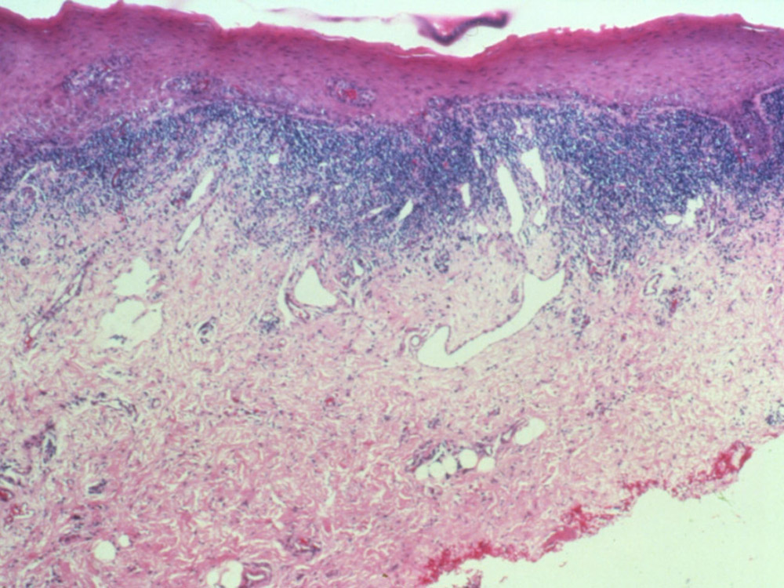
Notes:
h:\TMP_FacStaffTransfer\Assad\2297_Assad\Page 3-03.jpg

Slide 30
Lichen Planus
Differential-squamous cell, vesiculobullous disorders
Treatment-only the erosive or ulcerative lesions require treatment, usually with topical steroids
Consider systemic steroids if erosive/ulcerative forms persist

Slide 31
Lichen Planus
Lichenoid drug reactions
Lisinopril or other ACE Inhibitors
Consultation with physician ~ change BP med??

Slide 32
Benign Mucous Membrane Pemphigoid (BMMP)
Chronic
Vesiculobullous, autoimmune disorder
Females in the 5th decade
Oral lesions
Erythema, desquamation, ulceration, vesiculation of keratinized gingiva

Slide 33
BMMP
Histologic evaluation-subepithelial vesiculation
Epithelium separated from underlying lamina propria, basal layer intact
Immunofluorescence along the basement membrane

Slide 34
BMMP

Slide 35
BMMP

Slide 36
Diagnosis
Michel’s Solution ~ oral biopsy

Slide 37
Direct Immunofluorescence

Slide 38
BMMP
Ocular lesions-unilateral conjunctivitis, within 2 years becomes bilateral, may produce scarring, blindness
Differential-any of the vesiculobullous disorders
Therapy-topical steroids or systemic

Slide 39
Pemphigus
Group of autoimmune bullous disorders
Predominant IgG immunoglobulin
Pemphigus vulgaris-most common
Cutaneous and/or mucous membrane vesicles
Lethal 10% of the time
60% of patients present with oral lesions as the first sign of disease

Slide 40
Pemphigus
Oral lesions- small vesicles to large bullae
Skin lesions-bullae present on flexor surfaces

Slide 41
Diagnosis
Nikolsky’s Sign
Michel’s Solution ~ oral biopsy

Slide 42
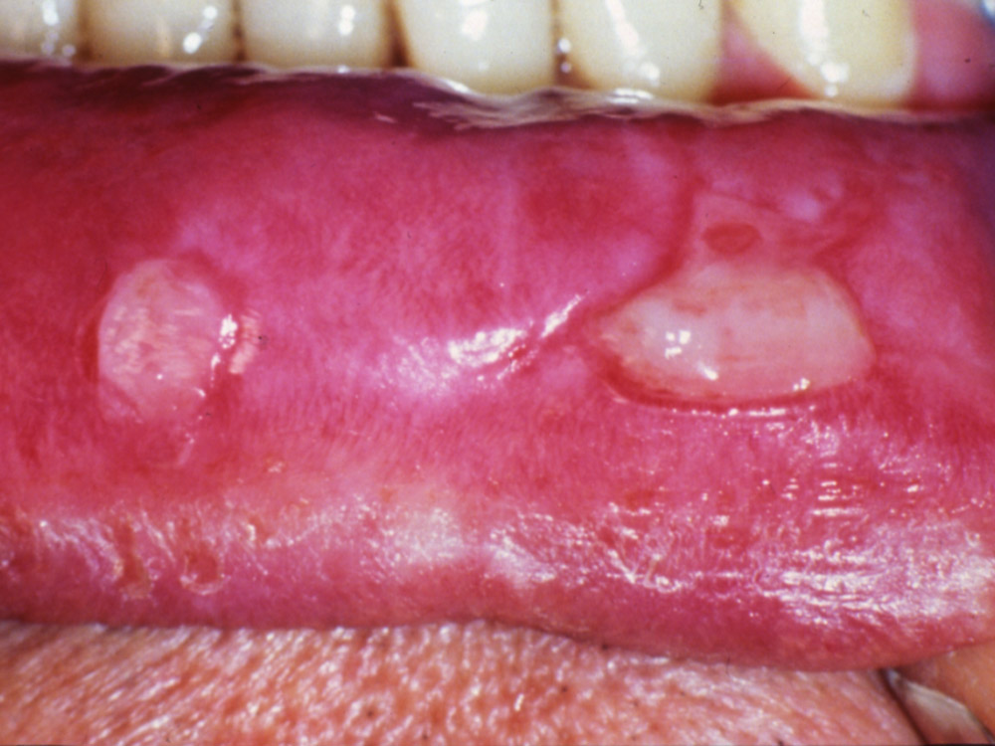
Notes:
h:\TMP_FacStaffTransfer\Assad\2297_Assad\Page 3-05.jpg

Slide 43
Direct Immunofluorescence

Slide 44
Treatment
Systemic corticosteroids

Slide 45
Benign Lesions
Fibroma
Firm, asymptomatic, smooth surfaced
Buccal mucosa and lower lip
Response to trauma/chronic irritation

Slide 46
Treatment

Slide 47
Benign Lesions
Pyogenic granuloma
Sessile, hemorrhagic, exophytic, ulcerated
Overgrowth of granulation tissue secondary to irritation
Female predilection

Slide 48
Pyogenic Granuloma

Slide 49
Treatment
Excisional
Low rate of recurrence if fully resected

Slide 50
Benign Lesions
Peripheral ossifying fibroma
Young adults
Female predilection
Exclusively on the gingiva
Firm, sessile, exophytic

Slide 51
Peripheral Ossifying Fibroma

Slide 52
Histology

Slide 53
Treatment
Excisional biopsy
15-20% recurrence rate

Slide 54
Benign Lesions
Peripheral Giant Cell Granuloma
Female predilection
Firm, pink/red/blue, sessile
Confined to gingiva

Slide 55
Peripheral Giant Cell Granuloma

Slide 56
Histology

Slide 57
Treatment
Excisional
15-20% recurrence

Slide 58
Floor of Mouth/Ventral or Lateral Tongue Lesions
White plaques
Generally painless
Painful if ulcerated
History of smoking/smokeless tobacco and/or alcohol consumption
Floor of mouth and lateral tongue lesions are areas highly associated with carcinoma

Slide 59
Clinical Presentation

Slide 60
Clinical Presentation

Slide 61
Lesion Description
Circumscribed, adherent, white plaques with variations in size and surface characteristics
Patients description: Painless and persistent

Slide 62
Histology
Ventral Tongue
Floor of Mouth

Slide 63
Histology

Slide 64
Histology

Slide 65
Microscopic Findings
Keratotic stratified squamous epithelium exhibiting severe maturational changes
Nuclear hyperchromaticity
Cellular pleomorphism
Increased mitotic figures
Histologic diagnosis: Carcinoma in-situ with severe dysplasia

Slide 66
Lateral Tongue Carcinoma

Slide 67
Case #1
63 yo Caucasian Female
Unremarkable health history
Unremarkable dental history
Chief Complaint: “My gums have recently swelled up, I think I have an abscess”

Slide 69
Periapical

Slide 70
Clinical Evaluation
Periodontal probe depths WNL
Endodontic ice #’s 27-30 WNL
Percussion/Palpation #27-30 WNL
Class II Mobility #28 and Class I #29
Soft, fluctuant swelling in the alveolar mucosa facial #27/28

Slide 71
Surgical Exposure

Slide 75
Histological Diagnosis
Ameloblastoma
Most commonly posterior mandible
Derived from cells involved in tooth formation
Aggressive lesions
Predominantly 4th/5th decade of life
Tooth displacement/cortical expansion
High recurrence rates
Surgical resection is recommended treatment

Slide 76
Case #2
80 y.o. Caucasian Male
Referred for endodontic assessment
History of dental trauma
Chief complaint: “Gum tissue swelling in past few months”

Slide 77
Periapical

Slide 78
Perio/Endo Testing
Periodontal findings WNL
Normal pulpal responses #6-10
Normal periapical responses #6-10
EPT responses #6-10
Firm/indurated elevation buccal #6/7/8

Slide 79
Preoperative

Slide 80
Intraoperative

Slide 81
Enucleation

Slide 82
Postoperative

Slide 83
Diagnosis
Keratocystic Odontogenic Tumor (KCOT or OKC)
Aggressive lesion
High recurrence rate ~ 30%
More common posterior mandible
More common in 2nd/3rd decades of life

Slide 84
Case #3
82 year old Caucasian Male
History of uncontrolled type II diabetes
History of periodontal disease
Unremarkable health history/nonsmoker
Chief complaint: “Gum tissue is starting to swell in past month”

Slide 85
Periapical

Slide 86
Clinical Presentation

Slide 87
Case #4
13 y.o. Caucasian male
Unremarkable health history
History of dorsal tongue white lesion

Slide 88
Preop

Slide 89
Biopsy

