Slide 1
Mucogingival Deformities: AAP World Workshop 2018
Shaun M. Whitney DDS
Inland Empire periodontal study club
5/10/2019

Slide 2
Mucogingival Deformities
Most common deformities
  Lack of keratinized gingiva
  Gingival recession
Consensus ~ minimum amount of KG not required to prevent attachment loss if good conditions are present
Attached gingiva is needed in patients with suboptimal plaque control

Slide 3
Mucogingival Deformities
Clinical significance
  Esthetically unacceptable for patients
  Dentinal hypersensitivity
  Exposed root surfaces
    Carious lesions
    Non-carious lesions ~ abrasions/erosion

Slide 4
Normal Mucogingival Condition
Normal Mucogingival Condition
  Absence of pathosis
    Gingival recession
    Gingivitis
    Periodontitis

Slide 5
Periodontal Biotype
Periodontal Biotype
  Defined now by gingival thickness, keratinized tissue width, bone morphotype and tooth dimension
  3 types
    Thin scalloped biotype
    Thick flat biotype
    Thick scalloped biotype

Slide 6
Thin Scalloped Biotype
Thin Scalloped Biotype
  Slender triangular crown
  Subtle cervical convexity
  Interproximal contacts close to incisal edges
  Narrow zone of KT (typical range of 2.8mm to 5.5mm)
  Clear thin delicate gingiva
  Relatively thin alveolar bone (ave 0.34mm mean buccal bone thickness)

Slide 7
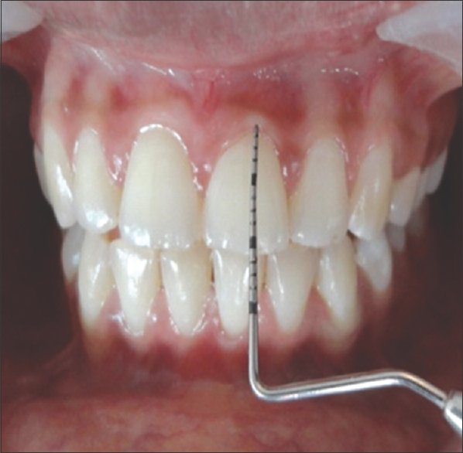
Thin Scalloped Biotype

Slide 8
Thick Flat Biotype
Thick Flat Biotype
  Square-shaped tooth crowns
  Pronounced cervical convexity
  Large/broad interproximal contact located more apically
  Broad zone of keratinized gingiva (average 5mm to 6.6mm)
  Thick, fibrotic gingiva
  Thick alveolar bone (Average 0.75mm mean buccal bone thickness)

Slide 9
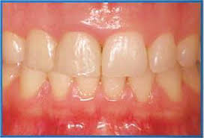
Thick Flat Biotype

Slide 10
Thick Scalloped Biotype
Thick Scalloped Biotype
  Thick fibrotic gingiva
  Slender teeth
  Narrow Zone of keratinized gingiva
  Pronounced gingival scalloping

Slide 11
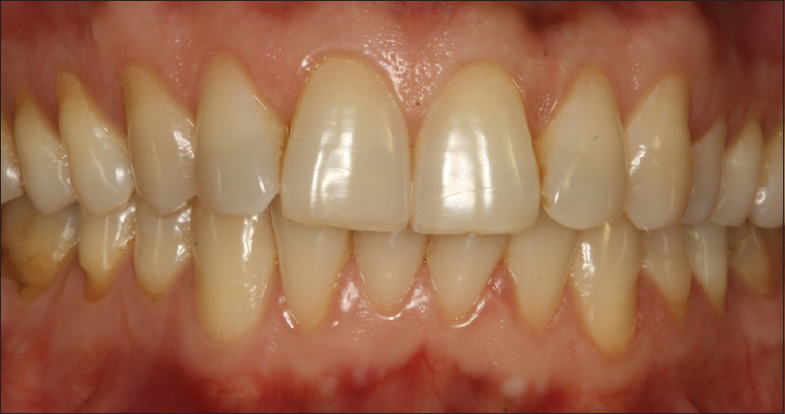
Thick Scalloped Biotype

Slide 12
Periodontal Biotype and Attached Gingiva
Thin biotype, absence of attached gingiva, and reduced thickness of alveolar bone due to abnormal tooth positions are risk factors for recession
Current consensus (low level of evidence) is that there needs to be 2mm of keratinized gingiva with 1mm of attached gingiva to maintain periodontal health

Slide 13
Biotype and Orthodontics
5-12% incidence of developing recession post-orthodontics
Facially inclined teeth show increase in apico-coronal width of KT when teeth moved lingually
Higher probability of recession during tooth movement in areas with <2mm of gingiva
  May consider treating these areas prior to orthodontics

Slide 14
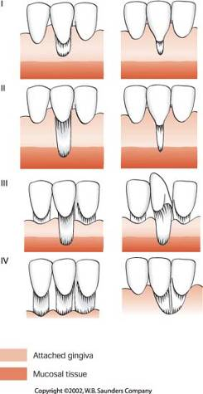
Miller Classification
I - recession above MGJ with no bone/interproximal tissue loss
II - recession to/or beyond MGJ with no interproximal loss
III – recession beyond MGJ with interproximal bone/ tissue loss or malpositioned teeth
IV - generalized recession with severe bone/tissue loss

Slide 15
Factors for a New Mucogingival Classification System
Recession Depth
Gingival Thickness
Interdental Clinical Attachment Level

Slide 16
Recession Depth
General consensus is deeper recession depth less likelihood for full root coverage
Difficult to assess when CEJ has been obliterated by restorations, abrasion, caries, etc
Anatomical CEJ should be reconstructed with restorative dentistry prior to coverage
No significant evidence to show that recession increases tooth mortality

Slide 17
Gingival Thickness
Gingival thickness <1mm associated with reduced probability of root coverage with advanced flaps

Slide 18
Interdental CAL
Interdental Clinical Attachment Level
  Recession associated with normal integrity of interdental attachment have higher likelihood of full root coverage
  Loss of interdental attachment reduces likelihood of root coverage
  Severe loss of interdental attachment impairs likelihood of root coverage

Slide 19
New Classification
Proposed by Cairo et al
  Recession Type 1 (RT1)
  Recession Type 2 (RT2)
  Recession Type 3 (RT3)

Slide 20
Recession Type 1
Gingival recession with no loss of interdental attachment
Interproximal CEJ is not detectable at mesial and distal aspects of the tooth
Replaces Miller Class I/II
100% root coverage can be predicted

Slide 21
Recession Type II
Gingival recession associated with loss of interproximal attachment
Amount of interproximal attachment loss (Distance from CEJ to depth of pocket) is less than or equal to the buccal attachment loss (Distance from buccal CEJ to depth of pocket)
Replaces Miller Class III
100% root coverage may occur but not as likely

Slide 22
Recession Type III
Gingival recession with loss of interproximal attachment
Amount of interproximal attachment loss (Distance from CEJ to base of pocket) is greater than the buccal attachment loss (Distance from buccal CEJ to base of pocket)
Replaces Miller Class IV
Full root coverage not achievable

Slide 23
Tooth Conditions and Recession
Caries
Non-carious cervical lesion
  Acidic foods/beverages and medications
    Smooth/broad shallow lesions with ill-defined margins
  Toothbrush trauma
    Sharply defined/notched out margins
  No scientifically sound evidence showing occlusal overload leading to abfractions
  Efforts should be made to educate the patient when attempting to perform root coverage in areas where the CEJ has been obliterated by caries or non-carious lesions
  Restorations should be placed to reconstruct the position of the CEJ to facilitate root coverage procedures

Slide 24
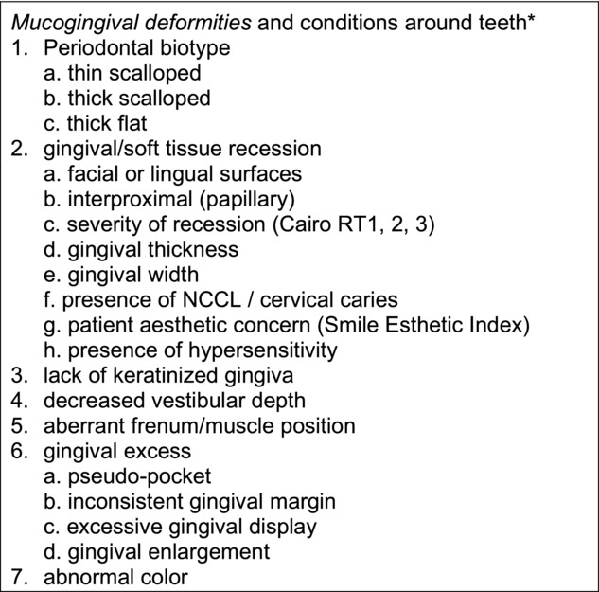
AAP World Workshop New Classifications

Slide 25
Conclusions
Gingival recession associated with esthetic concerns, dentin hypersensitivity, and carious/non-carious lesions, not associated with increased tooth mortality
Esthetic concerns, thin biotypes, dentin hypersensitivity, cervical lesions and mucogingival deformities best addressed with mucogingival surgical correction
  Consider restorative care as needed
New classification resolves issues with previous Miller Classification

