Slide 1
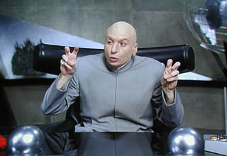
Lasers In Periodontics
Inland Empire Perio Study Club
November 17, 2017

Slide 3
Roadmap
Background
Mechanism of Action
Laser Types
Literature
Case Studies

Slide 4
Background
L.A.S.E.R.
Light Amplification by Stimulated Emission of Radiation
First invented in 1960
First report of caries removal in vivo 1985

Slide 5
Properties of all Lasers
Stimulated photons by atoms creates the following light:
Coherent ~ all phases of electromagnetic wave are identical
Monochromatic ~ visible light of a narrow range of wavelengths
Collimated ~ light rays that have minimal divergence as they propagate (highly directional)

Slide 6
Coherent

Slide 7
Mechanism of Action
Laser energy
Reflected
Scattered
Transmitted
Absorbed ~ Desired property of medical/dental lasers
Water molecules, proteins, pigments and macromolecules are responsible for absorption ~ produces thermal reaction in tissue
Absorption dependent on wavelength of laser

Slide 8
Light Energy

Slide 9
Laser Classes
Class 1
Laser will not damage eyes i.e. CD Rom Player
Class 2
Supermarket scanners
Class 3
Can damage eyes if focused on
Laser pointers
Class 4
Direct and reflected exposure can cause eye/skin damage
Fire Hazard
Dental/Medical Lasers fall into this class

Slide 10
Wavelength of Lasers

Slide 11
Laser Types
Neodymium:yttrium-aluminum garnet (Nd:YAG)
Carbon Dioxide (CO2)
Erbium:YAG (Er:YAG)
Erbium, Chromium:Ytrrium (Er,Cr:YSGG)
Argon

Slide 12
Laser Types
Excimer Lasers 193-350 nm wavelength
Argon-Fluoride
Xenon-Chloride
Indications
Hard tissue ablation
Calculus removal

Slide 13
Laser Types
Gas Lasers
Argon 438-515 nm wavelength
Helium-Neon 637 nm wavelength
Carbon dioxide 10,600 nm wavelength
Indications
Soft tissue surgery, cure composites, tooth whitening, subgingival curettage, removal of gingival melanin pigmentation

Slide 14
Laser Types
Diode Lasers
655-980 nm wavelength
Indications
Caries and calculus removal
General surgery
Subgingival curettage
Root canal disinfection*

Slide 15
Laser Types
Solid State Lasers
Nd:YAG 1064 nm wavelength (Periolase)
Soft Tissue Only
Er:YAG 2940 nm wavelength
Er:YSGG 2790 nm wavelength
Er,Cr:YSGG 2780 nm wavelength (Waterlase)
Hard and Soft Tissue
Indications
Selective ablation of plaque and calculus
Caries removal
Soft tissue surgery
Subgingival curettage
Osseous surgery
Scaling of root surfaces
Root canal disinfection*

Slide 16
Recommended Treatment
Most widely accepted for
Gingivectomy
Frenectomy
Melanin pigmentation removal
Amalgam tattoo removal
Less widely accepted for
Management of periodontitis

Slide 17
Surgical Literature
Effects on Wound Healing
Increased coagulation
Reduced bacteremia
Decreased swelling
Decreased scarring
Increased patient acceptance

Slide 18
Literature
Root surface modifications
Issue of altering root surface without damaging pulp/periodontium
Charring and melting noted with CO2 at certain settings
Heat induced cracking with CO2
Cavitation defects with Nd:YAG
Nd:YAG may remove smear layer at lower settings

Slide 19
Literature
Bacteria/Calculus
Limited evidence showing reduction in bacteria with laser over traditional therapy
Marketing point of companies “Laser sterilizes the pocket”
Microbial rebound noted with laser treatment
Nd:YAG may remove calculus at proper settings

Slide 20
Lasers and Periodontitis
Laser treatment predicated on concept of subgingival curettage with regeneration of attachment apparatus
LANAP – Laser assisted new attachment procedure
Periolase (Millenium)
LANAP is a new version of an old technique (ENAP ~ excisional new attachment procedure)
Bone is not altered

Slide 21
LANAP/ENAP

Slide 22
Literature
Slot 2009
Systematic review
Looked at 323 articles
8 articles met criteria
Randomized human clinical trials
Looked at Nd:YAG alone or in combo with ScRP
Looked at bleeding/gingivitis/plaque levels

Slide 23
Literature
Slot 2009
Findings
Nd:YAG similar to ScRP in terms of inflammation and PD reduction
No additional benefits over ScRp
No evidence to support Nd:YAG laser is superior to traditional modalities of perio treatment

Slide 24
Literature
Slot 2014
Systematic review
Looked at diode laser vs. traditional therapy
Screened 416 papers of which 9 selected
Combined effect of diode laser plus traditional therapy is no more effective than traditional therapy along (looked at PD and CAL)

Slide 25
Literature
Schwartz 2008
Systematic review
11 studies for review w/o meta-analysis
Looked at Er:YAG, CO2, Nd:YAG vs mechanical debridement alone
Looked at short term (6 months) and long term (24 months) outcomes
Found no additional benefits of lasers vs. mechanical debridement alone
Some evidence for use of Er:YAG

Slide 26
Nebraska Study
Nguyen 2015
Single masked, RCT, 22 patients with history of chronic periodontitis exhibiting sites with >/= 5mm PDs, patients enrolled in routine PMT program
50 sites treated with ScRp and 50 sites treated with ScRp plus Diode laser
Outcomes assessed BOP, PD, CAL, IL-1Beta crevicular fluid
Results
Both modalities showed reduced BOP/PD/IL-1Beta but not s.s. different
CAL gains not s.s. different

Slide 27
Laser for Tx of Peri-implantitis
Mailoa 2014
Systematic review/Meta Analysis
Looked at peri-implantitis treatment outcomes with lasers, saline, CHX, Tetracycline, CA
7 human studies/2 animal studies
No s.s. difference in PD reduction/CAL/Bone fill regardless of modality used
Animal studies showed higher BIC on rough surface implants when compared to smooth implants with use of laser

Slide 28
AAP Position Statement 2011
Regarding lasers for use of nonsurgical periodontal treatment
Subgingival curettage
No additional benefit with use of laser
Diseased pocket lining curettage not effective with either use of chemicals, curettes, or lasers
Reduction of Subgingival bacteria
Insufficient evidence to support s.s. reduction in bacterial load compared to ScRp
Scaling and Root Planing
Er:YAG lasers show greatest potential for subgingival root surface debridement
Most studies show minimal benefit when combined with ScRp

Slide 29
Literature
Most literature presented by laser companies has been the following:
1) Company funded
2) Case reports
3) Performed by operators with vested interest

Slide 30
Conclusions
Lasers show promise in soft tissue surgery, caries removal, pigmentation removal
Limited evidence to support use of lasers for management of periodontal patients
Marketing Strategies
No need for surgery
Cure for periodontal disease
Cost vs. Benefit

Slide 31
Case #1
17 year old female
Severe dental phobia
Recently completed orthodontic care
CC: “My teeth look small”

Slide 32
Clinical Photos

Slide 33
Clinical Photos

Slide 34
Treatment Plan?

Slide 35
Laser Crown Lengthening/Frenectomy

Slide 36
Laser

Slide 37
7 day PO care

Slide 38
1 week change

Slide 39
Case #2
65 year old male
History of chronic periodontitis
Openly stated he did not want traditional scalpel surgery

Slide 40
Radiograph

Slide 41
Buccal/Lingual #29 Preop

Slide 42
Surgical Exposure with Waterlase

Slide 43
Bone Graft

Slide 44
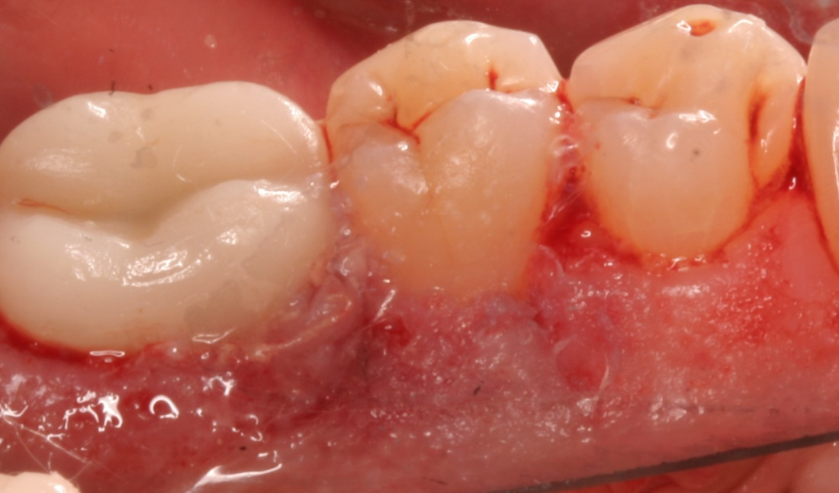
Postop

