Slide 1
John B.
Study Club September 2022

Slide 2
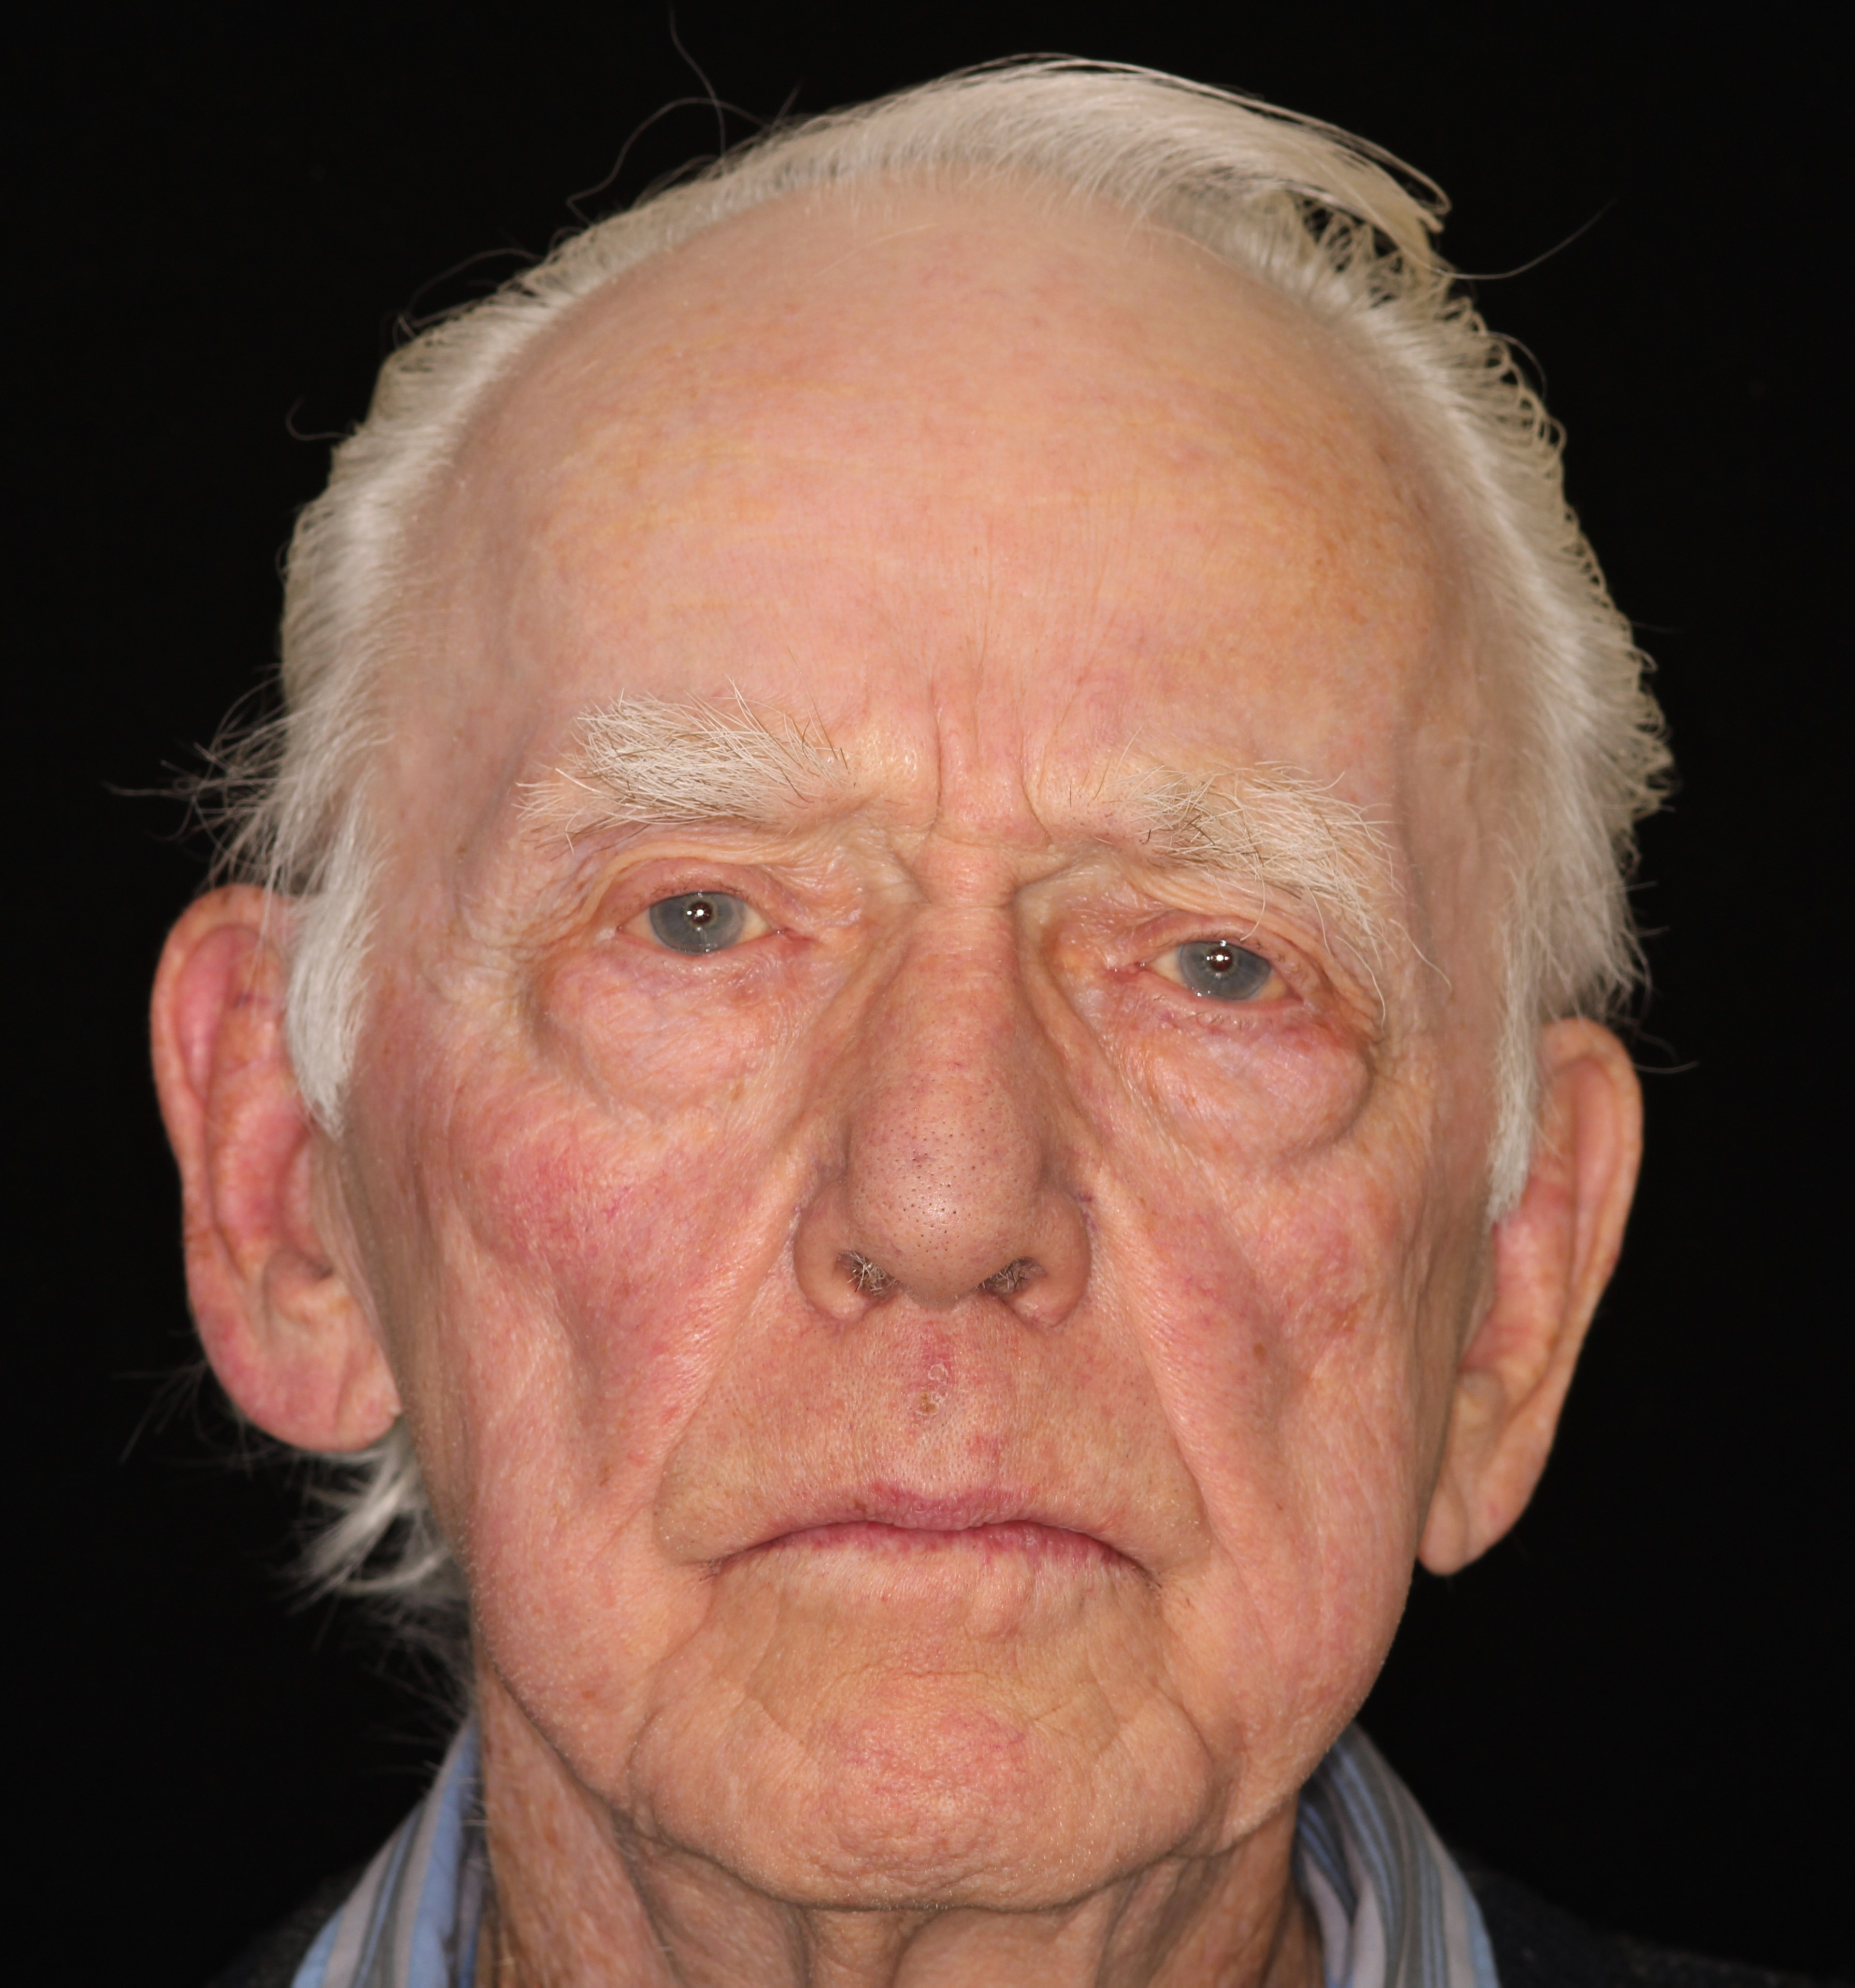
87 YO male
Arthritis
Allergic to Penicillin
CC of Would like to get his teeth fixed and replace some missing ones

Slide 5
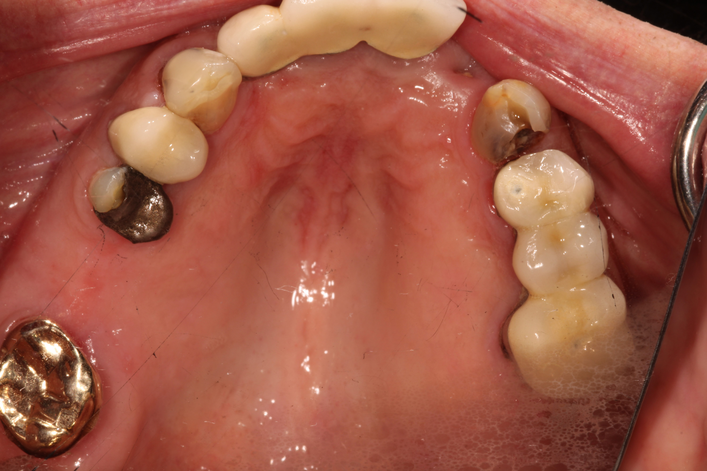
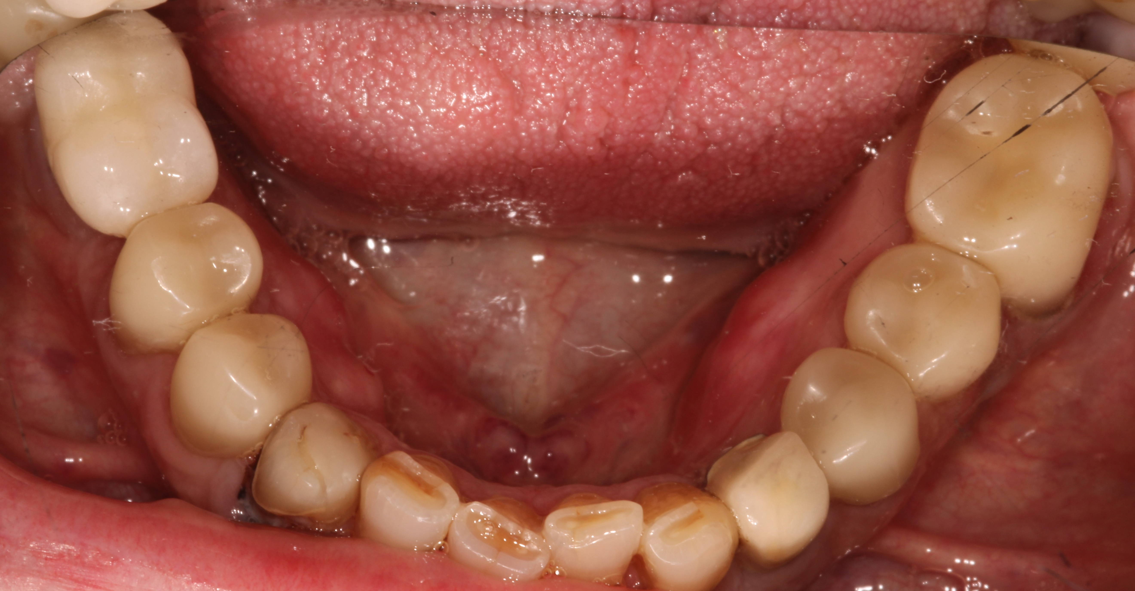

Slide 7
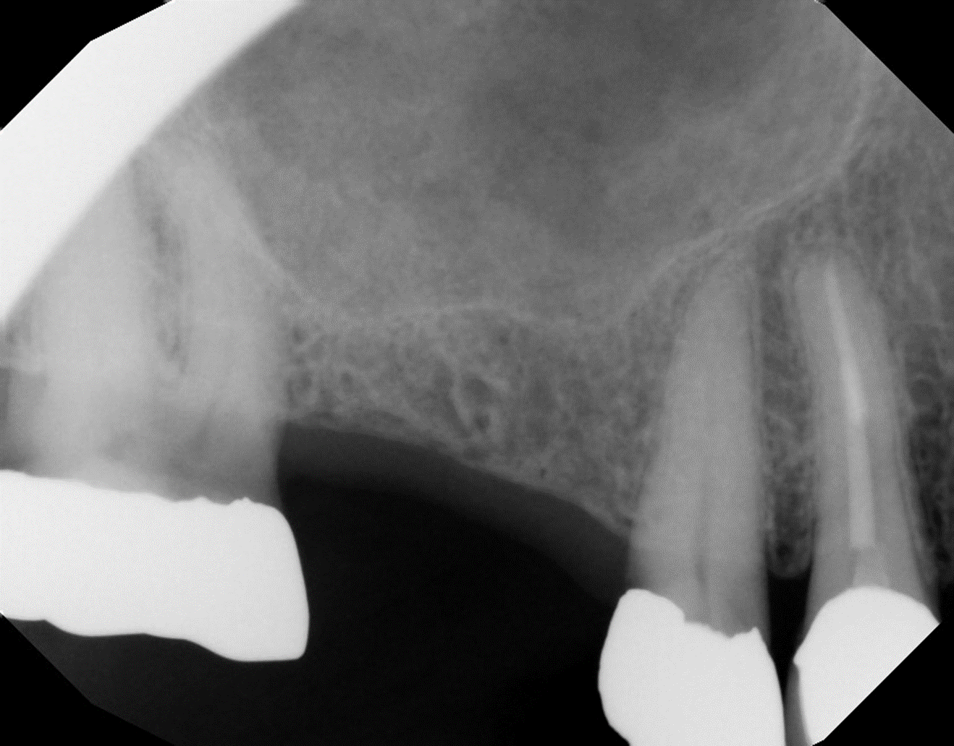

Slide 8
