Slide 1
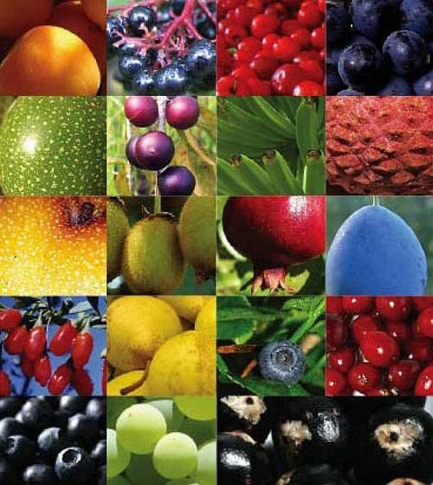
Antioxidants in Oral Care
IEPSC Member Presentation
Oct. 10, 2014
Jeff Henneberg DDS

Slide 2
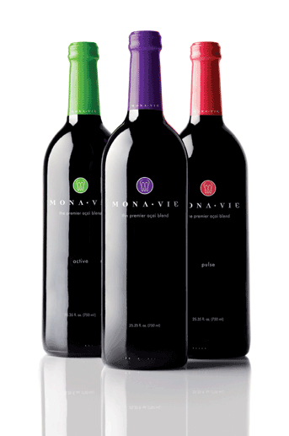
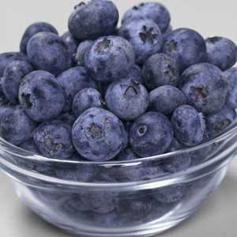
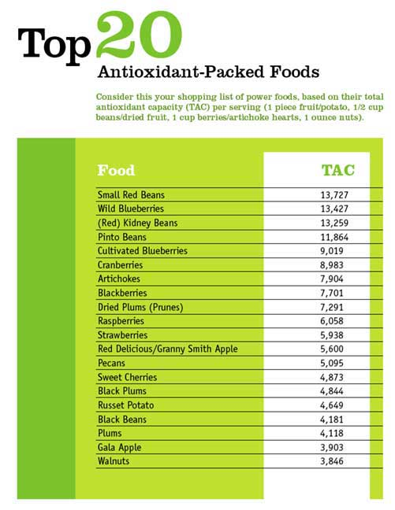
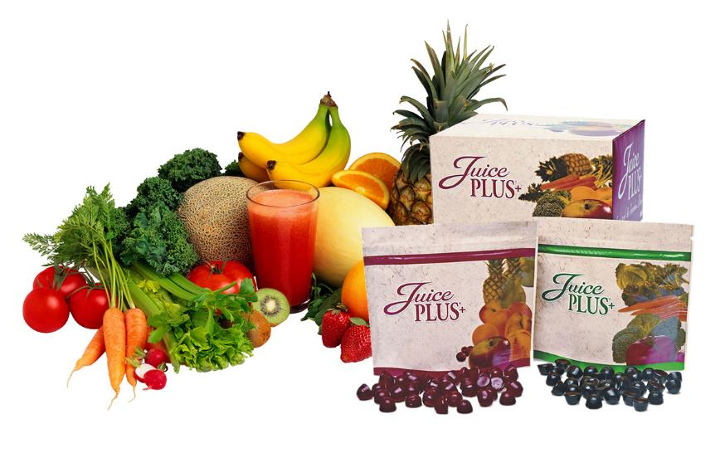
Notes:
Over the past decade or so, antioxidants and their role in our health and daily nutrition has impacted much of the product development and understanding of the fight against diseases. I am sure we are all aware of the various foods that can provide us with a rich dose of antioxidants in our diets. However, for me every time I hear the word I am reminded of some multilevel marketing campaign touting the latest and greatest way to improve my health, the health of my friends and family while making a bunch of money. I don’t intend to debate the way a product can be introduced to the market, or to comment on my own feelings about multilevel marketing businesses, (I am still an official Juice Plus distributor). I would rather like to share some information about how antioxidants, their role in our response to bacteria and maybe some thoughts on how we can incorporate the use of antioxidants in our practice.

Slide 3
QUESTIONS
Regardless of the marketing method, does the product have merit?
Do my “natural remedy” patients have something to offer, besides my
skepticism?
Is there new research about antioxidants or supplements that could enhance my patient care?
What does the literature say about antioxidants and their role in dentistry?
Most of the focus involved the role antioxidants play in periodontal disease and the mechanisms involved in the inflammation process.
Notes:
A couple of months ago I was about to apply our fluoride varnish to their teeth, when she stopped me and said she didn’t need it because she takes a daily dose of tea tree and sage oil which will help her teeth and gums. She didn’t want my poison. I am not suggesting we give up fluoride but it did lead me to think about what is truly out there worth looking at. In reviewing articles related on antioxidants and their role in dentistry, I was surprised to find quite a bit of research out there.

Slide 4
Tissues respond to all negative stimuli by inciting the inflammation process.
INTRAORAL INFLAMMATION
1. Bacteria 2. Host response
“Oxidative stress stays at the heart of periodontal damage that happens from host-pathogen interactions.” S. Aksakalli. Dentistry 2013 4:1
“The challenge of the future is in the harnessing of a resolution to inflammation for the treatment of chronic inflammatory diseases”. Thomas Van Dyke, J. Periodontal, April 2014
Notes:
As we know PD is a inflammatory disease, not just an infectious disease. This understanding suggests there are two players: the stressor and the reaction to the stressor. In the case of PD, bacteria is the stressor which has been the primary focus in dentistry for many years, but now our understanding of oral health has expanded to focus on how the oral cavity (the host) responds to stressors.

Slide 5
INTRAORAL INFLAMMATION
Diabetes
Caries
Nicotine
Salivary Antioxidants
TAC
Xerostomia
Oral Lichen Planus
Oral Oxidative
Stress
8-Hydroxy-Deoxyguanosine
Ulcers
Peri-Implant Disease
Oral Cancer
Periodontal disease
Notes:
This diagram illustrates the factors that can illicit an inflammation response. So basically, when there is inflammation, the saliva can be measured with particular markers to see if the total antioxidant capacity is low or high. Antioxidants exist naturally in our saliva. The same technique can be used to measure the amount of oxidative stress, like 8 hydroxy deoxyguanosine marker to see the amount of stress/inflammation is present. Interestingly, when inflammatory markers are found in saliva the antioxidant capacity of saliva is very low and the reverse is true, when the salivary capacity of saliva is high there are little to no inflammatory markers present in saliva. A simple review of what antioxidants are might be a good reminder before delving into these factors listed that cause oxidative stress and a decrease in total antioxidant capacity

Slide 6
ANTIOXIDANT REVIEW
Molecules that can inhibit oxidation of other molecules
Oxidation of molecules produces free radicals = harmful chain reactions
Cell death
Carcinogenesis
Low-density lipoproteins in cardiovascular disease
Many diseases associated
Majority of free radicals are O2 free Reactive Oxygen Species (ROS)
Antioxidants neutralize the free radical through an enzymatic process.

Slide 7
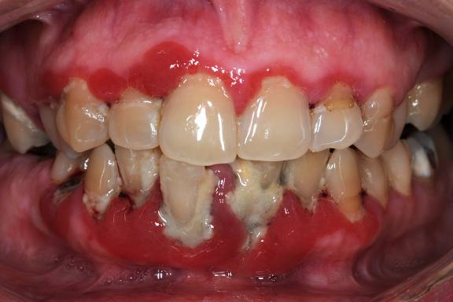
Salivary Antioxidants and Periodontal Disease
2003: Low salivary antioxidant levels are associated with periodontal disease. 2011: It has been now made clear that the equilibrium between the free radicals/ROS and antioxidants is the main prerequisite for healthy periodontal tissue.
1. Iain Chapple, Journal of the American Dental Association, 2003
2. P. Dahiya, et. al.; “Oxidative stress in chronic periodontitis,” Review Article 2011, Vol 2.
Chronicles of Young Scientists
3. R. V. Chandra, et. al.; “Efficacy of lycopene as a locally delivered gel in the treatment of chronic periodontitis: smokers vs nonsmokers,” Quintessence International, Vol 43. May 2012
Notes:
Of all the listed conditions I showed in the previous slide causing inflammation, periodontal disease is the most studied over the past decade. An earlier paper by Chapple in JADA showed the low salivary antioxidant levels are associated with PD. But more recently it has been stated that the level of salivary antioxidants is a prerequisite for healthy periodontal tissue. Bacteria reduction is obviously still critical, but enhancing the level of antioxidants in saliva is also needed.

Slide 8
Salivary Antioxidants and Peri-Implant Disease
Total Antioxidant Status (TAS) of saliva is significantly decreased in patients with peri-implant disease. Oxidative stress and inflammatory markers (cytokines) may be an important factor contributing to the destruction of peri-implant tissues.
S. Liskmann, et. al., “Characterization of the antioxidant profileof human saliva in peri-implant health and disease.” Clinical Oral Implants Research February 2007
R. L. W. Messer, et. al., “Cytokine Secretion from monosytes persists differentially after activator removal - one mechanism of long-term biological response to implants.” Journal of Biomedical Materials Research, Oct. 2007
M. L. Paperella, et. al., “Oral Mucosa Tissue Response to Titanium Cover Screws.” J Periodontal August 2012
Notes:
I have heard that peri-implantitis affects about 40% of implants. I can’t speak to the accuracy of this, but I know that I have seen this on a few of my implants. Is it home care, occlusion, location of placement. The literature clearly demonstrates that salivary antioxidant levels are depleted and inflammatory markers (cytokines) are elevated in perio-implant disease. What about a host response to metals?

Slide 9
Salivary Antioxidants and Oral Lichen Planus
TAC was significantly lower in Oral Lichen Planus patients compared with controls, indicating a significant oxidative process in the oral cavity.
Salivary antioxidant ability in patients with recurrent aphthous ulcerations is impaired.
Daniela Miricescu, et al., Therapeutics, Pharmacology and Clinical Toxicology, June 2011
Assessment of salivary and serum antioxidant vitamins and lipid peroxidation in patients with recurrent aphthous ulceration. Saral Y, Coskun BK, et. al., The Tohoku Journal of Experimental Medicine Aug. 2005.
Notes:
Patients suffering from Oral Lichen Planus as well as those with Aphthous Ulcers exhibit diminished antioxidant capacity along with high levels of salivary inflammatory markers.

Slide 10
Salivary Antioxidants and Nicotine
Nicotine may play a pivotal role in the pathogenesis of oral disease by destruction of the salivary antioxidant systems.
R. Nagler et. al.; IMAJ 2004, Vol. 6, 691-694
R. Malhotra, et. al., "Nicotine and Periodontal Tissues," Journal of Indian Society Periodontol Jan-Mar 2010
Notes:
Both smokers and smokeless tobacco users clearly show depleted antioxidant levels in saliva on a consistent basis.

Slide 11
Salivary Antioxidants and Dental Caries
Salivary antioxidants level was lower among old adults compared to middle-aged ones and correlated with higher rates of caries in older adults
Salivary antioxidants and physicochemical characteristics related to dental caries experience among a group of old adults. B.A. Yas, B. S. Diab et. al., Journal of Baghdad College of Dentistry 2009
Notes:
We know from literature that the antioxidant levels in saliva naturally diminish as we age. In a population of older adults (55-65 yrs) a higher caries rate was correlated with lower salivary antioxidant levels.

Slide 12
Salivary Antioxidants and Xerostomia
An increase in ROS-induced oxidative DNA damage was found in minor salivary glands in xerostomia patients.
Antioxidant administered before and after irradiation, prevented and restored radiation-induced salivary gland dysfunction in human salivary gland cells
M. Kuraji, et. al. Oral Therapeutics and Pharmacology 2012.
Nagler, Salameh, Reznick, et al. Rheumatology 2003
Tai, Inoue, Yamada, Morito et al. Radiat Res 2009
Ma, Derossi, Ogbureke, Dickenson, et al. IADR, 2011
Notes:
evidence exists that suggest the minor salivary glands in patients with xerostomia have been affected by oxidative damage. Cellular studies suggest the administration of antioxidants can protect against salivary gland dysfunction.

Slide 13
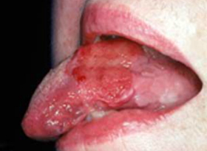
Salivary Antioxidants and Oral Cancer
The increase in Free Radicals lowers salivary antioxidants
which increases oxidative damage to DNA and proteins which may promote oral squamous cell carcinoma. Bahar G, et al. Cancer, 2007
“Administration of local antioxidants to the oral cavity should be considered” Hersckovich O, The Journal of Gerontology, 2007

Slide 14
INTRAORAL INFLAMMATION
Diabetes
Caries
Nicotine
Salivary Antioxidants
TAC
Xerostomia
Oral Lichen Planus
Oral Oxidative
Stress
8-Hydroxy-Deoxyguanosine
Ulcers
Peri-Implant Disease
Oral Cancer
Periodontal disease
Notes:
This diagram illustrates the factors that can illicit an inflammation response. So basically, when there is inflammation, the saliva can be measured with particular markers to see if the total antioxidant capacity is low or high. Antioxidants exist naturally in our saliva. The same technique can be used to measure the amount of oxidative stress, like 8 hydroxy deoxyguanosine marker to see the amount of stress/inflammation is present. Interestingly, when inflammatory markers are found in saliva the antioxidant capacity of saliva is very low and the reverse is true, when the salivary capacity of saliva is high there are little to no inflammatory markers present in saliva. A simple review of what antioxidants are might be a good reminder before delving into these factors listed that cause oxidative stress and a decrease in total antioxidant capacity

Slide 15
OXIDATIVE STRESS & Polyphenols
MICROBIAL CHALLENGE (bacteria is introduced)
Antigens and Lipopoly-saccharides
HOST IMMUNO-INFLAMMATORY RESPONSE (body’s response)
Antibodies and PMN’s push back against the microbes
Cytokines and Chemokines initiate bone metabolism and
connective tissue furthering the inflammation process.
Fibroblasts proliferate and wound healing takes place (hopefully)
Or disease wins
Polyphenols show promise in this process by affecting it in three ways.
Notes:
So the literature suggests that adding antioxidants may be able to help with these conditions, specifically affecting oxidative stress and modulating the inflammatory process. A particular type of antioxidant known as polyphenols has been studied extensively and has been shown to have an effect during three time points within the inflammatory process: 1) At the onset of host response to a stressor, inflammatory messengers are released to incite the greater process; Cytokines and Chemokines are critical messengers and it has been shown that a combination of polyphenols will reduce Cytokines and Chemokines. 2) During the inflammatory process a chemical process known as oxidative stress takes place. Left unchecked oxidative stress can further exacerbate the inflammatory cycle. Research has shown these same polyphenols can reduce oxidative stress. 3) Finally, on the repair end of the inflammatory process, stimulation of fibroblasts is necessary for wound healing. These same antioxidants have been shown to stimulate fibroblast activity and accelerate would healing.

Slide 16
POLYPHENOLS
Polyphenols (Antioxidants)
Reduce Cytokines and Chemokines Fordham J., Naqvi A, et. al.; "Leukocyte Production of Inflammatory Mediators Is Inhibited by the Antioxidants Phloretin, Silymarin, Hesperetin, and Resveratrol" Mediators of Inflammation 2014.
Neutralize Reactive Oxygen Species and Reduce Oxidative Stress San Miguel S., Svoboda K., et. al.; "Bioactive Polyphenol Antioxidants Protect Oral Fibroblast From ROS Inducing Agents," Archives of Oral Biology 2012.
Proliferate Fibroblast and Accelerate Wound Healing San Miguel S., Svoboda K., et. al.; "Bioactive Antioxidants Mixtures Promote Proliferation And Migration On Human Oral Fibroblasts," Archives of Oral Biology 2011
San Miguel S., Svoboda K., et. al.; "Antioxidants Counteract Nicotine and Promote Migration via RacGTP in Oral Fibroblast Cells," J Periodontal 2010.
Notes:
So, polyphenols help to reduce cytokines and chemokines. Neutralize Reactive Oxygen Species and reduce oxidative stress, and proliferate fibroblast and accelerate wound healing.

Slide 17
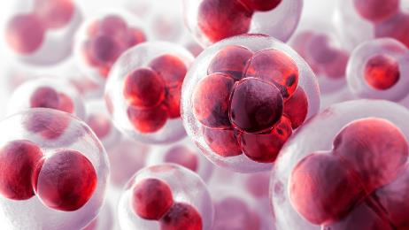
POLYPHENOLS (cont)
“Considerable body of literature supports a role for oxidative stress in the pathogenesis of age-related human diseases and a contribution of dietary polyphenols to their prevention”
A. Scalbert. et, al,; American Journal of Clinical Nutrition
“ Direct and indirect evidence support the preventive polyphenol effect against oral cancer with good evidence. Consistent studies showing that polyphenols inactivate periodontal pathogens and suggest a preventive effect against periodontal disease with fair evidence.”
S. Petti, et. Al,; “Polyphenols, Oral Health and Disease: A Review”. Journal of Dentistry, 2009.
Polyphenols adhere to the mucosal wall, can be retained for long periods and can function as slow releasing devices positively affecting the oxidative stress reactions in the mouth. I. Ginsburg, et. al,; “The Oxidant-Scavenging Abilities in the Oral Cavity May Be Regulated by a Collaboration Among Antioxidants in Saliva, Microorganisms, Blood Cells, and Polyphenols: A Chemiluminescence-Based Study” PLOS One, 2013
Notes:
Polyphenols are a large group of molecules found in a variety of plants and foods. Topical application of this type of antioxidant, seems to be useful because they have the ability to adhere to oral cells due to their molecular weight. With this adhesion these antioxidants actually stick around in the oral cavity from 48 - 72 hours which seems to allow them to work with the naturally occurring antioxidants in saliva. This activity boosts the antioxidant level in the mouth.

Slide 18
A product we are trying
INGREDIENTS:
Antioxidants
Ferulic Acid – found in leaves and seeds
Phloretin – apples
Polyphenolic antioxidants
Menthol, Thymol, and Essential Oils
Xylitol (10%) – inhibition of S. Mutans
Anyone else using this product or one similar?
Successes? Feedback?
Notes:
Eric and I have decided to try this particular product as an adjunct to what we can offer our patients. It seems to have a purposeful group of ingredients specific to aiding in the TAC and reduction of oxidative stress. Anyone else using this product? Successes? Feedback?

Slide 19
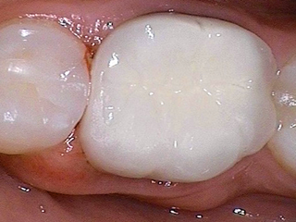
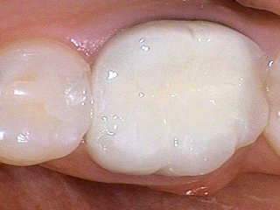
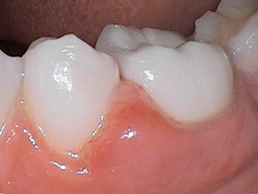
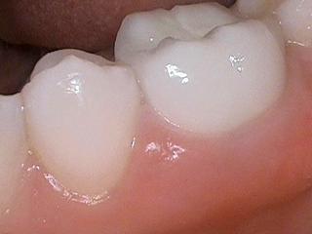
Before and Afters
41-year-old female patient complained of gingival tenderness and swelling on the lower left side. Radiographs were negative, and 4-5 mm "pseudo- pocketing" was noted between teeth #19 and 20.
Following twice daily gel application for 8 days, the marginal swelling and inflammation resolved, the tissue is no longer tender, and the probing depth decreased to 3mm.
Dentist: Ron Bosher, DDS Plano, TX
Baseline
8 Days

Slide 20
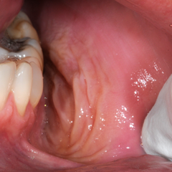
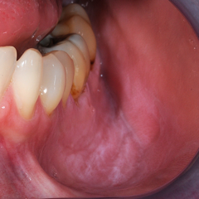
Before and Afters (cont)
Baseline
Week 6
Patient Stats: Male, 43, Frequent smokeless tobacco user, Moderate oral health
Despite a strong recommendation to stop using smokeless tobacco the patient did not stop “dipping.” During the six-week trial the patient continued to dip in the same frequency and in the same area in the mouth, the only change in habit was using the gel 3x per day.
Periodontist: Pat Allen, DDS PhD, Dallas, TX

Slide 21
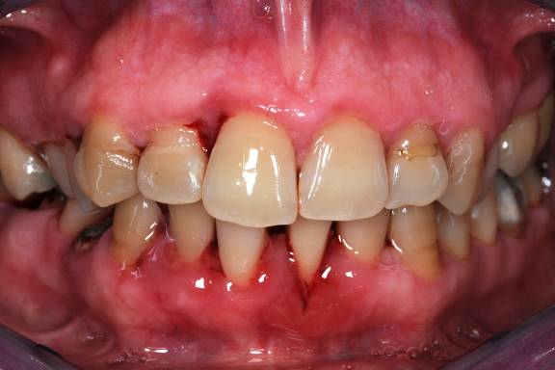
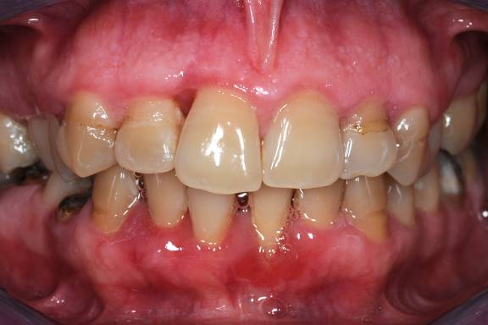
Before and Afters (cont)
Patient Stats: Female, Age 55, Overweight, No other medical issues known.
The photo on the left is 4 weeks after the 6 monthly sessions of SRP. The tissue of the patient had responded as much as it was going to from non-surgical perio therapy. The question was then asked: would the tissue further respond with a daily topical AO gel? The gel was applied 2x per day for three weeks and clearly you can see the tissue change.
Periodontist: Pat Allen DDS PhD, Dallas TX
Day 180, SRP x 6
Day 201, 3 weeks of Topical Gel

Slide 22
Chlorhexidine?
Can we reduce bacteria completely?
Recent research shows that chlorhexidine kills fibroblasts, and suggests that we may want to rethink it’s use.
1. Journal of Dentistry, June 2013, J. Ghabanchi, et. al., “Effects of three Commercial Mouth Rinses on the Cultured Fibroblasts:An in Vitro Study.”
2. Toxicol. Appl. Pharmacoll, 2009, Faria, et. al., “Chlorhexidine induced apoptosis or necrosis in L929 fibroblasts: A role for endoplamic reticulum stress.”
3. Int. J. Morphol, 2006, Salami, et. al., “A comparison of the effect of Chlorhexidine, tap water and normal saline on healing Wounds.”
The use of Essential Oils (Menthol, Thymol, etc) as an alternative to Chlorhexidine to reduce gingival inflammation shows NO significant difference. Journal of Periodontal, Feb. 2011, V. Leeuwen “Essential Oils Compared to Chlorhexidine with Respect to Plaque and Parameters of Gingival Inflammation: A Systematic Review”.
Notes:
We can’t reduce bacteria 100%. However, an adjunct to an antimicrobial rinse like chlorhexidine on a preventative basis may be warranted, like the one in the previous slide. It may not replace chlorhexidine as an alternative, but patients appreciate the taste and ease of use. I have already seen a couple of cases (Erosive lichen planus and swelling around a crown) that have responded well to just the gel alone.

Slide 23
QUESTIONS/DISCUSSION?
Thanks for listening

