Slide 1
Presentation By: Rob Hardwick D.D.S.

Slide 2
Personal History
53 year-old male , was born and raised in Pampa, TX, (town of 15,000). He earned a GED.
He got married at age 18, divorced at 22.
He got a job at Cabot Co. as a stacker of carbon black (basically is burnt oil used in tires), where he worked for 3 years.
He joined the Air Force and was stationed in California for 6 years. He got remarried while in the Air Force.
Then he attended a 2- year electronic tech school in California.
Later he worked for Qualimatrix in Emeryville, CA, working with lasers for 3 years.
He then moved back to Pampa and worked for Carbon Black Co. as a computer electronics tech for 7 years.
In 2001 he got divorced after 17 years and relocated to Olympia, WA, where he lived in a Salvation Army shelter and later in Spokane at Union Gospel Mission.
He received disability social security benefits, got remarried and moved to Colville, WA.

Slide 3
Medical History
Smoked since age 13, smoking 3/4 of a pack a day. He's trying to quit.
He takes meds for his high blood pressure.
He takes meds for high cholesterol.
He has arthritis, but not in TMJ.
He has dizzy spells.

Slide 4
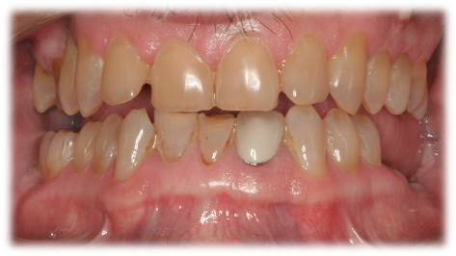
Chief Complaints
He has “breaking teeth.”
He has loose teeth that do not
not bother him.
He has no pain.

Slide 5
Profile
Acceptable profile partially hidden by his beard.
There is an indication of lost vertical dimension as a result of bite collapse.

Slide 6
Family Dental History
His dad had false teeth around age 28.
His mom still has some of her own teeth.
His middle sister has decayed teeth with no dental care.
His younger sister has good teeth and has received regular dental care.

Slide 7
Dental History
No routine childhood dental care.
At age 9 he had "a couple of lower front teeth knocked out," and he received a stainless steel crown.
No dental care again until in Air Force, where the stainless steel crown was replaced with a porcelain crown. His wisdom teeth were also removed.
He had dental care from 1995 through 2001 through dental insurance, and none since then.
He has never had anything like scaling or root planing, and perio problems have never been mentioned by previous dentists that he recalls.
His goal is to "keep as much as [he] can."

Slide 8
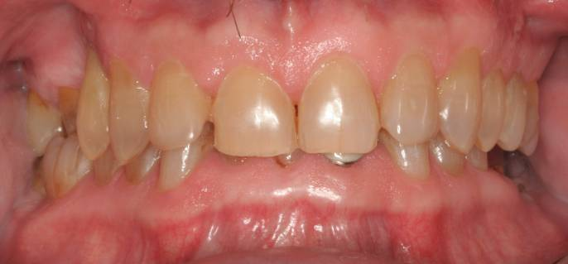
Home Care
Brushes once a day.
He flosses when food is stuck in his teeth.
He loves chocolates, but has cut back considerably lately.
He does not drink soda.

Slide 9
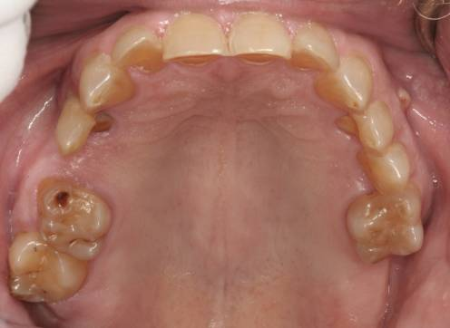
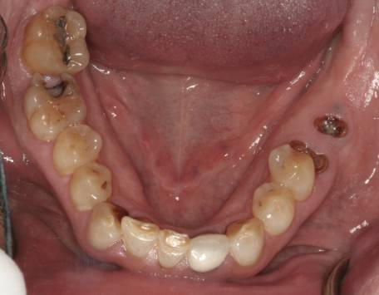
MISSING TEETH: #1, #4, #15, #16, #17, #18, #19 (root tips), #24, #32.
Heavy incisal-lingual wear on anteriors and lingual wear on bicuspids.
#7, #10 in buccal version.
Heavy wear on incisors. #30 D decay.
#27 is in buccal version.
Mandibular
Maxillary
Fractured/Worn Teeth: #3, #7, #8, #9, #10, #12, #13, #25, #26, #30.
Poor, mismatching arch forms, resulting in bite collapse.
Incomplete maxillary arch incomplete with gap at #4 and missing #15.
Mandibular arch has poor left posterior bite support due to lack of molars.

Slide 10
Pano 11-20-2012

Slide 11
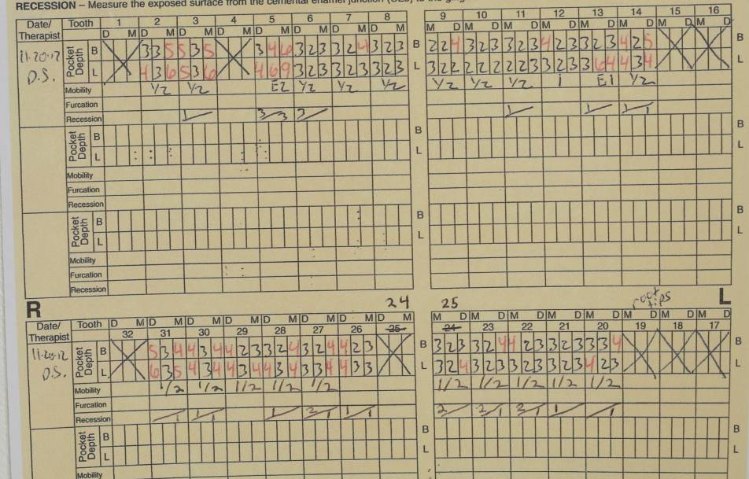
Perio probing 11-20-12

Slide 12
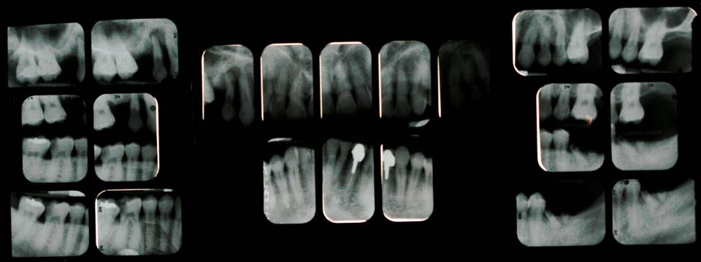
Radiographs 11-20-12
Abscessed teeth #5 with mesial and distal vertical bone loss.
#19 root tips.
#24 endo PFC.
Deep decay on distal of #30 and possible pulp involvement.
His perio disease and dental decay rate seem relatively modest considering the exposed dentin, lack of dental maintenance and poor home care with the exception of #5, hopeless perio, #19 and #30 with extensive decay.

Slide 13
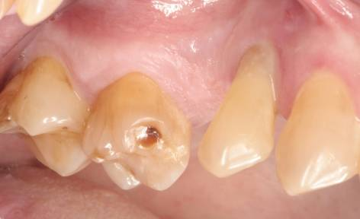
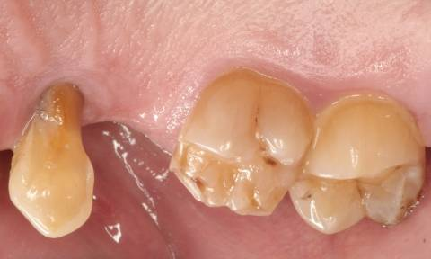
Upper Right Posteriors
Buccal Palatal
Missing #4.
Perio abscess #5 with suppuration.
MB fracture of #3 with decay.
Gingiva is fibrous and non-stippled.

Slide 14
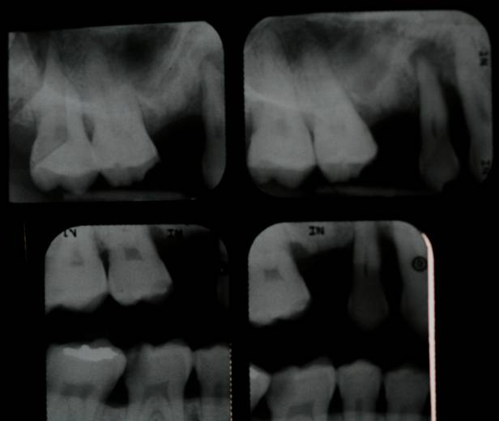
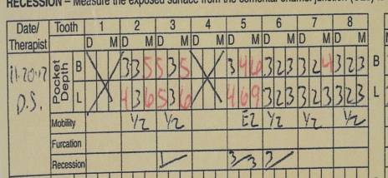
Upper Right Posteriors
#3 mesial vertical bone loss with
probable furcation involvement.
Horizontal bone loss between #2
and #3.
#4 mesial and distal bone loss.
Large maxillary sinus

Slide 15
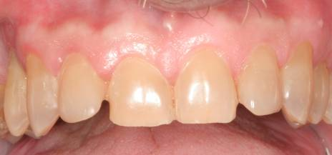
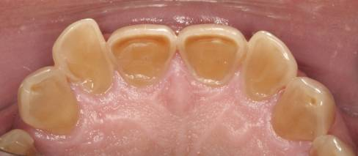
Upper Anteriors
Buccal
Lingual
Obvious parafunction which patient admits.
There is heavy incisal wear with cupping and chipping.
#7 and #10 are protrusive.
Gingiva appears fibrous.

Slide 16
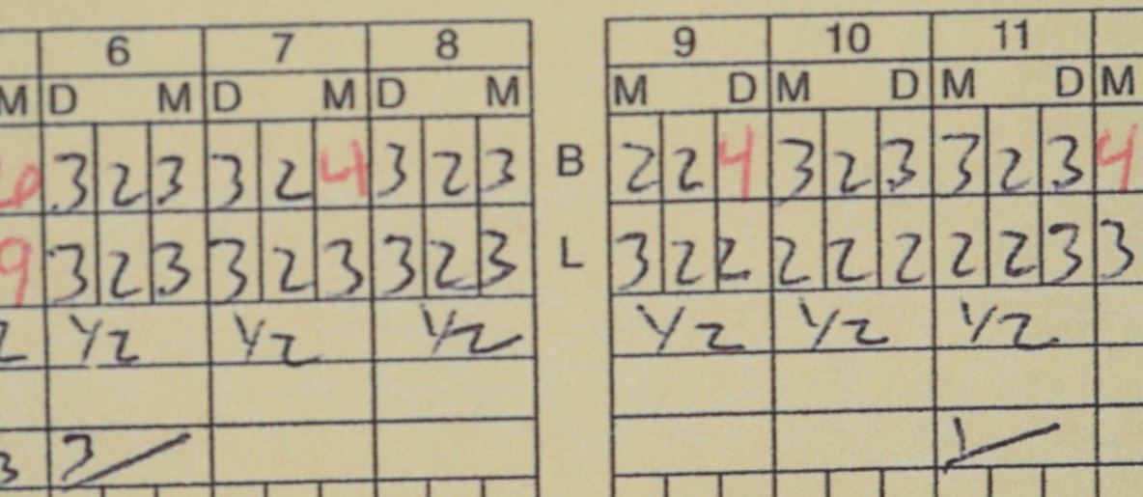
Upper Anteriors
Good horizontal bone except for #5.
Minimal decay or restorations.

Slide 17
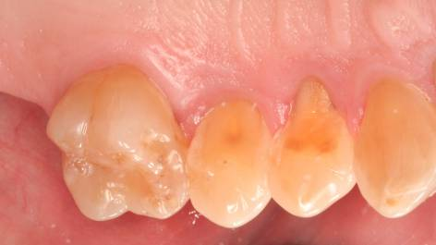
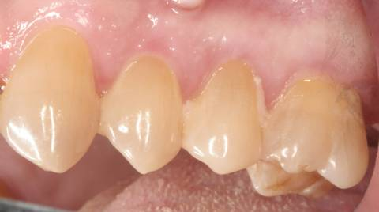
Upper Left Posteriors
Palatal
Buccal
Palatal cusps worn off bicuspids.
Puffy, red, nonstippled interproximals.

Slide 18
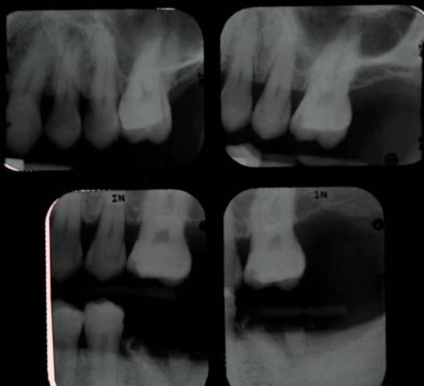
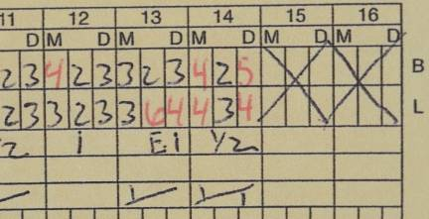
Upper Left Posteriors
Minimal radiographic
bone loss.
No interproximal decay.
No restorations.
Radiolucency apex #12.

Slide 19
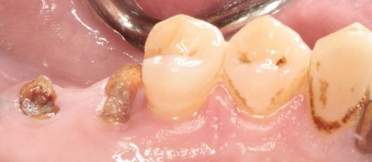
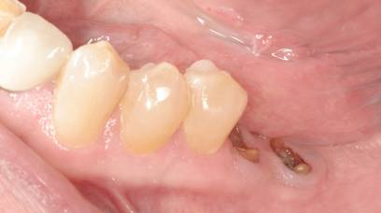
Lower Left Posteriors
Lingual
Buccal

Slide 20
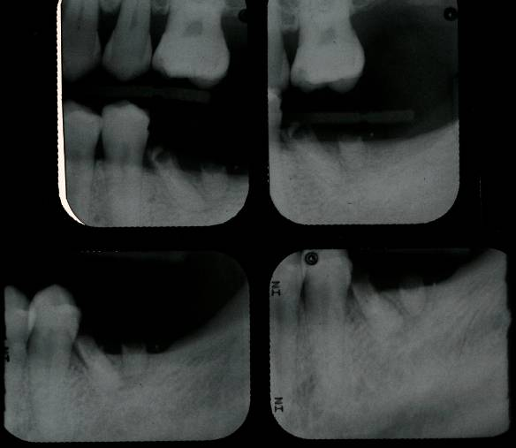
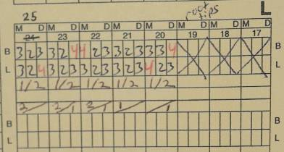
Lower Left Posteriors

Slide 21
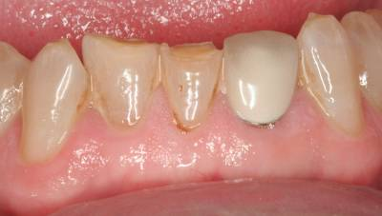
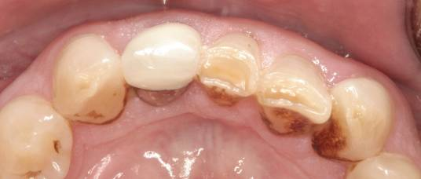
Lower Anteriors
BUCCAL
LINGUAL
Fibrous gingiva and heavy calculus.
#23 has unaesthetic PFC.
#25, #26 worn and fractured incisal edges.
#24 missing from childhood accident.

Slide 22
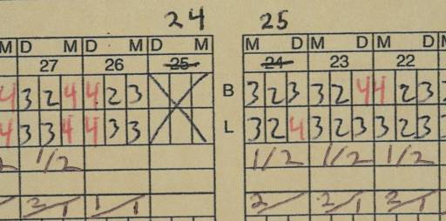
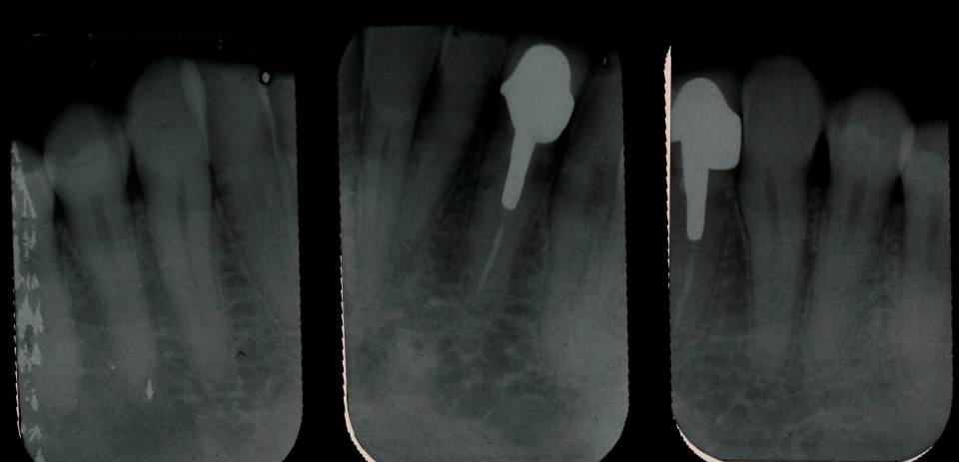
Lower Anteriors

Slide 23
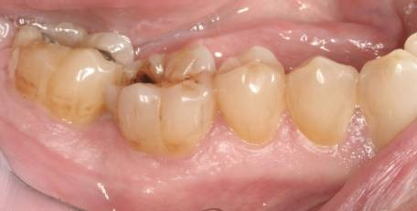
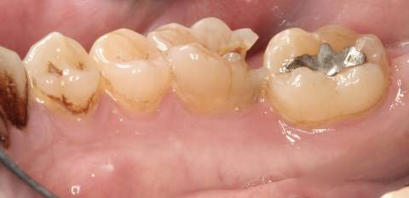
Lower Right Posteriors
Buccal
Lingual
#30 deep distal decay but asymptomatic.

Slide 24
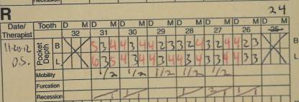
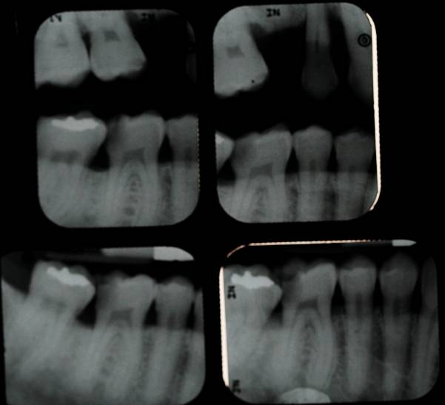
Lower Right Posteriors
#30 Deep distal decay.
#31 distal perio pocket not
apparent on radiograph.
Good perio prognosis from
radiograph.

Slide 25
Right Side

Slide 26
Left Side

Slide 27
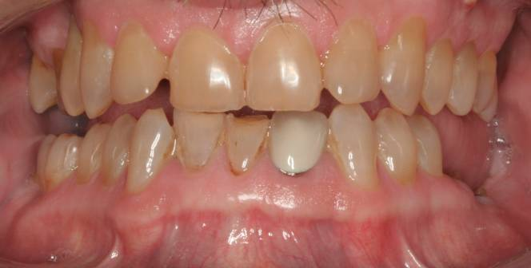
Diagnosis of Perio
Generalized moderate periodontitis with some advanced breakdown.
Fibrous gingiva with some generalized recession.
Adequate attached gingiva with esthetic margin discrepancies.
Normal mobility with good crown to root ratio.
Heavy calculus. Radiographic subgingival calculus on mesial of #2, distal of # 3.
Severe mobility on #5 with hopeless periodontitis.
#13 poor prognosis due to lingual pocket and lack of lingual tooth structure.
Posterior areas of pocketing with some vertical and horizontal bone loss.
#3 mesial furcation.
Overall prognosis of remaining teeth is fair.

Slide 28
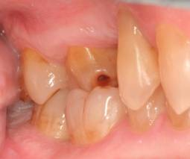
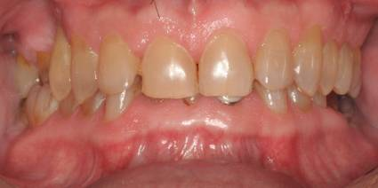
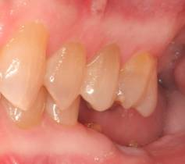
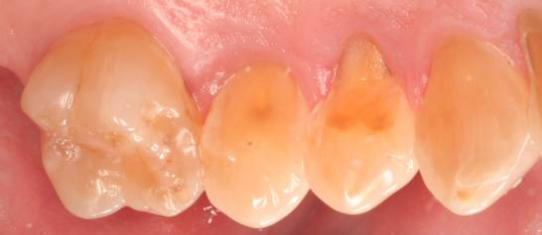
Diagnosis of Occlusion
Class II Division 2: Both skeletal and dental with 100% overbite and with lower anteriors occluding on or near upper palatal soft tissue.
Posterior bite collapse. There is reasonable posterior bite support on the right side with little or no posterior bite support on the left side
Telescope bicuspids with extreme palatal wear.
#3 and #31 in crossbite.

Slide 29
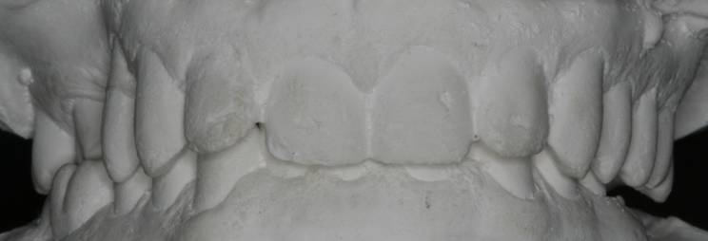
Occlusion
Excursions:
Right working- group function: on the right side cuspid rise on #6, #5 is too mobile for function.
Left working- group function.
Protrusive- steep angle with very worn teeth.

Slide 30
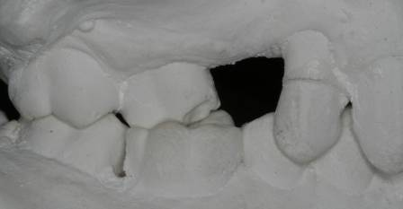
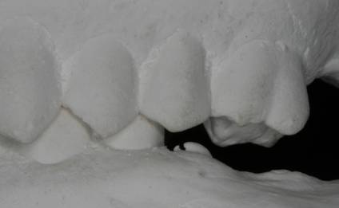
Right Posterior Occlusion
#3 and #30 are in crossbite.
#5 telescoped bite and Type II
mobility.
Left Posterior Occlusion
Deep bite collapse.
Telescoped bicuspids.
Absence of molar bite support.

Slide 31
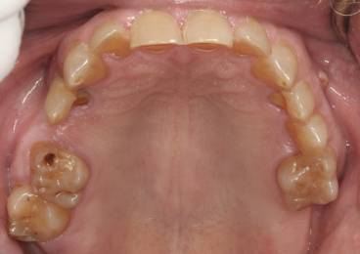
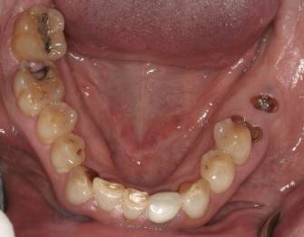
Diagnosis of Restorative
Teeth #s 6 through 13 need lingual anatomy restored.
Esthetic crown failure on #23 with opaque porcelain, size discrepancy and exposed metal margin .
#25 and #26 have incisal wear and fractures.
#30 has a DO fracture with deep decay.
#31 has old occlusal amalgam.
#19 unrestorable root tips.
Missing and unrestorable teeth.
Areas of decay

Slide 32
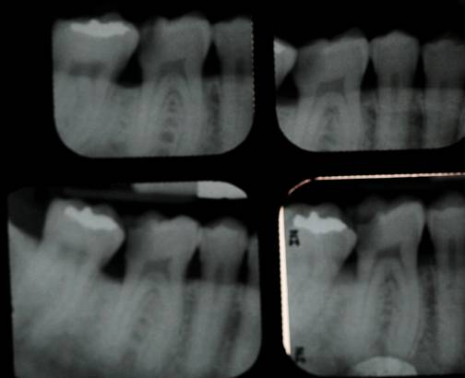
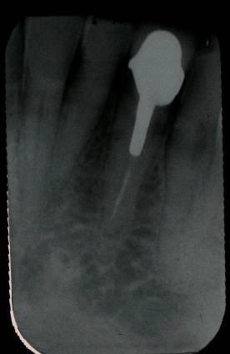
Diagnosis of Endo
Probable pulp involvement on # 30 distal.
Long-standing endo on # 23 has a widened PDL at apex but is asymptomatic. May be a chronic lesion.
#12 Endo due to heavy lingual wear. Tooth has a periapical radiolucency which is asymptomatic.

Slide 33
Diagnosis of TMJ and Parafunction
He is asymptomatic. He has no pain, locking or limitations.
There were no remarkable findings with the clinical exam for TMJ.
He is aware of parafunction both day and night.

Slide 34
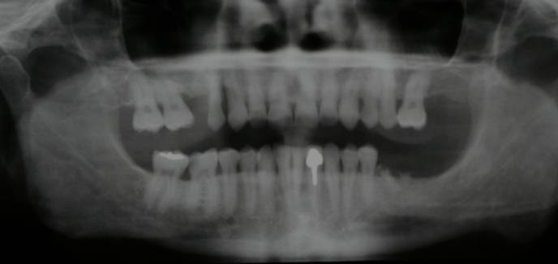
Treatment Plan
Phase I Disease Control
Oral home care instructions and ongoing supervision.
Replace defective restorations and restore decayed teeth.
4 quads of scaling and root planning.
Extract and socket preservation bone graph hopeless teeth, #5 and #19.
#12,13 extract and socket preservation bone graph on due to endo #12, perio defect #13 and lack of sound tooth structure for both teeth.
Provide night guard.
Re-evaluate Phase I Treatment

Slide 35
Phase II Definitive Perio Treatment
3 quadrants of osseous surgery with bone grafting where possible, upper right, upper left and lower right.
Even gingival margins for aesthetics.
During osseous surgical procedure, identify teeth with poor prognosis and extract them.
Re-evaluate Phase II Treatment and Ongoing Perio Maintenance

Slide 36
Phase III
Comprehensive orthodontic treatment in anticipation for orthonathic surgery.
Orthonathic surgery.
Bone graphs for implants including lateral sinus.
Provide new night guard.
Re-evaluate Phase III Treatment and Ongoing Perio Maintenance
Evaluation for implants #4, #5,#12, #13 and #19 for single crown restorations.

Slide 37
Phase IV Treatment
Perform necessary bone grafting, ridge augmentation.
Perform implants #4, #5,#12, #13 and #19 to create up to first molar occlusion.
Re-evaluate Phase IV Treatment and Ongoing Perio Maintenance

Slide 38
Phase V Treatment
Place full upper and lower provisionals with at least first molars to evaluate occlusion, function, patient tolerance, aesthetics, TMJ comfort and facial muscle comfort.
The goal of the occlusion would be to have simultaneous, even contacts on all teeth in centric relation, with CR=CO, as well as protected posterior teeth through anterior coupling.
The case should have interference-free excursive movements in right lateral, left lateral and protrusive.
His smile should have even gingival margins with a pleasing display of teeth and with a tooth length that looks reasonable in proportion to his face.
Re-evaluate Phase V Treatment and Ongoing Perio Maintenance
The provisionals should be worn at least 90 days to adequately evaluate
the success of the occlusion, comfort and aesthetics.

Slide 39
Phase VI Treatment
Place upper and lower full mouth definitive restorations using the provisionals as a model.
The goal of the occlusion on the permanent restorations would be to have simultaneous, even contacts on all the teeth in centric relation, as well as protected posterior teeth through anterior coupling.
The case should have interference-free excursive movements in right lateral, left lateral and protrusive.
The successful aesthetic result of the provisionals should be completely transferred to the permanent restorations.
Provide permanent night guard.
Re-evaluate Phase VI Treatment and Ongoing Exams and Perio Maintenance

Slide 40
Alternative Treatment Plan
Upper Arch
Perio scaling and root planing with possible selective perio surgery .
Extract #5 and place bridge from #3 through #6.
#12 ,#30 endo.
Conservative fillings and selective crowns with scaling and root planing.
I would use existing occlusal relationship with obvious compromise due to limited space.
Provide night guard.
Eventually an upper CD may be necessary over time due to bite collapse from poor occlusal relationship and lack of space for adequate restorative treatment.
Lower Arch
Perio scaling and root planing with possible selective perio surgery .
Possible implant/crown on #19.
Replace crown on #23.
Composite incisal on #25 and #26.
Build-up and crown on #30 with possible endo.
Both Arches
Continue case monitoring with periodic exams, perio maintenance and improved home care, especially flossing.

