Slide 1
Inland Empire Perio Study Club
Member Presentation
March 11, 2011
Dr. Rob Hardwick

Slide 2
Bisphosphonates: The Good the Bad and the Ugly
Implant considerations with Bisphosphonates

Slide 3
What are bisphosphonates (also called diphosphonates)?
They are organic compounds with 2 phosphonate (PO₃) groups.
They are related to pyro-phosphates, the endogenous regulator of bone turnover.
-They were developed in 1800’s.
-They have been used (etidronic acid) in detergents, water treatment and cosmetics.

Slide 4
Nitrogen vs. non-Nitrogen containing Bisphosphonate
Nitrogen containing Bisphosphonates are the newer generation created for medical use.
Nitrogen containing Bisphosphonates are more powerful and specific (e.g., osteoclastic inhibition) than non-Nitrogen containing Bisphosphonates.
Nitrogen containing Bisphosphonates can be oral (Ibandronate, Alendronate) or IV (Pamidronate, Zoledronate).

Slide 5
Bisphosphonate chemical formulas
chemical formulas

Slide 6
History in Medical Use
They were first investigated in 1960’s for use in disorders of bone metabolism.
1977 Etidronate (Didronel) (oral non-nitrogen containing bisphosphonate): approval for prescription by FDA to reduce turnover rate of bone. It controls heterotopic ossification (HO) where bone tissue forms outside of the skeleton often after orthopedic surgery or bone injury and to treat Paget’s bone disease (Paget disease is a chronic disorder that can result in enlarged and misshapen bones).

Slide 7
History in Medical Use
1995 Merck launched Fosamax (Alendronate)-(oral nitrogen containing bisphosphonate) and it made its debut for treatment of osteoporosis primarily in post-menopausal women and Paget’s disease.

Slide 8
History in Medical Use
2001 Pamidronate (Aredia) was approved in US.
2002 Zoledronic acid or zoledronate (Zometa) was approved in US.
Both of these IV drugs are powerful, nitrogen containing bisphosphonates. They are approved for treatment of metastatic bone disease, such as multiple myelomas, malignant hypercalcemia (high levels of calcium in the blood caused by tumors) and other tumors with bone metastasis, such as prostate and breast cancers.

Slide 9
Mechanism of Action of Non-Nitrogen Containing Bisphosphonates
Primarily reduces osteoclastic activity and eventually creates atypical osteoclasts.
Creates apoptosis of osteoclasts.
Inhibits osteoblasts preventing bone calcification.
Is metabolized and has very short half-life.
In the long run they can cause osteomalacia (soft bones).

Slide 10
Mechanism of Nitrogen Containing Bisphosphonates
They inhibit activity of enzymes that utilize pyrophosphates.
These drugs preferentially stick to calcium and bind to it, i.e. mostly on hydroxyapatite in bones.
Inhibit osteoclastic mediated bone resorption and eventually creates atypical osteoclasts.
Creates apoptosis of osteoclasts.
Not metabolized by the body.
Half-life over ten years (the effect may not be as great if unaffected new bone covers the old).

Slide 11
Patients taking nitrogen containing bisphosphonates run the risk of developing BRONJ. Approved by the Board of Trustees of AAMOS September 25, 2006 Bisphosphonate-Related Osteonecrosis of the Jaw
Note that diagnosis of BRONJ is driven by clinical observation.

Slide 12
Possible additional risk factors for BRONJ
Approved by the Board of Trustees of AAMOS September 25, 2006
Corticosteroid therapy
Diabetes
Smoking
Alcohol use
Poor oral hygiene
Chemotherapeutic drugs

Slide 13
Early signs of BRONJ
PA
Sclerosis of lamina dura
Widening of PDL
Also see in hyper-occlusion
Bone becomes hyper-mineralized
Short term → Good
Long term → Brittle
Mobile teeth
Pain

Slide 14
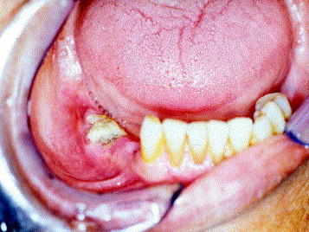
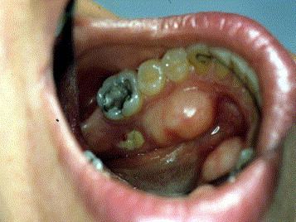
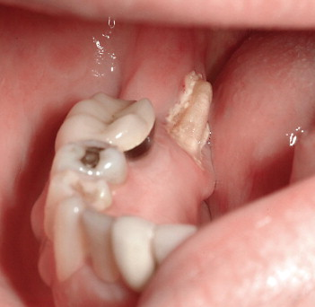
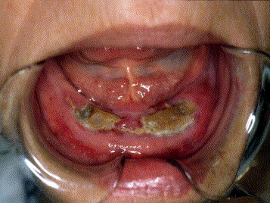

Slide 15
Bone Lesion

Slide 16
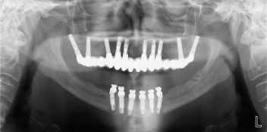
Mx implants 10 years ago
On Fosamax for last 5.5 years
6 implants placed in Md
Necrosis of lower implants
Implants placed into bone that had already absorbed bisphosphonates is the problem bone.

Slide 18
Patients taking nitrogen containing bisphosphonates run the risk of developing BRONJ. Approved by the Board of Trustees of AAMOS September 25, 2006

Slide 19
Risk of IV Bisphosphonates
Rapid osteo-accumulation, i.e., within days, weeks or months.
The cumulative risks of IV BP’s therapy for the incidence of BRONJ are the range of .8 to 12 %.
Placement of dental implants should be avoided in the oncology patient exposed to IV BP’s.
Oncology patients taking IV BP’s are advised to avoid dental implants, and existing implants need to be monitored closely. The patient needs to be advised to do excellent home care and receive regular prophylaxis.

Slide 20
Risk of Oral Bisphosphonates
The cumulative risks of oral bisphosphonate for the incidence of BRONJ were calculated by Merck (Fosamax) to be 0.7/100/000 person/years of exposure.
This was calculated from the number of reported cases likely to have been BRONJ, divided by the number of alendronate pills prescribed since the drug’s approval.
This implies an unspecific cumulative effect.

Slide 21
Risk of Oral Bisphosphonates
Another comparison of oral bisphosphonates vs. IV bisphosphonates is .01% to .04% versus .07% to 12% (Bedogni, MD 2010).
In other words the prevalence of BRONJ in oral bisphosphonates use is much lower.

Slide 22
Are oral BPs worth the risk? For Treatment of Osteoporosis
The medical consensus is definitely yes.
It is estimated that the number of hip fractures in the United States will triple by 2020 and that 1 of every 2 women will sustain an osteoporosis fracture in her lifetime. In people who sustain hip fractures, less than 25% regain full function and twenty-four percent of the women who fracture a hip will die within a year.
(US Dept. of Health 2004, and ADA Council Scientific Affairs 2006)
Fosamax claims 50% reductions in fractures of the spine and hip with three year use.
Concerns: Atypical bone fractures are reported and bone quality is questioned.

Slide 23
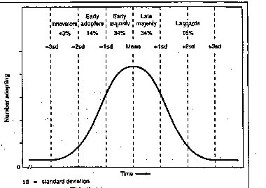
Osteoporosis & Bone Mineral Density (BMD) WHO definition
Normal T > -1
Osteopenia T -1 to -2.5
Osteoporosis < -2.5

Slide 24
Recommendations concerning IV and oral BPs

Slide 25
Updated ADA Recommendations for Managing the Care of Patients Receiving oral BP Therapy 2008
Implant placement and Maintenance
Patients need to be informed of risk. Considered to be small.
Because implant placement requires an osteotomy the dentist and patient should consider other treatment options.
Discontinuing BP therapy may or may not eliminate or reduce the risk of developing BRONJ.
Sound oral hygiene and regular dental care are vital.
Use bone grafts judiciously with primary closure if feasible.
CTX testing is unreliable and therefore no recommendation.
Carefully stage treatment and watch healing results (i.e. one quadrant at a time.)

Slide 26
Test Slide to see if Sal’s awake.

Slide 27
Suggested Treatment Guidelines Proposed by Marks 2007
CTX Test
CTX ≤ 100 pg/ml High risk
CTX 101-150 pg/ml Moderate risk
CTX ≥ 151 pg/ml Little-no risk
CTX Rx
Morning fasting serum C-Terminal Telopeptide (CTX) bone turnover marker
Dx = Osteonecrosis 733.40

Slide 28
Why the jaws?
BRONJ starts in the alveolar bone.
Recall high remodeling rate in jaws (300%).
Remodeling rate in alveolus 10x than that of long bone.
All cases have occurred in the jaws, except for a single case occurring after ear surgery.

Slide 29
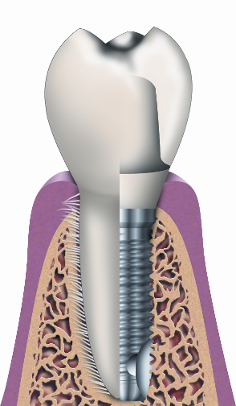
Bone is a living tissue
Constant turnover
Body → 30% per year
Jaws → 300% per year
Implants → 500% per year
300%
500%

Slide 30
Iran Retrospective Study Shabestari DDS, MS, 2009
Purpose: To evaluate implant survival in patients with a history of oral bisphosphonate therapy.
Data:
There were 46 ITI implants placed in 21 osteoporotic females, average age 53, who were evaluated with regards to probing depth, mobility, thread exposure and bleeding.
Mean duration of oral BP therapy was 20.5 months(<2yrs).

Slide 31
Iran Study (The Good)
Summary:
None of the implants showed mobility and all patients could be considered free from peri-implantitis.
Many other studies report similar findings, especially with short-term oral bisphosphonate use.

Slide 32
Swiss Systemic Review Dr. Madrid, Dept of Oral Surgery, 2009
Purpose: Evaluating the risk of developing BRONJ with implant patients receiving IV and oral BP therapy.
Data:
Literature review found: there is a consensus on contraindicating implants under IV BP therapy, and not contraindicating dental implants in oral BP patients.

Slide 33
Swiss Study (The Good)
Summary:
The placement implants may be considered a safe procedure in patients taking oral BPs less than 5 years related to BRONJ.
Also, BPs do not influence short-term (1-4 years) implant survival rate.

Slide 34
Swiss Study
Points of Interest: The Good
Animal studies using monkeys and beagle dogs showed retarded bone loss around affected teeth with alendronate.
Orthopedic surgery has studied alendronate with experimental arthroplasty on animals. Results suggest increased bone density and pull-out force necessary to remove implant. There has also been an attempt to coat implants with BPs, which promotes osteogenesis at the bone implant interface.

Slide 35
Kaiser Retrospective Study Martin DDS, 2010
Purpose of the Study: Examine the pattern of implant failures reported in a large cohort of patients (8,572) who received oral bisphosphonate therapy.
Data/Results: 16 patients (all women, average aged 70 years) had 26 implant failures.

Slide 36
Kaiser Study (The Bad)
Summary:
There were more late than early failures (over one year).
Among the 10 patients with 18 late implant failures, 4 were patients whose 10 implants were placed and osseointegrated before starting bisphosphonates.
None of the 16 patients with failed implants met AAOMS criteria for BRONJ.

Slide 37
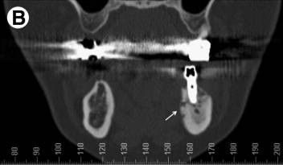
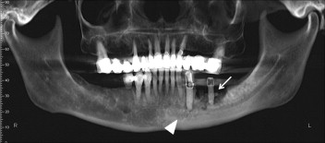
Italian Case Report (The Ugly) Bedogni MD, 2010
Purpose: Documents case of BRONJ as a result of oral BP therapy.
Data:
63 year old patient who developed BRONJ 6 years after oral BP therapy, and two years after implant placement.
Notice increased bone density of left mandible.

Slide 38
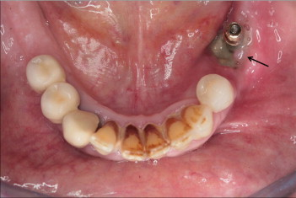
Italian Case Report
Peri-implant necrotic bone exposed in first molar region (arrow) associated with purulent discharge. This is BRONJ with late onset (>1 yr), i.e. not related to osteotomy. The patients poor oral hygiene should be noted.

Slide 39
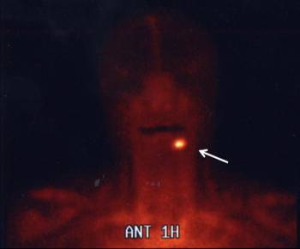
Italian Case Report
Anterior View of technetium 99-labeled lukocyte scintigraph. The persistent contrast uptake at 24 hours at the site of mandibular involvement provides evidence of active bone infection.

Slide 40
Italian Case Report Literature Review
Summary: The literature review found 9 BRONJ cases of implants which began with infection. These were oral BP cases with mean duration of 5.5 years of treatment. Mean time from implant placement to jaw infection and BRONJ development was 5.7 months.

Slide 41
Israeli Study Lazarovici, DMD, 2010
An Israeli study in Sheba Medical Center from 2003 to 2009 reviewed patients who had developed BRONJ associated with dental implants subsequent to bisphosphonate treatment.
145 patients were diagnosed with BRONJ, of which 27 were associated with dental implants.
11 of the 27 were associated with oral bisphosphonate (Fosamax). The rest were IV.
All patients stopped receiving the BPs soon after the diagnosis of BRONJ was established.

Slide 42
Israeli Study Oral bisphosphonate average length of time for development of BRONJ was 5.33 years.
3 years = 36 month window
5 years = 60 month window
Discuss case #5, #3

Slide 43
Israeli Study
The response to the treatment among patients taking oral BPs was better than that for the patients receiving IV BPs i.e., 63% of the oral BP patients had a complete response compared with only 31% of the IV.

Slide 44
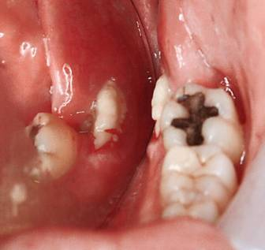
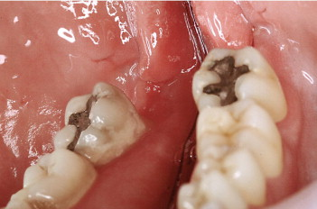
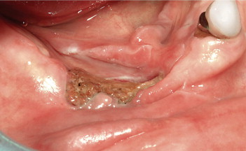
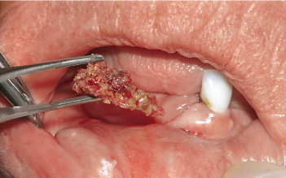
Before and After

Slide 45
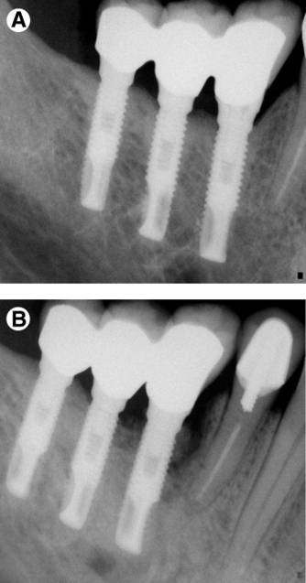
Israeli Study ( The Bad)
Spontaneous Implant BRONJ in 65-year-old man with multiple myloma.
#A Implants were placed 58 months before comencing IV BP therapy.
# B is the same area 33months after commencing IV BP therapy. Raiograph demonstrates a sequestrum attached to the mesial of the anterior implant

Slide 46
Israeli Study (The Ugly)
Because the IV BP 60 year old multiple myeloma patient did not respond to nonsurgical treatment, the implants were removed. Note the necrotic bone integrated with the implants.

Slide 47
Israeli Study
Conclusions:
The study revealed that the development of BRONJ associated with implants is a late complication and that it is usually not related to the oral surgery.
Some cases of BRONJ can be cured with discontinuation of BP and antibiotics, especially oral BP.
Patients treated with BPs who receive implants should be followed for long periods of time.

Slide 48
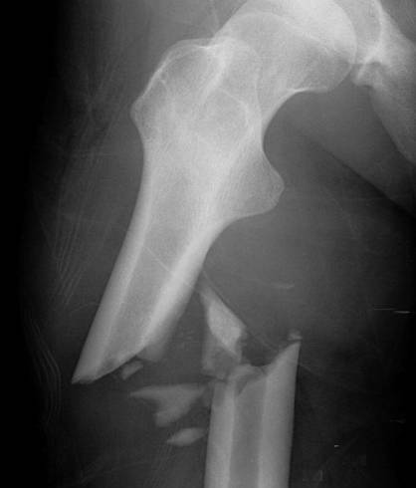
In large studies, women taking bisphosphonates for osteoporosis have had atypical fractures in the femur in the shaft, rather than at the head of the bone, which is the most common site of fracture. These unusual fractures, however, are extremely rare.
The Ugly

Slide 49
The Ugly
IV Induced
Multiple myeloma
Implants still solid
Manage with antibiotics and peridex
Best bet is to manage non-surgically
Surgery is last resort
Minor debridement is counter-productive

Slide 50
Conclusions
Do not place implants in IV bisphosphonate cancer patients.
Furthermore, if your current implant patient ends up with IV bisphosphonate, do a regimented recall schedule with heavy emphasis on home care and regular prophylaxis. Also counsel to limit other possible risk factors, such as smoking, etc.
If your patient is on oral bisphosphonates less than 3 years and no corticosteroids, proceed as normal with well-documented counseling and informed consent.
If your patient is on oral bisphosphonates in the 3-5 year range, consider CTX test along with counseling and informed consent. Consider a 3-6 months drug-holiday before placement and at least 3 months past placement (must be approved and coordinated with MD). Do one quadrant at a time and observe healing. OHI and regular prophylaxis.
If your patient is on oral bisphosphonates over 5 years, consider alternative treatment to implants. If you and the patient choose implants, be sure to have well-documented counseling and informed consent. I would definitely have a CTX test in the file for supportive evidence. Plan a 3-6 months drug-holiday before placement and at least 3 months past placement or until healing has occurred (must be approved and coordinated with MD). Do one quadrant at a time and observe healing. OHI and regular prophylaxis.

Slide 51
The End

Slide 52
Bibliography
American Association of Oral and Maxillofacial Surgeons Position Paper on Bisphosphonate-Related Osteonecrosis of the Jaws. September 25, 2006
Bisphosphonate-Related Osteonecrosis of the Jaw Associated With Dental Implants. T. Lazarovici, DMD, R. Yabalom, DMD, S. Taicher, DMD, D. Schwartz-Arad, DMD, PhD, O. Peleg, DMD, and N. Yarom, DMD. American Association Oral and Maxillofacial Surgeons. 2010.

Slide 53
Bibliography
Characteristics of Implant Failures in Patients With a History of Oral Bisphosphonate Therapy. D. Martin, DDS, F. O’Ryan< DDS, A. Indresano, DMD, P. Bogdanon, B. Wang, R. Hui, PharmD, MS, J Lo, MD. American Association of Oral and Maxillofacial Surgeons. 2010.
Correaltion Between Serum C-Terminal Cross-Linking Telopeptide of Type I Collagen and Staging of Oral Bisphosphonate-Related Osteonecrosis of the Jaws., Y Kwon, DMD, MSD, PhD, D. Kim, MD, PhD, J Ohe, DMD, J. Yoo, DMD, C Walter, MD, DDS.
Implant Placement in Patients with Oral Bisphosphonate Therapy: A Case Series. G Shabestari, DDSM MS, Y Shayesteh, DDS, MS, A Hhojasteh, DMD< MS, M Alikhasi, DDS, MS, N Moslemi, DDS, MS, A Aminian, DDS, R, Masaeli, DDS, B. Eslami, DDS, MS, N. Treister, DMS, SMSc. Clinical Implant Dentistry and Related Research. Vol 12, No .3, Sept 2010.

Slide 54
Bibliography
Oral Bisphosphonates and Dental Implants: A Retrospective Study. B. Bell, R Bell DDS. Ouranl Oral Maxillofacial Surgery 66:12022-1024, #5, May, 2008.
Oral Bisphosphonate-Associated Osteonecrosis of the Jaw After Implant Surgery:
A Case Report and Literature Review. Italy. Albert Bedagni, MD, Georgia Sia, MD, Andrea Totola, DMD, Pier Francesco Nocini, MD, DDS. 2010.
Oral Bisphosphonates: Risk, Prevention & Management. Presentation by David Engen. DDS, MSD & R. Hahn, DMD, MS.
Osseointegration of Dental Implants in Patients Undergoing Bisphosphonate Treatment: A Literature Review. F. Javed, K Almas. J. Periodontal, April 2010.

Slide 55
Bibliography
Outcomes of Placing Dental Implants in Patients Taking Oral Visphosphonates: A Review of 115 cases. B Grant, DDS, C Amenenedo, DDS, K Freeman, DrPh, R Kraut, DDS. American Association of Oral and Maxillofacial Surgeons. Received from Albert Einstein College. 2008.
Updated recommendations for managing the care of patients receiving oral bisphosphonate therapy. An advisory statement from the American Dental Association Council on Scientific Affairs. B. Edwards, MD, FACP, J Hellstein, DDS< MS, P Jacobsen, PhD, DDS, S Kaitmean, DMD, MD, A Mariotti, DDS, PhD, C Migliorati, DDS, MS, PhD. Jada 2008.
What impact do systemically administrated bisphosphonates have on oral implant therapy? A systematic review. C. Madrid, M. Sanz, Switzerland. Clinical Oral Implant Res. 20, 2009.

Slide 56
The bad

