Slide 1
Comparison of root coverage techniques
Member presentation
Kirk Davidson
11/18/16

Slide 2
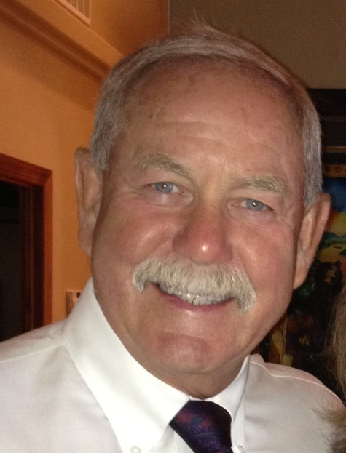
THE
CLASSIFICATION SYSTEM

Slide 3
CLASSIFICATION

Slide 4
CLASSIFICATION

Slide 5
PROCEDURES FOR ROOT COVERAGE
CORONALLY ADVANCED FLAP (CAF)
SUBEPITHELIAL CONNECTIVE TISSUE GRAFT (CT)+ CAF
CORONALLY ADVANCED FLAP + EMD
(ENAMEL MATRIX DERIVATIVE PROTIEN, I.E. EMDOGAIN
CAF + CT GRAFT + EMD
CAF + ACELLULAR DERMAL MATRIX (ADMG)
i.e. ALLODERM OR DERMIS

Slide 6
CORONALLY ADVANCED FLAP (CAF) (1)
trapezoidal ﬂap
divergent, oblique releasing incisions
Split – full – split thickness flap
Split through papilla, full thickness flap as far as depth of recession, release periosteum = split thickness flap (tension free flap)
De-epithelialize papilla
Plain root surface
Can treat root with tetracycline or ( 24% EDTA in this case)
Position flap slightly coronal to CEJ – suture of choice (vicryl in this case)

Slide 7
CAF

Slide 8
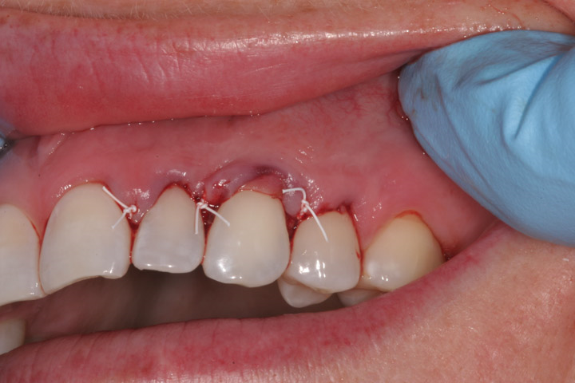
OTHER PROCEDURES USED IN CONJUNCTION WITH CAF
ADD CONNECTIVE TISSUE
Harvest CT from patients palate and suture donor tissue with resorbable sutures to cover the exposed root. Then displace flap coronally and suture.
ADD EMD –
PRIOR TO SUTURING FLAP CORONALLY
place EMDOGAIN on root let dry 2 min
Dr. Smart

Slide 9
What is EMD
Enamel Matrix Derivative (EMD)
is an extract of enamel matrix that contains amelogenins of various molecular weights.
Amelogenins are proteins that promote amelogenesis = the formation of enamel
Most commonly used is the product from Strauman = Emdogain

Slide 10
Emdogain
Is EMD + propylene glycol alginate
derived from developing teeth germs of 6 month old piglets.
Emdogain Theory = Attempt to build new periodontium by replicating the tooth forming apparatus present in tooth development. This is accomplished by:
Using enamel matrix derivative to form a matrix
Matrix mediates formation of cementum
Matrix provides foundation for all necessary tissues in a functional attachment

Slide 11
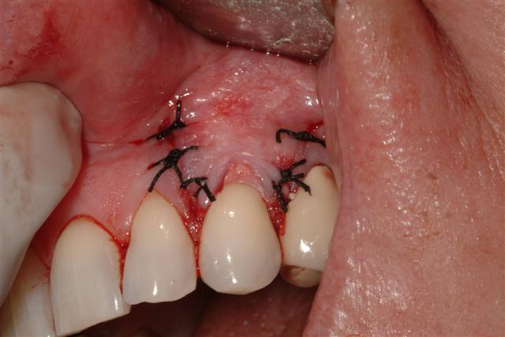
OTHER PROCEDURES USED IN CONJUNCTION WITH CAF
ADD CT GRAFT AND EMD
After securing harvested CT graft with resorbable sutures, gently elevate the graft, place EMD on root surface and let sit for 2 minutes, the replace graft over root surface and secure CAF. (4)
ADD ACELLULAR DERMAL MATRIX
Instead of harvesting donor tissue use a product such as Dermis or Alloderm to cover the root prior to securing coronally advanced flap.
Dr. Leone

Slide 12
What does the research say?
Chambrone L¹, Tatakis DN. Periodontal soft tissue root coverage procedures: a systematic review from the AAP Regeneration Workshop.
J Periodontol. 2015 Feb;86(2 Suppl):S8-51. doi: 10.1902/jop.2015.130674. (2)
This is systemic review from 2015 Reviewing Root Coverage procedures
included information from 17 Systematic reviews or Meta-analysis that were published between 2002 and 2013 comparing surgical treatment for recession
94 Randomized clinical trials comparing different types of root coverage surgical procedures
Primarily contained information on CL I and CL II defects

Slide 13
Chambrone L 2015 (2)
The Good News – All of the discussed treatments are effective in treatment of gingival recession.
They all resulted in :
Some amount of root coverage
Gain in clinical attachment level

Slide 14
Chambrone L 2015 (2)
Keratinized tissue was increased the most by:
CAF + connective tissue
CAF + ADMG ( i.e. alloderm or dermis)

Slide 15
The Break Down
Average amount of root coverage
Most amount of Keratinized tissue
CT +CAF
>
ADMG + CAF
EMD + CAF
>
CAF
CT + CAF
ADMG + CAF
EMD + CAF

Slide 16
What does the research say cont.(2)
Root modification Agents such as Tetracycline or citric acid do not appear to increase the success rate for surgical procedures.
CAF + CT procedures less successful in smokers, CAF alone no change in smokers

Slide 17
What about EMD + CT + CAF?
Only a few studies evaluated this
Compared EMD +CAF +CT vs CAF +CT
(3) – Evaluated 56 defects
30 were treated with CT + CAF
26 were treated with CT + EMD + CAF
The results:
Both had avg 2 mm gain KT
EMD group had average 0.3 mm more root coverage
EMD group of patients reported less post op sens.
No statistically significant difference

Slide 18
What about EMD + CT + CAF?
(4) Compared EMD +CT + CAF vs EMD +CAF
13 patients, 26 sites (1 site of each type on each patient)
The results
The
 | EMD+CT+CAF | EMD +CAF
Avg attch gain | 3.4 mm | 3.2
Increase in KT | 1.38 mm | .69 mm

Slide 19
Trends I noticed reading articles
Root coverage success on all mentioned types of grafts decreased with time
Not many studies over 2 years
Most studies that had follow up of 6 years or longer had considerably more poor results
Results for all types of surgeries varied widely between studies. i.e. Average root coverage for CT + CAF varied from 65% to 98% at 12 months
Most research done on CL I and CL II defects

Slide 20
Trends I noticed reading articles
Free gingival grafts were not extremely successful when root coverage was the goal with one surgery
When CAF conducted alone no consensus on KT width – Does it gain or lose KT?
CAF with 3 mm of KT has been well documented as being successful.
EMD treated sites appear to heal quicker i.e. – the appearance of an EMD treated site at 2 weeks is similar to a non EMD treated site at 4 weeks.

Slide 21
Summary
All the Discussed surgical techniques are documented as being successful for root coverage in the literature.
Some work better than others but they all can work

Slide 22
Summary
CT grafts are still the gold standard for treatment of recession defects when: root coverage, improvement in clinical attachment level, increase in keratinized tissue and one surgery is preferred.
Due to technique sensitivity evaluating effectiveness of surgical procedures is difficult
If patient is opposed to a second surgery site ADMG or EMD are both acceptable options

Slide 23
Summary continued
If the plan is to complete a CAF, then Emdogain will likely improve your results
Verdict is still out on if adding EMD to CT +CAF is worth the cost.
There are multiple case reports of great success with the technique as well as expert opinions.
EMD does seem to increase healing time and decrease post op pain
The one clinical trial I found showed no significant improvement with emdogain

Slide 24
Decision Tree
(2)

Slide 25
REFERENCES
1) Del Pizzo M, Zucchelli G, Modica F, Villa R, Debernardi C. Coronally advanced ﬂap with or without enamel matrix derivative for root coverage: a 2-year study. J Clin Periodontol 2005; 32: 1181–1187. doi: 10.1111/j.1600-051X.2005.00831.x. r Blackwell Munksgaard, 2005.
(2) Chambrone L¹, Tatakis DN. Periodontal soft tissue root coverage procedures: a systematic review from the AAP Regeneration Workshop. J Periodontol. 2015 Feb;86(2 Suppl):S8-51. doi: 10.1902/jop.2015.130674
(3) Rasperini G, Roccuzzo M, Francetti L, Acunzo R, Consonni D, Silvestri M. Subepithelial connective tissue graft for treatment of gingival recessions with and without enamel matrix derivative: A multicenter, randomized controlled clinical trial. Int J Periodontics Restorative Dent 2011;31:133-139

Slide 26
REFERENCES
(4) Berlucchi I, Francetti L, Del Fabbro M, Testori T, Weinstein RL. Enamel matrix proteins (Emdogain) in combination with coronally advanced flap or subepithelial connective tissue graft in the treatment of shallow gingival recessions. Int J Periodontics Restorative Dent 2002;22:583-593

