Slide 1
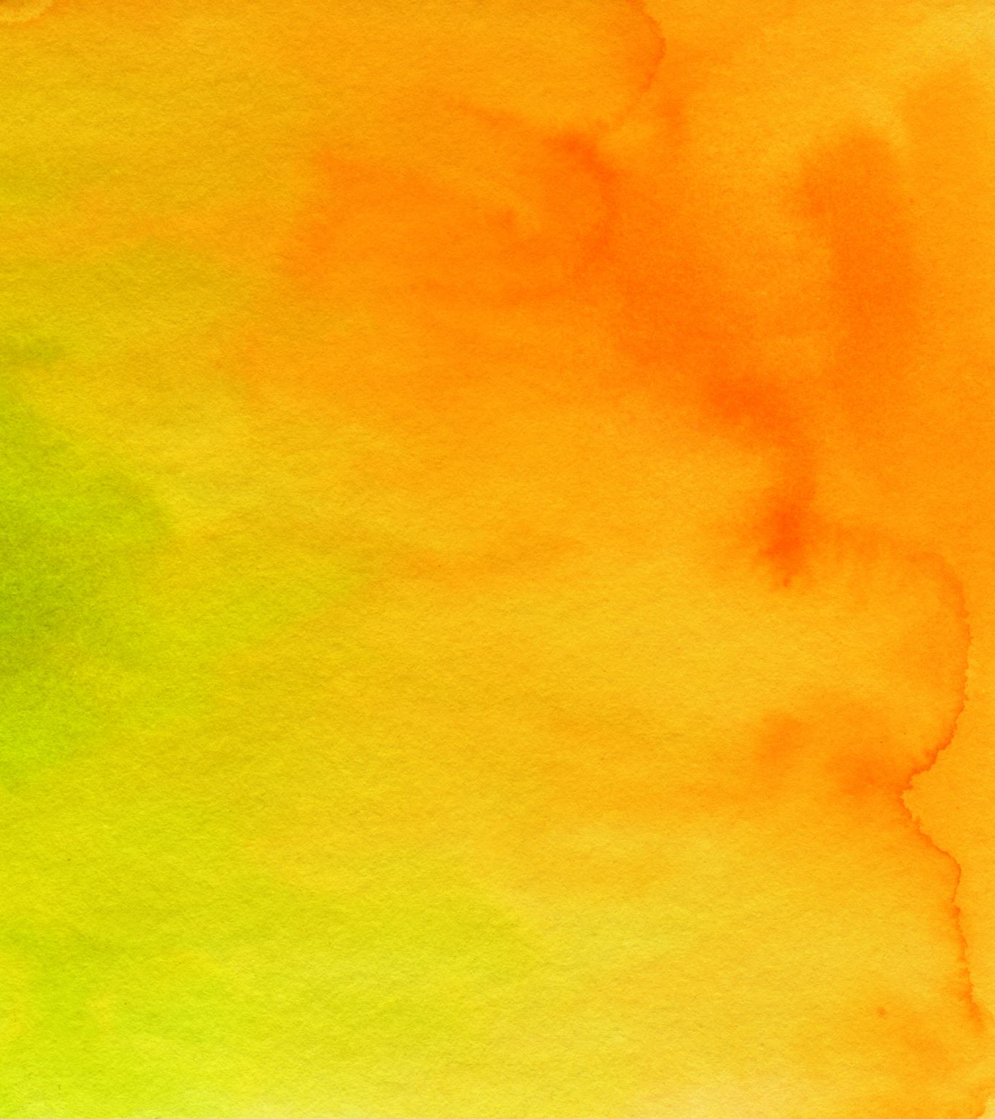
Endodontic Management of Immature Permanent Teeth
Inland Empire Perio Study Club
Logan Hazard
January, 2022

Slide 2
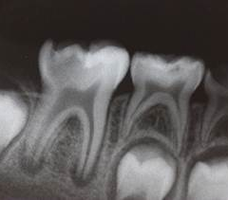
Why this topic?

Slide 3
Quick Sources
American Academy of Pediatric Dentistry
https://www.aapd.org/research/oral-health-policies--recommendations/pulp-therapy-for-primary-and-immature-permanent-teeth/
American Association of Endodontists
https://www.aae.org/specialty/wp-content/uploads/sites/2/2017/06/ecfespring2013.pdf

Slide 4
Why initiate endodontic therapy?
We want to save the tooth
Long term prognosis
Importance of tooth
Timing

Slide 5
…48 months later
https://cdn.ymaws.com/sites/cspd.site-ym.com/resource/resmgr/2015-speakers/DPAnnaChenToughChoiceforYoun.pdf

Slide 6
Diagnosis and Treatment Planning
Deep Caries/ Reversible Pulpitis
Irreversible Pulpitis
Necrotic/Apical Pathology
Can you avoid pulp exposure?
Yes
No
Regenerative Endodontics
(Revascularization)
Protective Liner
Indirect Pulp Treatment (IPT)
Complete Pulpotomy
Direct Pulp Cap
Partial Pulpotomy
Apexification

Slide 7
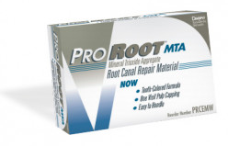
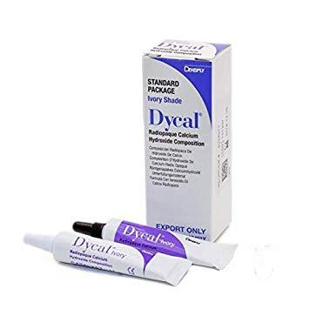
MATERIALS

Slide 8
Diagnosis and Treatment Planning
Deep Caries/ Reversible Pulpitis
Irreversible Pulpitis
Necrotic/Apical Pathology
Can you avoid pulp exposure?
Yes
No
Regenerative Endodontics
(Revascularization)
Protective Liner
Indirect Pulp Treatment (IPT)
Complete Pulpotomy
Direct Pulp Cap
Partial Pulpotomy
Apexification

Slide 9
Protective Liner
A protective liner is a thinly-applied liquid placed on the pulpal surface of a deep cavity preparation, covering exposed dentin tubules, to act as a protective barrier between the restorative material or cement and the pulp.
Protective Liner Considerations:
CaOH and MTA both have good track records. MTA seems to have better outcomes in most published studies.⁵
A small amount of affected dentin may be left at base of the prep to avoid pulp exposure. Leaving affected dentin and placing a liner has better clinical success than exposing the pulp.
A good peripheral seal is important to long-term success¹
Depending on quality of dentin at base of prep, indirect pulp treatment (IPT) may be considered.
Statistically, teeth restored using a single-visit technique are more likely to remain vital at follow-up appointments (96 percent vs 83 percent at a three-year follow up)*. There are many factors to consider though and case-by-case clinical judgement is important.²

Slide 10
Protective Liners: Clinical Procedure
Preop
Caries removal. Note that there was no exposure of pulp. A small amount of affected dentin was left in base of prep.
Placement of protective liner (CaOH in this case)
Final restoration
Janiga, A. (2018, November 8). Indirect Pulp Capping. Spear Review. https://www.speareducation.com/spear-review/2018/11/indirect-pulp-capping

Slide 11
Indirect Pulp Treatment (IPT)
Stepwise evacuation of caries performed over two visits, with an intermediate restoration in between.
IPT Considerations:
The second‐stage excavation several months later is carried out to firm dentin. It is easier to perform, as the consistency of the retained dentin should have changed.
An excellent seal is required of the intermediate restoration that should last for up to a year.
Protective liners are usually placed at second stage as well.
Based on a 5‐year follow‐up of a randomized clinical trial, a stepwise excavation approach for the management of deep carious lesions was superior to a complete carious removal procedure carried out in one visit, with less pulpal exposure, less pain and more teeth with vital pulps in the stepwise group.³
Notes:
What about selective removal without a second visit?
Single visit does slightly better in the studies.⁴ Maybe because initial decay was not as extensive?

Slide 12
Indirect Pulp Treatment: Clinical Procedure
Preop
Initial excavation of decay
Initial restoration (CaOH liner). 3 month wait time in this case.
Secondary excavation and restoration (CaOH liner).
4-year recall
Fagundes, Ticiane Cestari, Barata, Terezinha Jesus Esteves, Prakki, Anuradha, Bresciani, Eduardo, & Pereira, José Carlos. (2009). Indirect pulp treatment in a permanent molar: case reort of 4-year follow-up. Journal of Applied Oral Science, 17(1), 70-74.
Notes:
In my office, this would probably be pulpotomy. Why dink around?

Slide 13
Direct Pulp Cap
Placement of a dental material over the exposed pulp to facilitate both the formation of protective barrier and the maintenance of vital pulp.⁷
Direct Pulp Cap Considerations:
CaOH and MTA both have good track records. MTA has better outcomes in most published studies.⁶
Good isolation, and quick haemostasias are important.
In some studies, NaOCl decreased bond strength to dentin. Etched dentin and enamel were relatively unaffected, and other studies show contradictory evidence with increased bond strengths. Short exposure time (<10min) to NaOCl seems relevant.⁸
A good final restoration is important
The quality of reparative dentin after a successful pulp capping procedure has been evaluated histologically and reveals many nonmineralized defects, so‐called ‘tunnel defects’, that can easily be invaded by microorganisms.

Slide 14
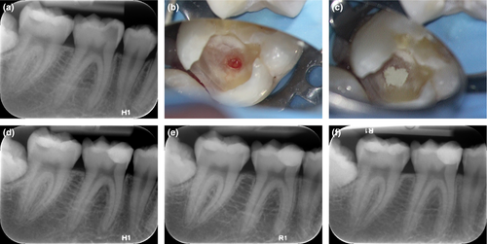
Direct Pulp Cap: Clinical Procedure
Preop
Isolation; Nonselective caries removal; Haemostasis using NaOCL.
Placement of pulp capping material (MTA in this case)
Final restoration
1 year
2 year
Bjørndal L, Simon S, Tomson PL, Duncan HF. Management of deep caries and the exposed pulp. Int Endod J. 2019 Jul;52(7):949-973. doi: 10.1111/iej.13128. Epub 2019 May 13. PMID: 30985944.
Notes:
#31 haha

Slide 15
Partial Pulpotomy
Inflamed pulp tissue beneath an exposure is removed to a depth of one to three millimeters or deeper to reach healthy pulp tissue. Pulpal bleeding is then controlled, and the remaining pulp is covered with CaOH or MTA before final restoration.
Partial Pulpotomy Considerations:
Isolate like you would for RCT (Rubber dam)
CaOH has been used successfully. MTA is way better and should be used most of the time. It’s way more predictable.
MTA must be 1.5mm thick
Bleeding must be controlled for several minutes using bactericidal agent such as NaOCl or Chx.
Has been used successfully in cases of acute pulpitis (in immature teeth)
Has also been used successfully in trauma cases when done up to 9 days following the pulpal exposure.
Keep in mind that MTA may cause tooth discoloration. A lot of trauma occurs on front teeth, so maybe CaOH is worth considering in these cases.
A few good examples can be seen here:
https://www.dentistrytoday.com/endodontics/8864-update-on-apexogenesis-case-reports-achieving-predictable-root-maturation-in-young-patients

Slide 16
Partial Pulpotomy: Clinical Procedure
Preop. “8 year-old boy presented with acute provoked pain in the lower right posterior area that lingered after removal of stimulus, and the parent reported the child taking painkillers.” Note the open apex
Immediately following treatment. Excavation was done with round bur, spoon instruments, and water. Haemostasias with light irrigation and loose cotton pellet.
24 month follow-up. Note the closed apex on #30
Demonstration of what pulp should look like prior to fill. Clean, homogenous, red, blood filled tissue, surrounded by healthy tooth.
https://youtu.be/2SusuxTRlng
Nagi P, Waly N, Elbardissy A and Khalifa M. Case Report: Immediate pain relief after partial pulpotomy of cariously exposed young permanent molar using mineral trioxide aggregate and root maturation, with two years follow-up [version 1; peer review: 2 approved with reservations]. F1000Research 2018, 7:1616 (https://doi.org/10.12688/f1000research.16381.1)
Notes:
It’s hard to know when you are at good pulp. I’ve never done one of these. When in doubt, just do complete pulpotomy.

Slide 17
Complete Pulpotomy
A complete or traditional pulpotomy involves complete surgical removal of the coronal vital pulp tissue followed by placement of a biologically acceptable material in the pulp chamber and restoration of the tooth. The main intent is to promote apexogenesis. The secondary intent is to retain vitality of radicular pulp.
Complete Pulpotomy Considerations:
MTA is pretty much the gold standard.
Bleeding must be controlled for several minutes using bactericidal agent such as NaOCl or Chx.
Has been used successfully in irreversible pulpitis.
This treatment is not indicated if there is apical pathology.
Partial pulpotomy?

Slide 18
Complete Pulpotomy: Clinical Procedure
Preop. 6 year-old boy presented with pain in the lower right posterior area that lingered after removal of stimulus, but with no pain on percussion. Note the open apex.
Abundant hemorrhage on access of pulp chamber indicates vitality. Pulp tissue was removed with spoon and bleeding was controlled, in this case, with saline and cotton.
2mm MTA and final restoration with resin composite
12 month follow-up. Note development of apex. The tooth tested vital at this appointment.
Gomez, Felipe, Fuentes, Jorge, Saravia, Diego, & Silva, Mónica. (2020). Induction of Root Development and Apical Closure in Permanent Mandibular Molar with Irreversible Pulpitis through Total Pulpotomy with Application of Mineral Trioxide Aggregate. International journal of odontostomatology, 14(2), 144-149. https://dx.doi.org/10.4067/S0718-381X2020000200144

Slide 19
Apexification
Historically, this has been the go-to procedure for immature teeth
Inducing root end closure of an incompletely formed non-vital permanent tooth by removing the coronal and non-vital radicular tissue just short of the root end and placing a biocompatible agent such as calcium hydroxide or MTA in the canals.
Apexification Considerations:
Traditionally, CaOH has been used. Multiple appointment are usually necessary to re-apply. Today, it seems that MTA is used more often.
Although root end closure occurs, root development stops. This leaves thin root walls that are prone to fracture.⁹
Notes:
I’ve never done this procedure , but it seems technique sensitive- especially in molars. Almost always one-step w/ MTA

Slide 20
Apexification: Clinical Procedure
Preop. “13-year-old boy was reported with pain in the right mandibular 2nd molar 3 weeks ago. Hard tissue examination revealed presence of deep dental caries in relation to the lower 2nd molar. The tooth did not respond to electric and thermal testing. Radiographic examination revealed deep pit communicating with pulp and presence of blunderbuss canals”
Working length determination and minimum instrumentation with NaOCl irrigation.
b.5) CaOH was placed. Patient returned 2 weeks later with no symptoms.
Placement of MTA plug. “Initially, 25 gutta-percha cones were used to transfer it [MTA] to the apical third followed by final condensation using small endodontic plugger. Repeated radiographs were obtained to check adequacy of MTA. The blunt end of a large paper point was moistened with water and left in the canal to promote setting for 4–6 hours. A cotton pellet was placed in chamber and the tooth restored with temporary cement. After 4–6 hours, the tooth was isolated and accessed as before. A hand plugger was lightly tapped against MTA plug to confirm a hardened set. The canals were dried using sterile paper points and obturated using ZOE sealer and injectable thermoplasticized gutta-percha.”
8 month follow-up
Vinod Kumar, Mohammed Zameer, Vijaya Prasad, T. Mahantesh, "Boon of MTA Apexification in Young Permanent Posterior Teeth", Case Reports in Dentistry, vol. 2014, Article ID 673127, 5 pages, 2014. https://doi.org/10.1155/2014/673127
Notes:
1) Necrotic lower 2nd with impacted 3rd Minimum instrumentation and placement of MTA plug with gutta percha/small endo plugger Backfill gp

Slide 21
Regenerative Endodontics
More of a concept than a procedure. Regenerative Endodontics is the engineering of the patient's natural tissues to replace or regenerate what has been lost. Various regenerative endodontic treatment protocols have been associated with a successful clinical outcome and currently there is no single recommended protocol.⁹
Regenerative Endodontics Considerations:¹⁰
Biological principles
Stem Cells- Undifferentiated cells. In RE these usually come from the blood/apical papilla
Scaffolds- Provide support for cell organization, proliferation, differentiation and vascularization. In RE these usually are derived from the blood clot and dentin. Sometimes PRF. Maybe even noninfected necrotic tissue.
Growth Factors- proteins that bind to receptors on the cell and act as signals to induce cellular proliferation and/or differentiation.

Slide 22
Regenerative Endodontics
More of a concept than a procedure. Regenerative Endodontics is the engineering of the patient's natural tissues to replace or regenerate what has been lost. Various regenerative endodontic treatment protocols have been associated with a successful clinical outcome and currently there is no single recommended protocol.⁹
Regenerative Endodontics Considerations:¹⁰
Biological principles
Stem Cells- Undifferentiated cells. In RE these usually come from the blood/apical papilla
Scaffolds- Provide support for cell organization, proliferation, differentiation and vascularization. In RE these usually are derived from the blood clot and dentin. Sometimes PRF. Maybe even noninfected necrotic tissue.
Growth Factors- proteins that bind to receptors on the cell and act as signals to induce cellular proliferation and/or differentiation.
MAGIC

Slide 23
Regenerative Endodontics Considerations:
Case Selection
Necrotic tooth. If it’s not necrotic, other treatment modalities are more predictable and less invasive.
Immature apex. Better vasculature. Maybe more stem cells since some may come from apical papilla.
No post needed. Pulp space barrier is placed over the canal space as part of the procedure, eliminating the use of this space for retention.
Compliant patient. Procedure takes multiple visits, and follow-through is mandatory for success.
Informed Consent
At least two appointments. If they can’t follow through, don’t start.
Minocycline and MTA can cause tooth staining
As with all endodontic procedures, there is a possibility of pain and/or swelling after the procedure and that there may be a lack of response to treatment.

Slide 24
Regenerative Endodontics Considerations:
Visit 1)
Clean the tooth- GENTLY.
Place Triple Antibiotic Paste (TAP)
…3-4 weeks…
Visit 2)
Remove TAP
Stimulate bleeding (Stir the pulp)
Place MTA and final restoratio
…6-12 months…
Visit 3)
Follow-up.
No symptoms. No PARL. Root development.

Slide 25
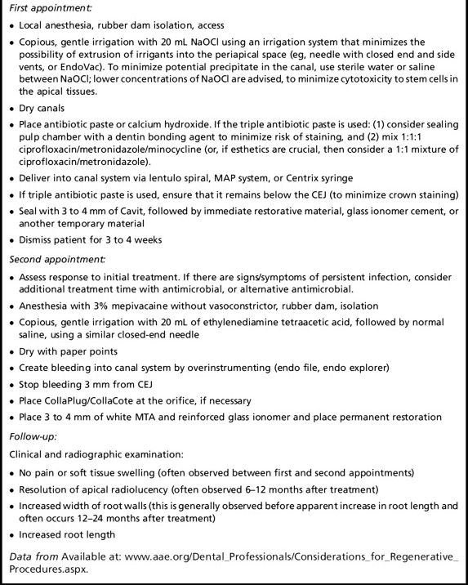
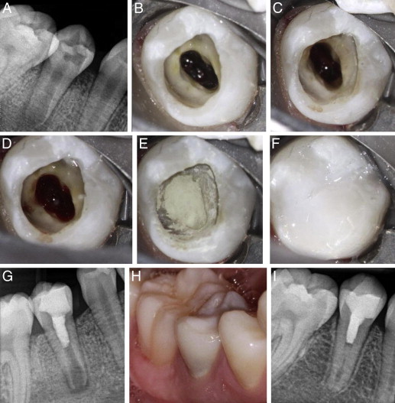
Regenerative Endodontics: Suggested Clinical Procedure
Images from regenerative endodontic procedures (REPs). (A) Periapical radiograph of mandibular right second premolar before the initiation of treatment showing occlusal caries, immature apex, and apical lesion. (B) Clinical photograph from the second appointment showing a bluish color of TAP in the canal immediately after the removal of temporary, (C) vital tissue in the apical third of the canal evident after irrigation to remove TAP, (D) the formation of blood clot, (E) the placement of white MTA, and (F) composite restoration. (G) A periapical radiograph made immediately after the placement of final restoration showing MTA covering pulp space and composite restoration. (H) A photograph at the 14-month follow-up showing grayish discoloration in the cervical third of the crown. (I) A periapical radiograph made at the 14-month follow-up showing increased root wall thickness.
Law AS. Considerations for regeneration procedures. J Endod. 2013 Mar;39(3 Suppl):S44-56. doi: 10.1016/j.joen.2012.11.019. PMID: 23439044.
Notes:
A) Preop- they opened, cleaned, and placed TAP B-G=visit 2. TAP; Vital tissue; blood clot; MTA; Final restoration H-I= Visit 3. Grey tooth, but good apex

Slide 26
Diagnosis and Treatment Planning
Deep Caries/ Reversible Pulpitis
Irreversible Pulpitis
Necrotic/Apical Pathology
Can you avoid pulp exposure?
Yes
No
Regenerative Endodontics
(Revascularization)
Protective Liner
Indirect Pulp Treatment (IPT)
Complete Pulpotomy
Direct Pulp Cap
Partial Pulpotomy
Apexification

Slide 27
Diagnosis and Treatment Planning- Take Home Message
Deep Caries/ Reversible Pulpitis
Irreversible Pulpitis
Necrotic/Apical Pathology
Can you avoid pulp exposure?
Yes
No
Regenerative Endodontics
(Revascularization)
Protective Liner
Indirect Pulp Treatment (IPT)
Complete Pulpotomy
Implants are cool- teeth are cooler. Save teeth.
Learn to use MTA or newer root repair materials. They can be as useful as implants.
Direct Pulp Cap
Partial Pulpotomy
Apexification

Slide 28
Alleman DS, Magne P. A systematic approach to deep caries removal end points: the peripheral seal concept in adhesive dentistry. Quintessence Int. 2012 Mar;43(3):197-208. PMID: 22299120.
Hoefler, V., et al. “Long-term survival and vitality outcomes of permanent teeth following deep caries treatment with step-wise and partial-caries-removal: A systematic review.” Journal of Dentistry. 2016: 54: 25-32.
Bjørndal L, Fransson H, Bruun G et al. (2017) Randomized clinical trials on deep carious lesions: 5‐year follow‐up. Journal of Dental Research 96, 747–53
Hoefler, V., et al. “Long-term survival and vitality outcomes of permanent teeth following deep caries treatment with step-wise and partial-caries-removal: A systematic review.” Journal of Dentistry. 2016: 54: 25-32.
Leye Benoist F, Gaye Ndiaye F, Kane AW, Benoist HM, Farge P. Evaluation of mineral trioxide aggregate (MTA) versus calcium hydroxide cement (Dycal(®) ) in the formation of a dentine bridge: a randomised controlled trial. Int Dent J. 2012 Feb;62(1):33-9. doi: 10.1111/j.1875-595X.2011.00084.x. PMID: 22251035.
Hilton TJ, Ferracane JL, Mancl L; Northwest Practice-based Research Collaborative in Evidence-based Dentistry (NWP). Comparison of CaOH with MTA for direct pulp capping: a PBRN randomized clinical trial. J Dent Res. 2013;92(7 Suppl):16S-22S. doi:10.1177/0022034513484336
Bjørndal L, Simon S, Tomson PL, Duncan HF. Management of deep caries and the exposed pulp. Int Endod J. 2019 Jul;52(7):949-973. doi: 10.1111/iej.13128. Epub 2019 May 13. PMID: 30985944.
Tariq S. Abuhaimed, Ensanya A. Abou Neel, "Sodium Hypochlorite Irrigation and Its Effect on Bond Strength to Dentin", BioMed Research International, vol. 2017, Article ID 1930360, 8 pages, 2017. https://doi.org/10.1155/2017/1930360
Regenerative Endodontics . Endodontics: Colleagues for Excellence; American Association of Endodontics. Chicago, IL; Spring; 2013.
Law AS. Considerations for regeneration procedures. J Endod. 2013 Mar;39(3 Suppl):S44-56. doi: 10.1016/j.joen.2012.11.019. PMID: 23439044.

