Slide 1
George Loftus DDS R.H. ‘Bob’ Age 72
UR Sinus Augmentation Implant #3, #4

Slide 2
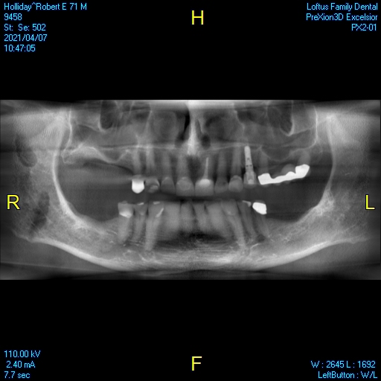
Pano 4-7-2021 Pre-Op

Slide 3
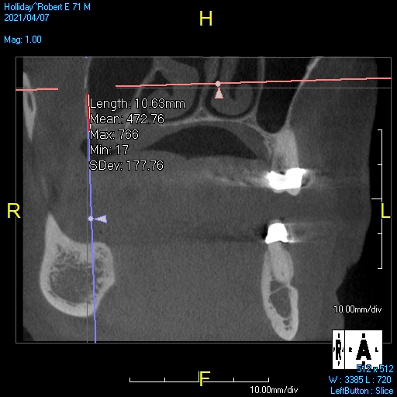
UR Artery Location

Slide 4
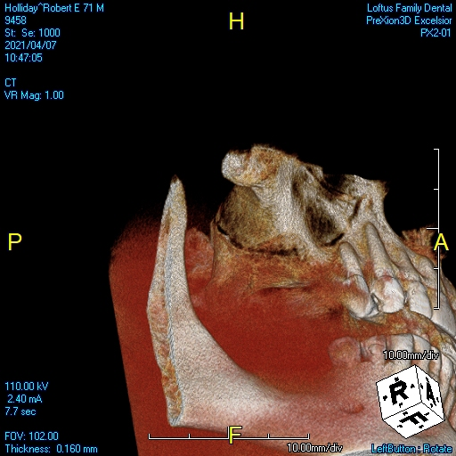
UR

Slide 5
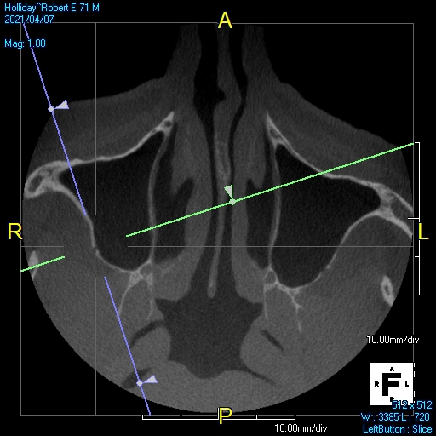
UR

Slide 6

UR

Slide 7
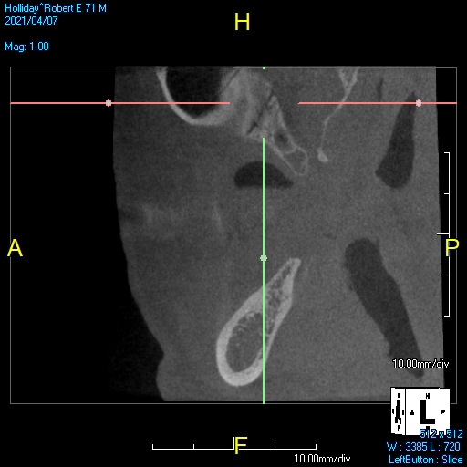
UR

Slide 8
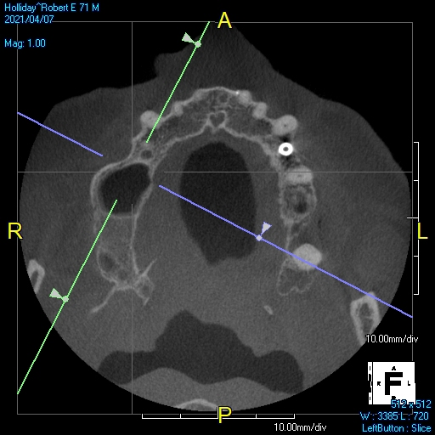
UR

Slide 9
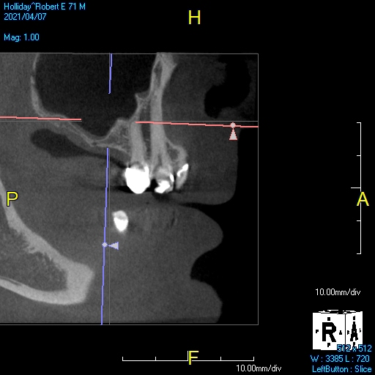
UR

Slide 10
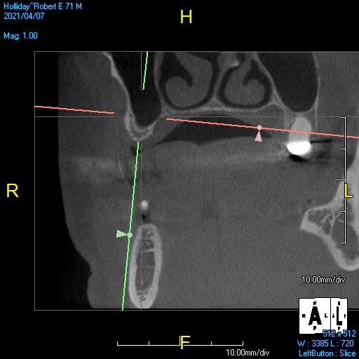
UR

Slide 11
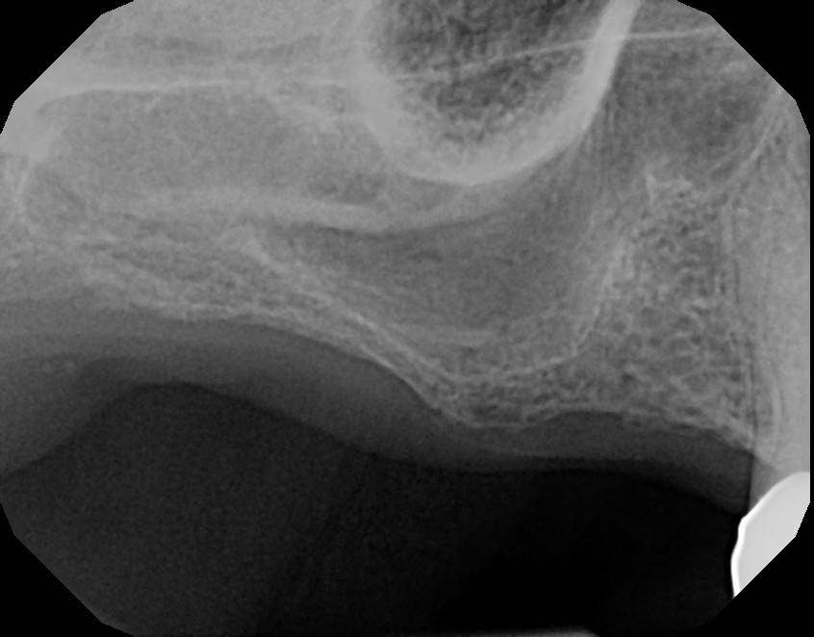
UR

Slide 12
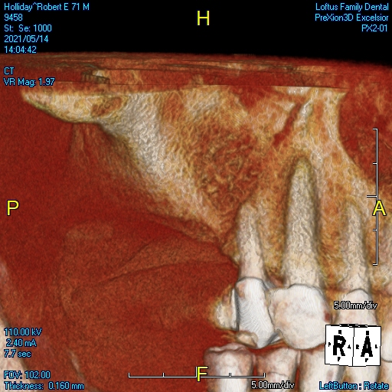
UR Post OP 5-14-2021 Study Club

Slide 13
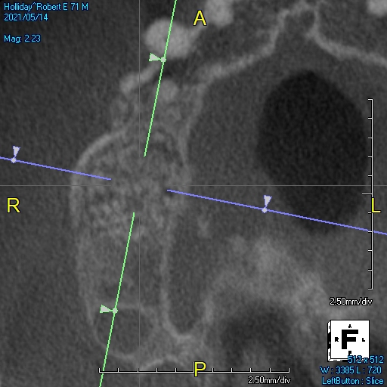
UR Post OP 5-21-2021

Slide 14
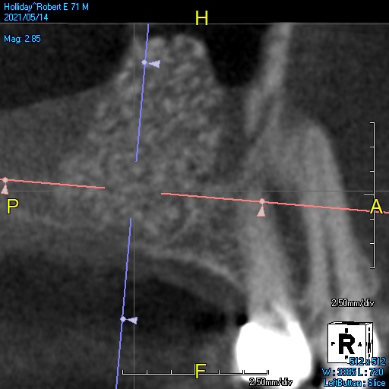
UR Post OP 5-21-2021

Slide 15
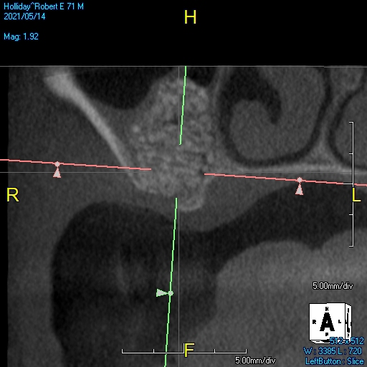
UR Post OP 5-21-2021

Slide 16
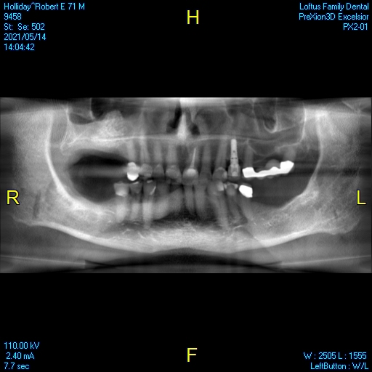
UR Post OP 5-21-2021

Slide 17
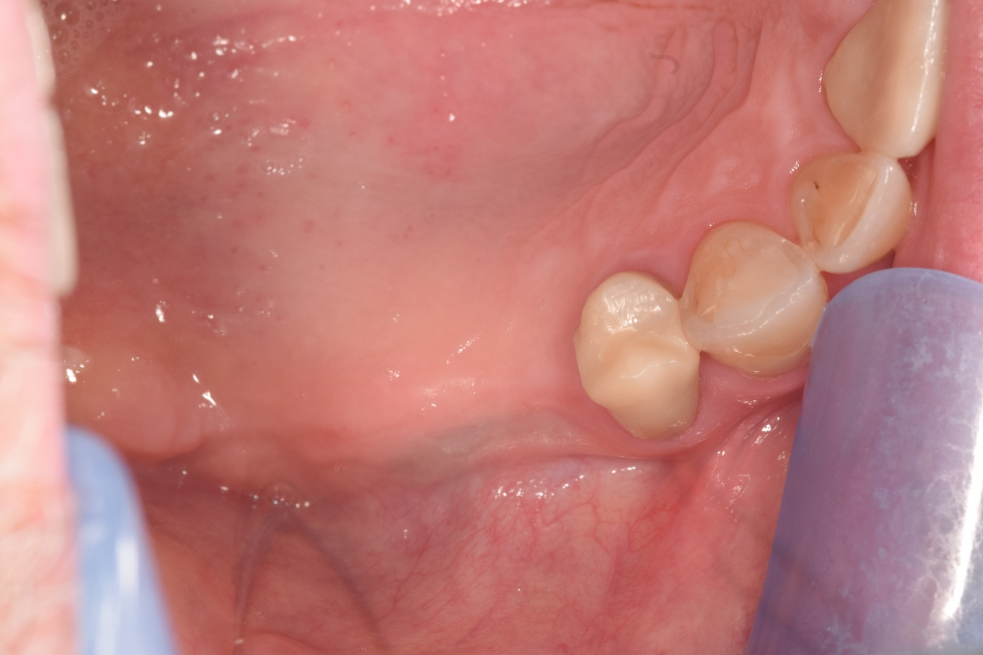
UR

Slide 18
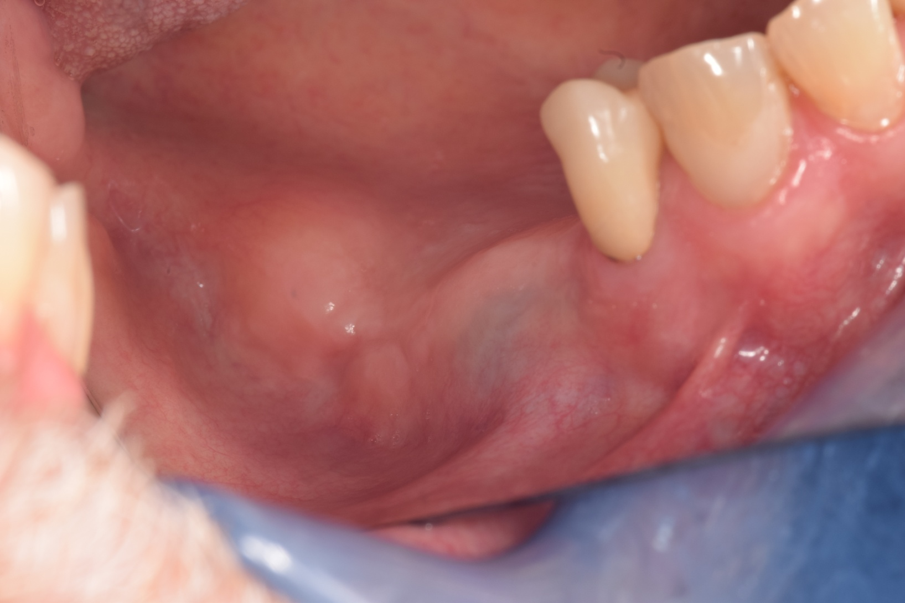
UR

Slide 19
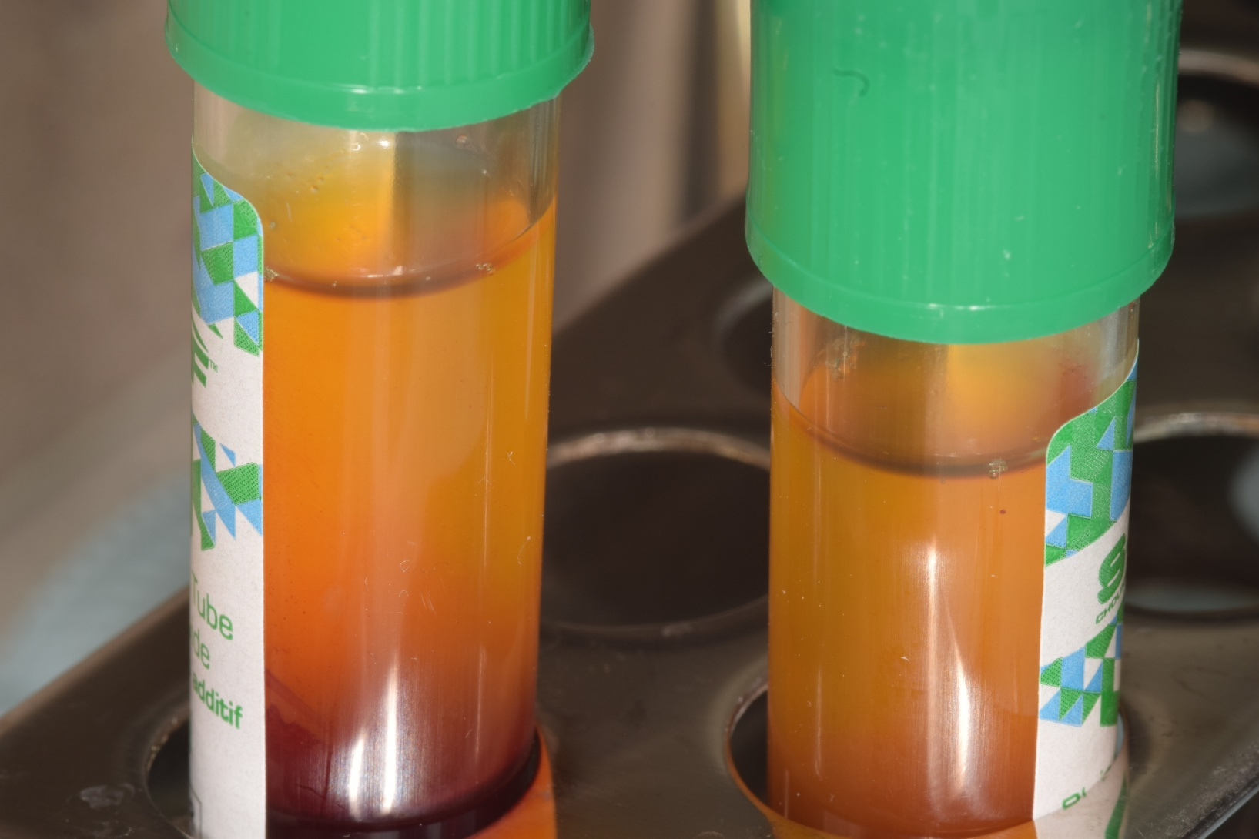

Slide 20
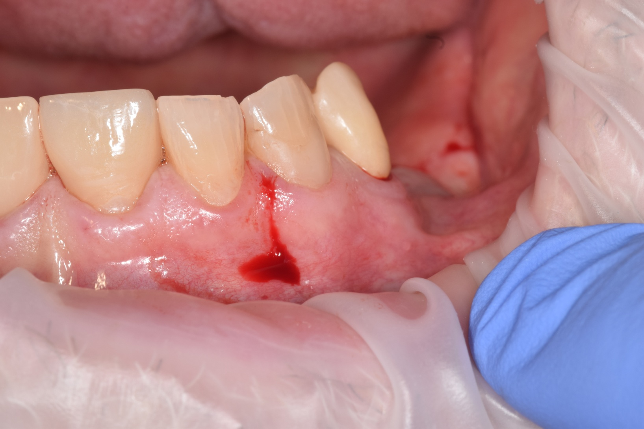

Slide 21
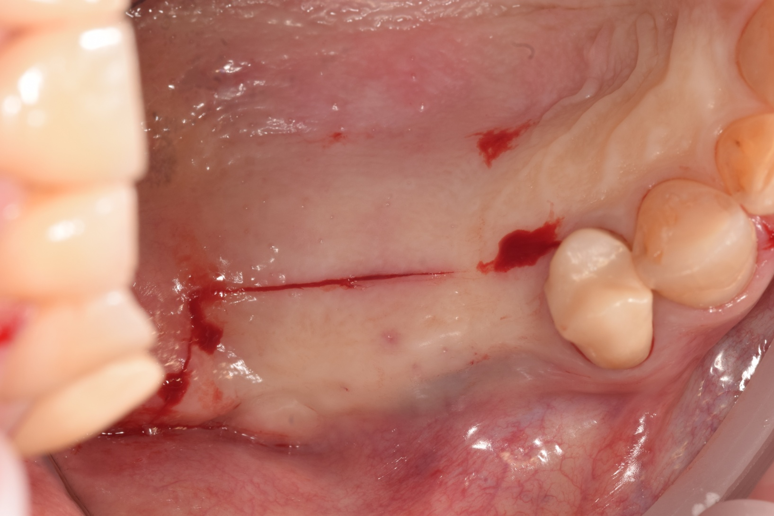

Slide 22
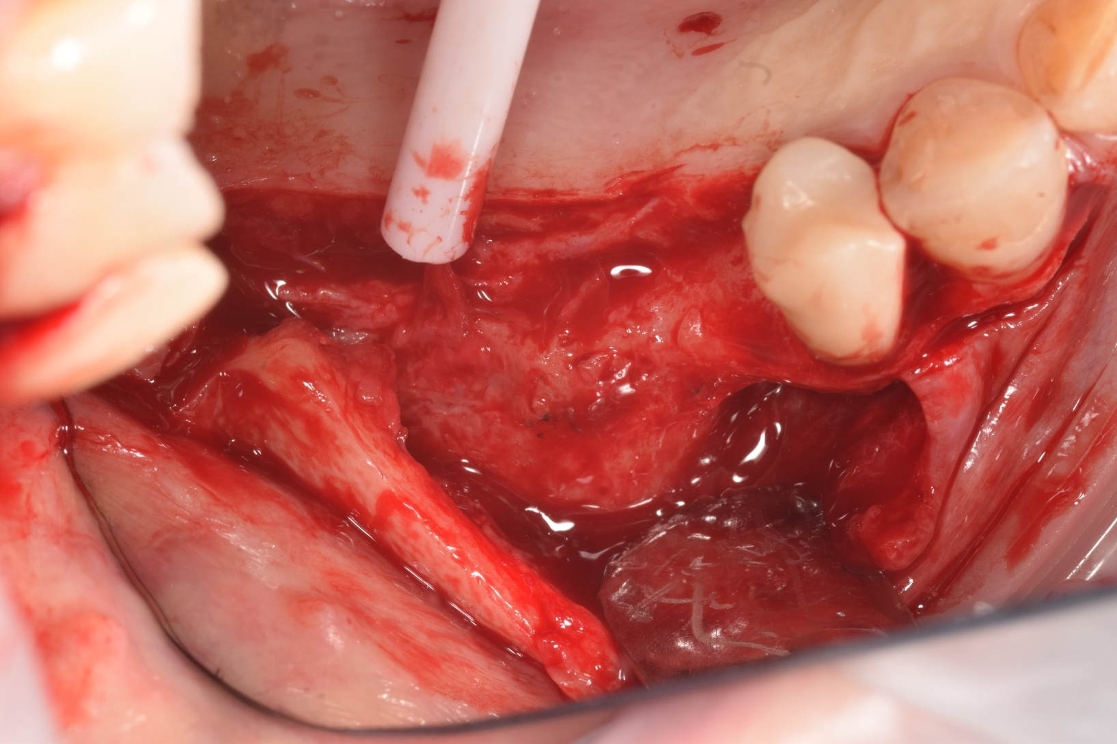

Slide 23
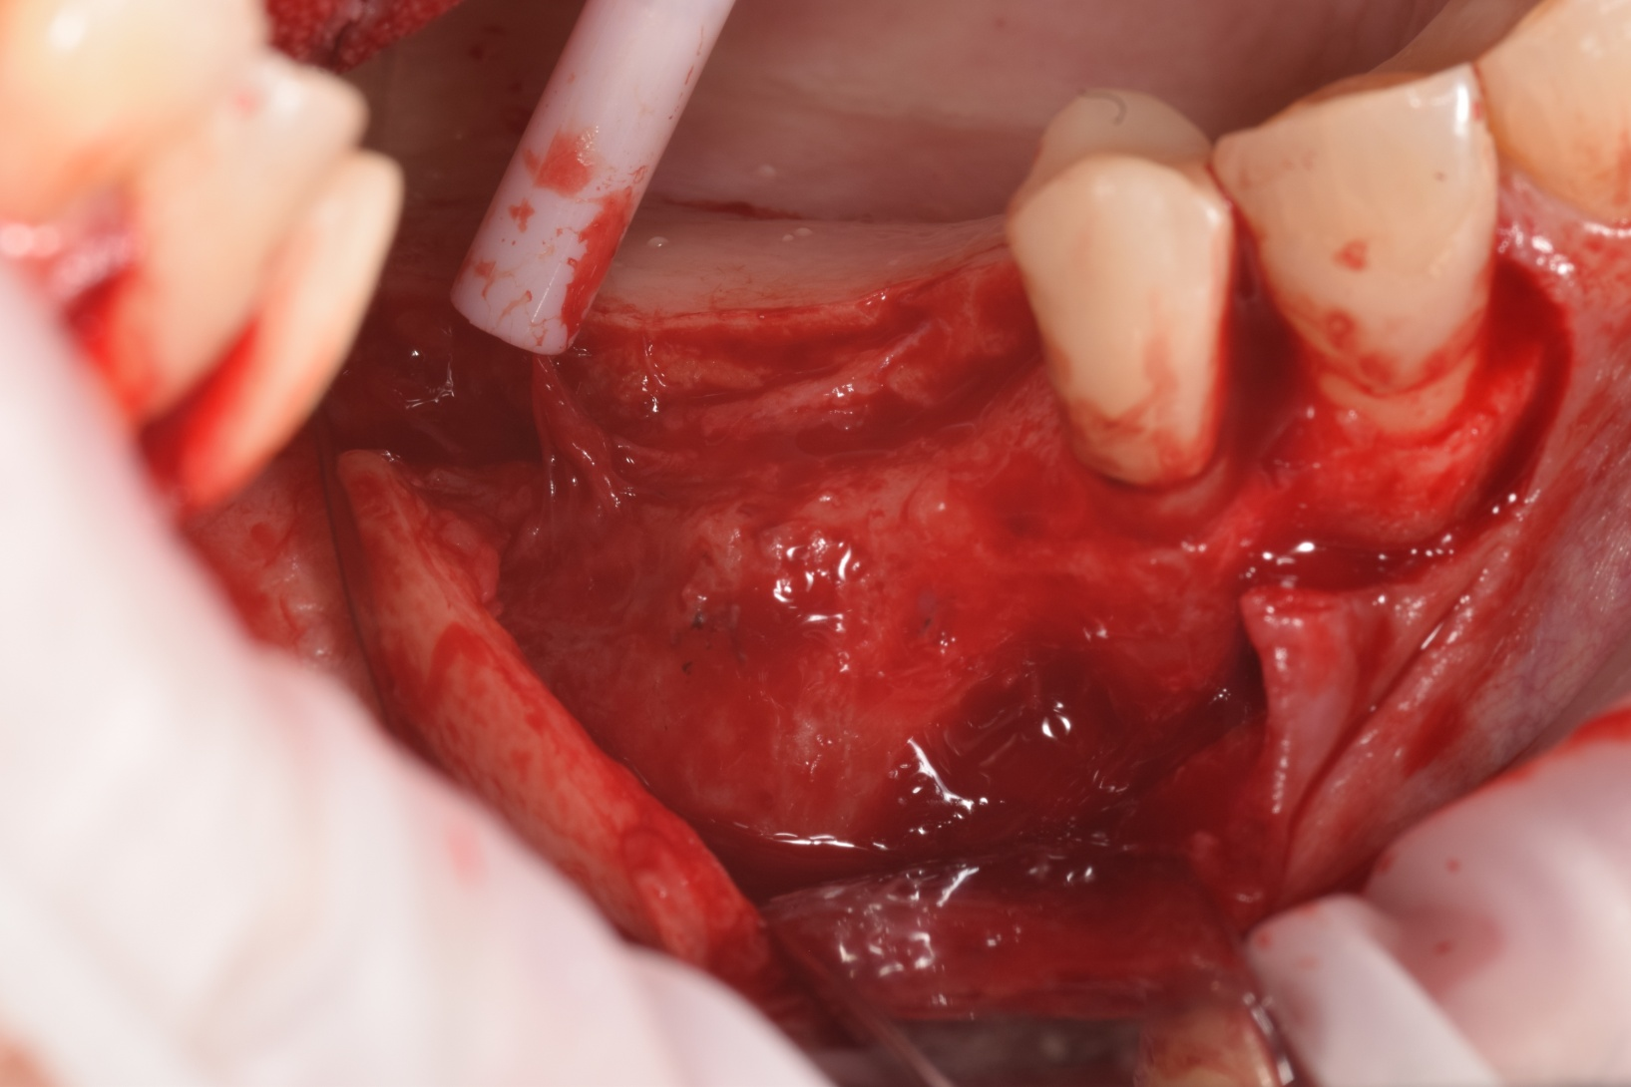

Slide 24
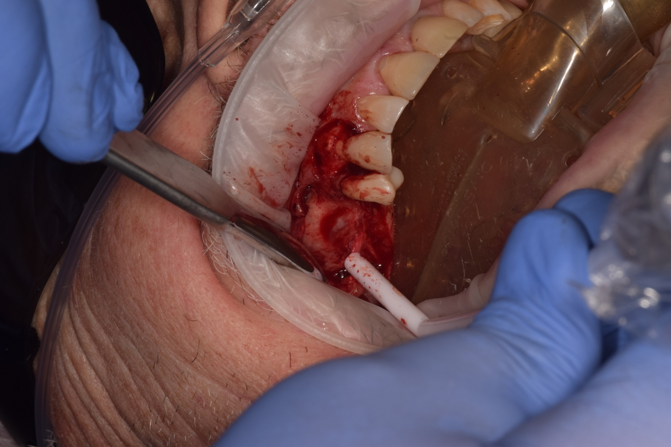

Slide 25
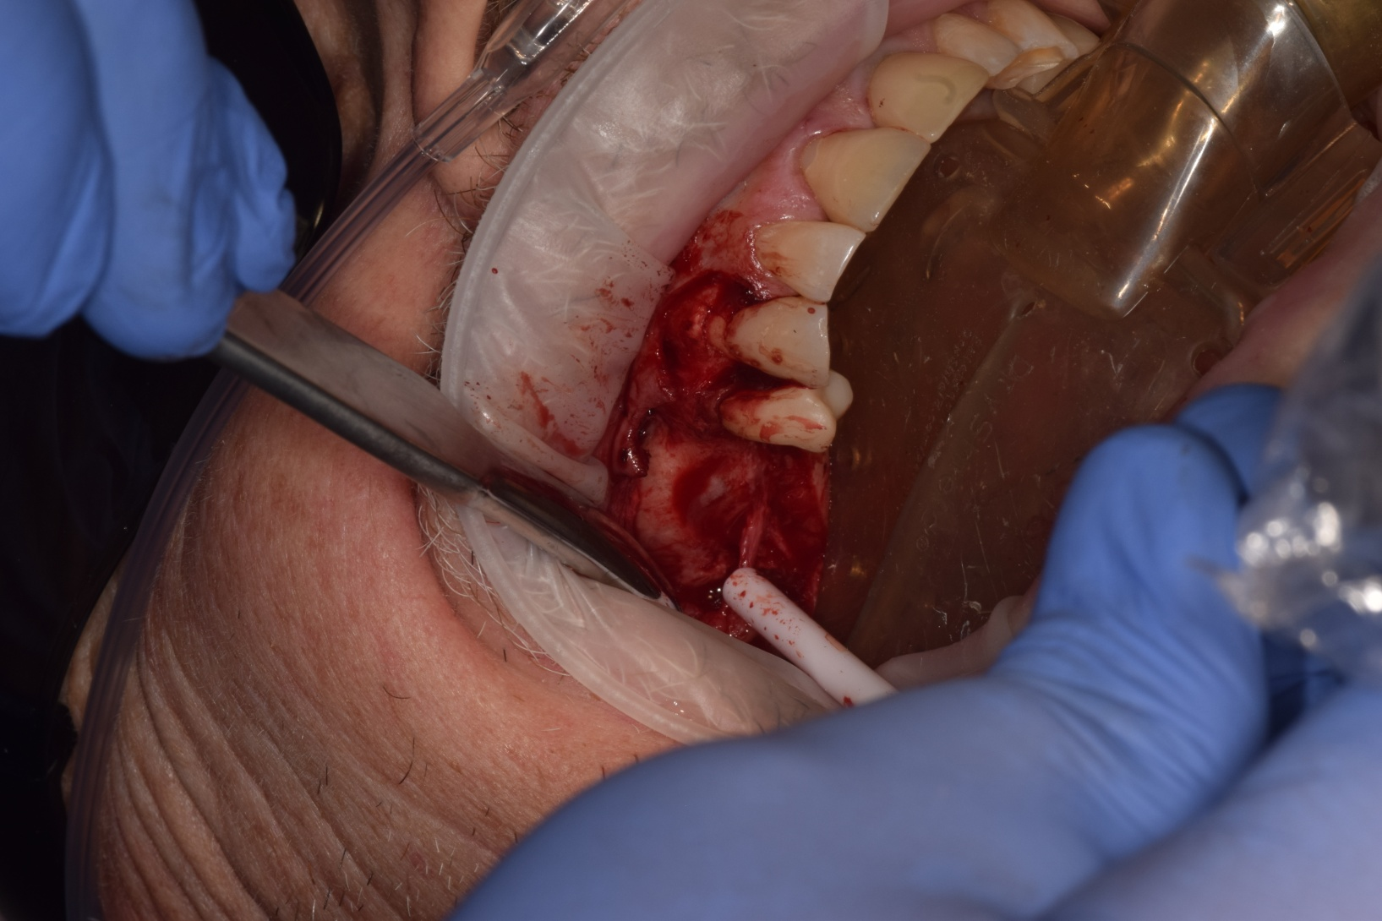

Slide 26
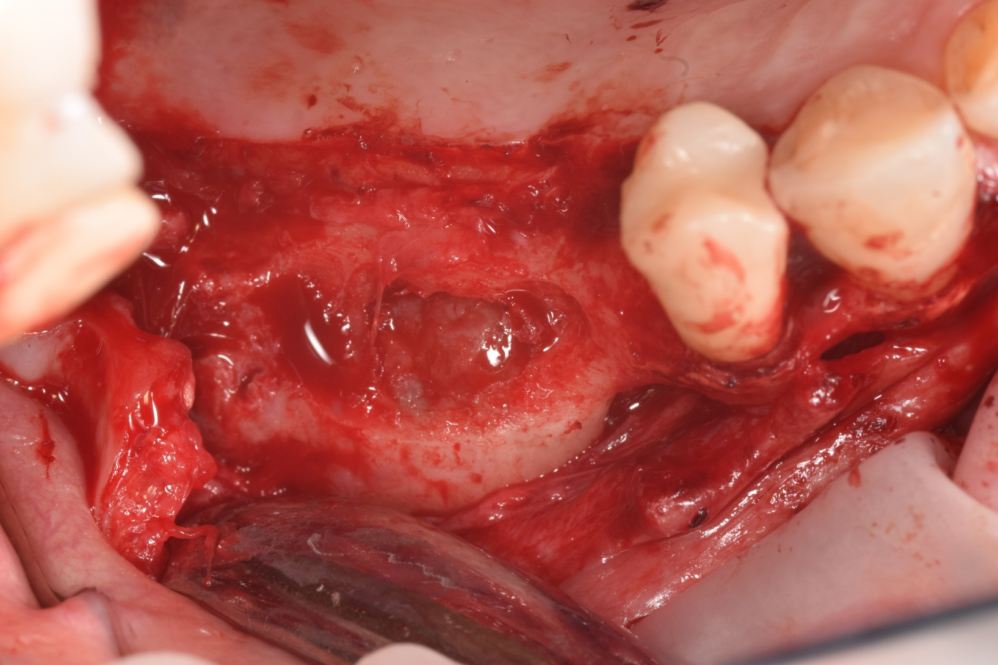

Slide 27
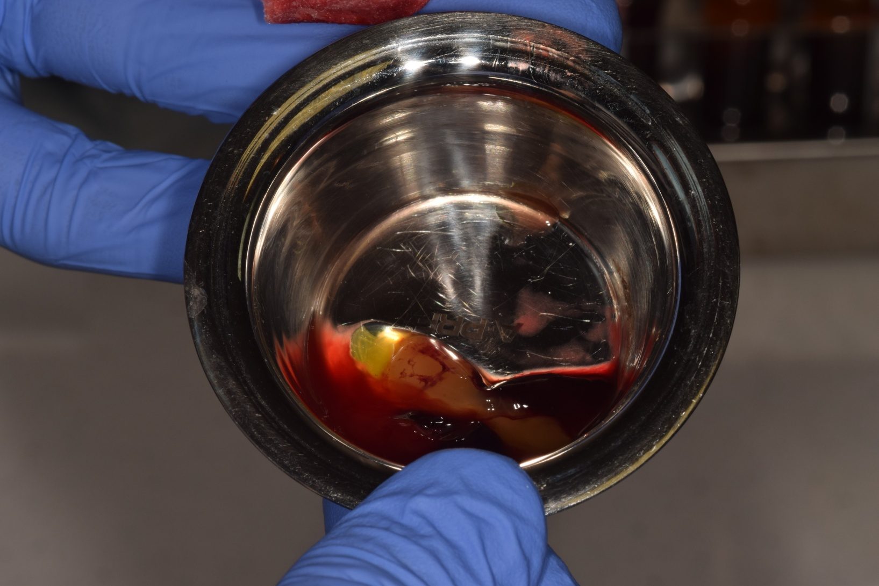

Slide 28
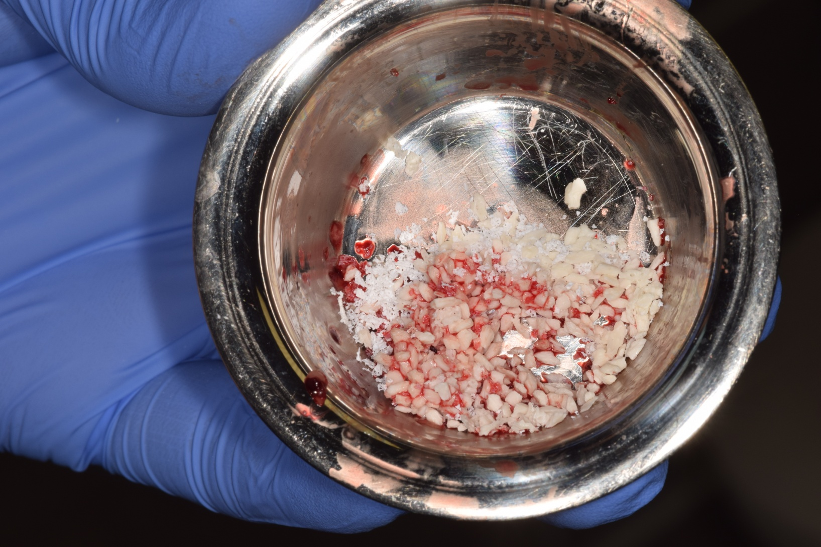

Slide 29
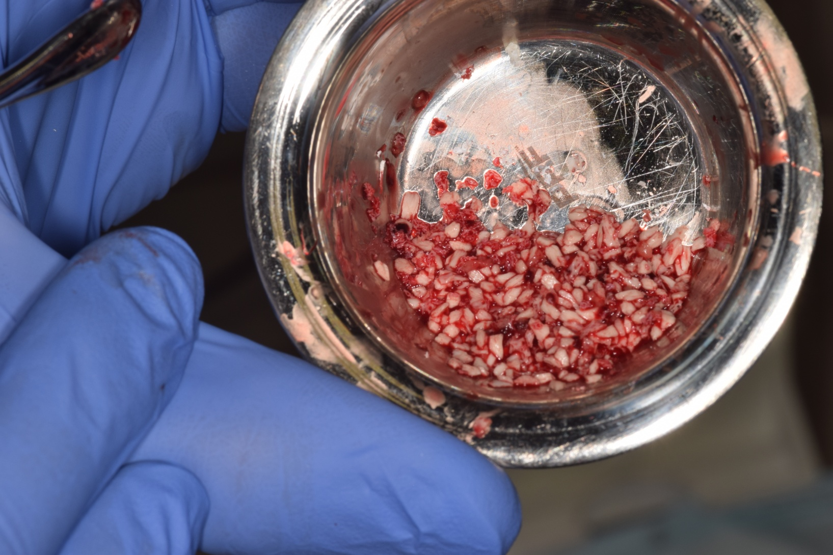

Slide 30
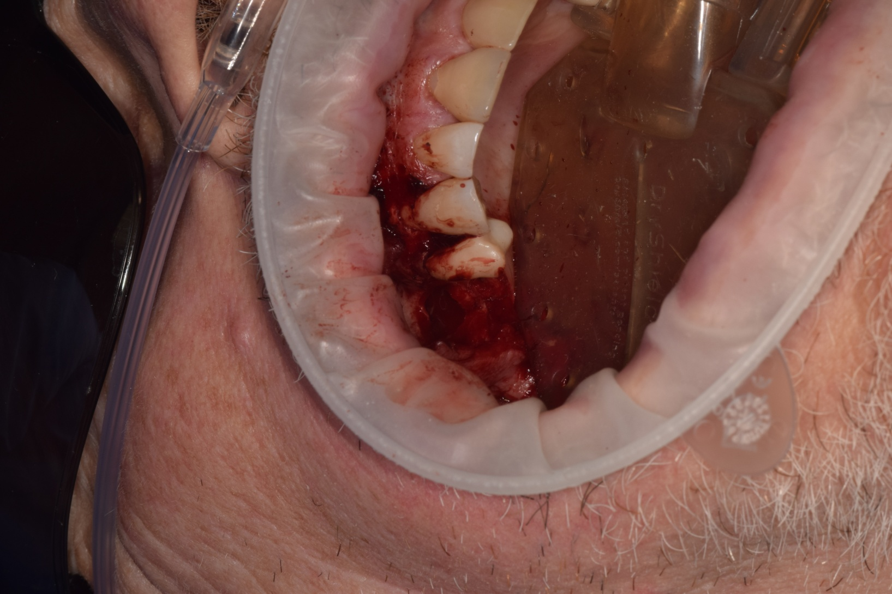
UR

Slide 31
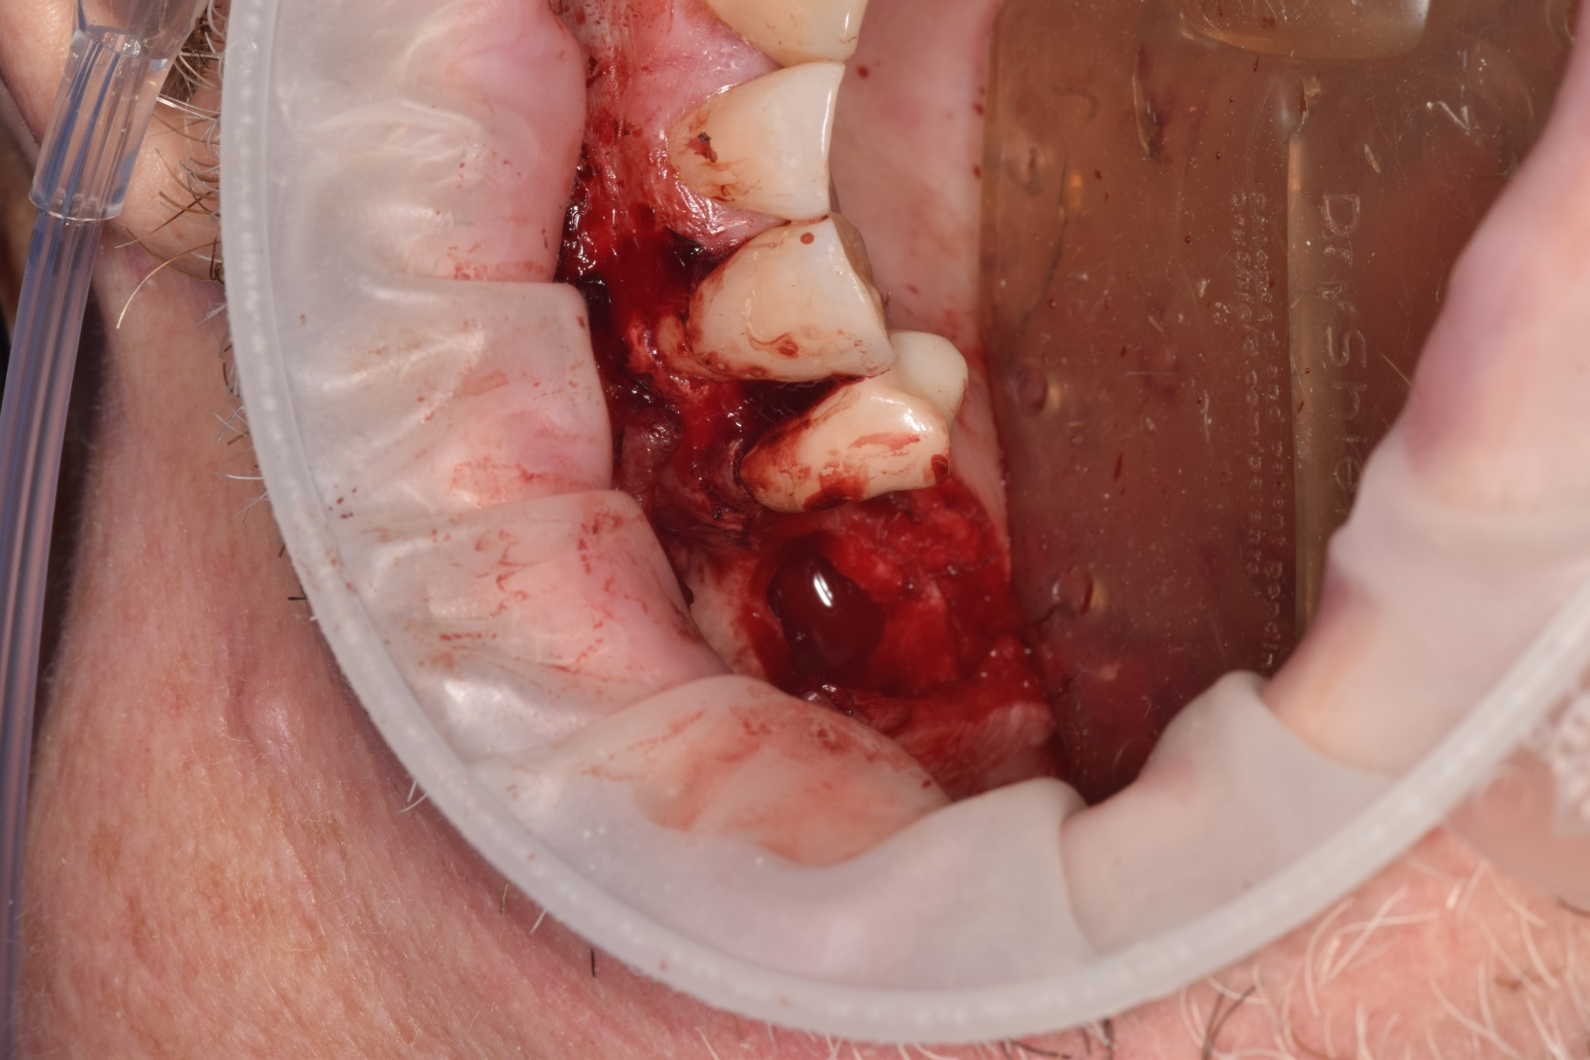
Window access

Slide 32
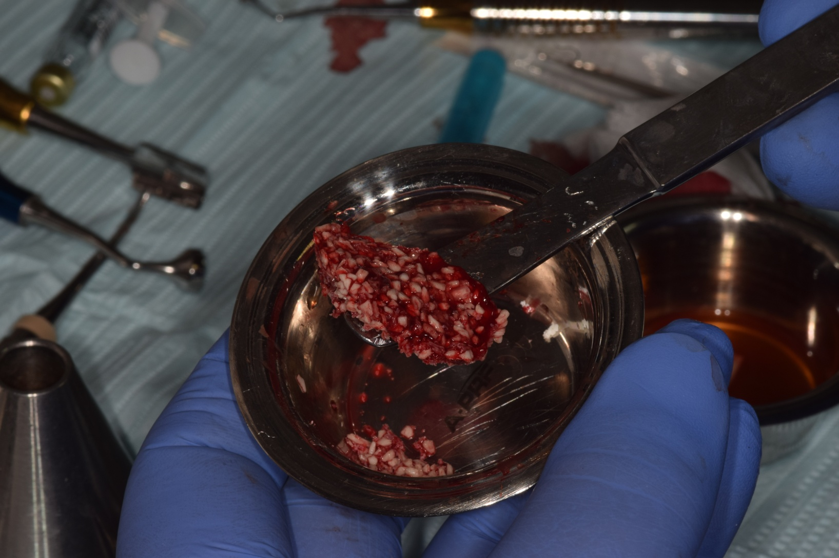
Sticky Bone

Slide 33
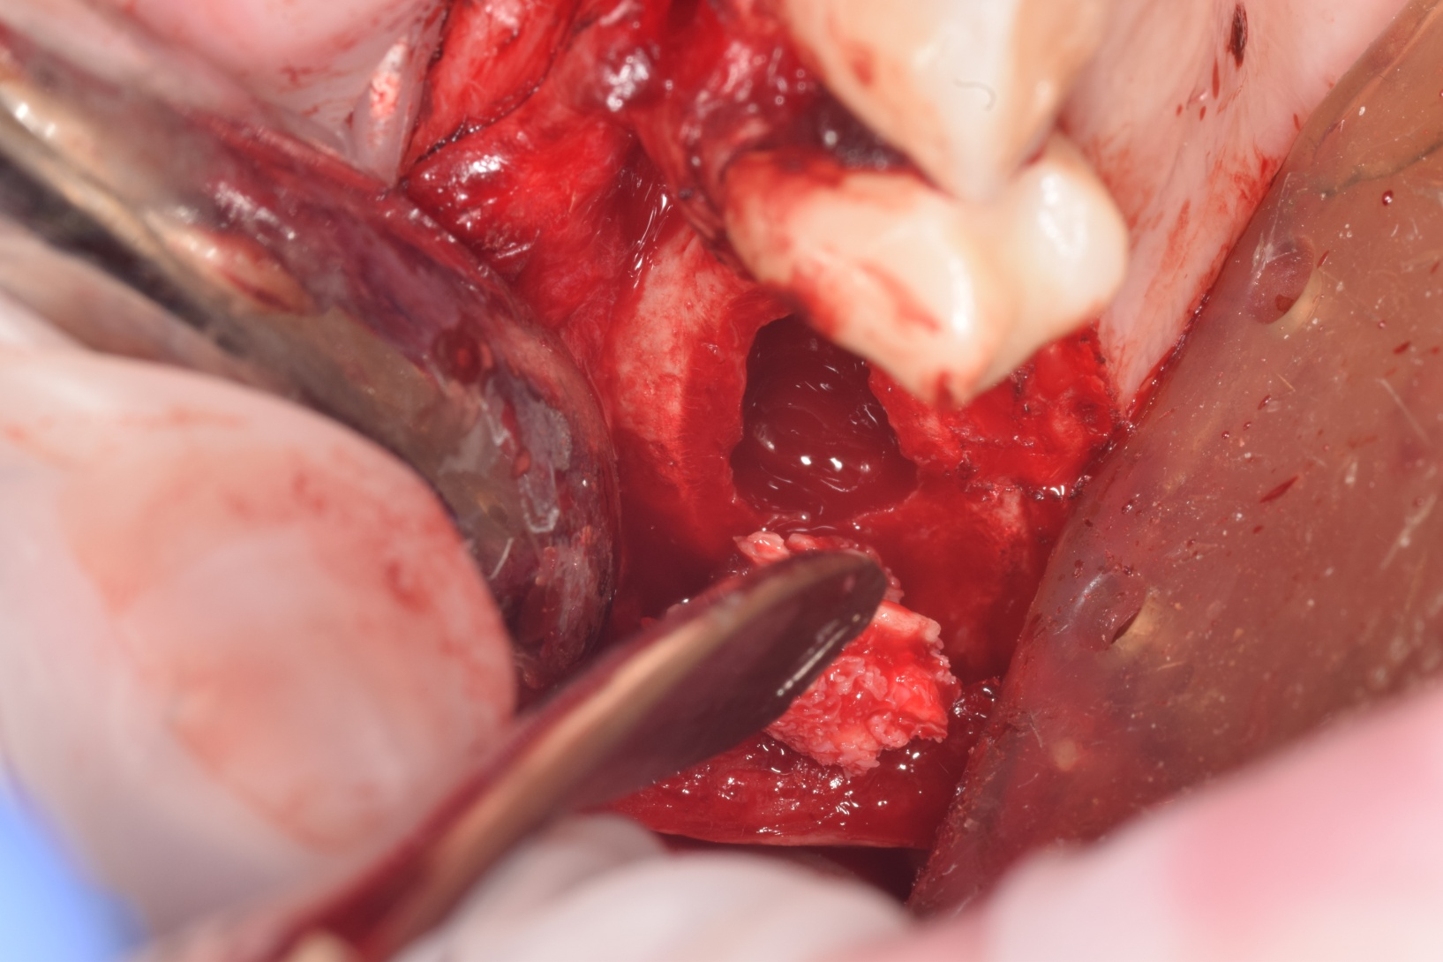
Placing Bone Graft

Slide 34
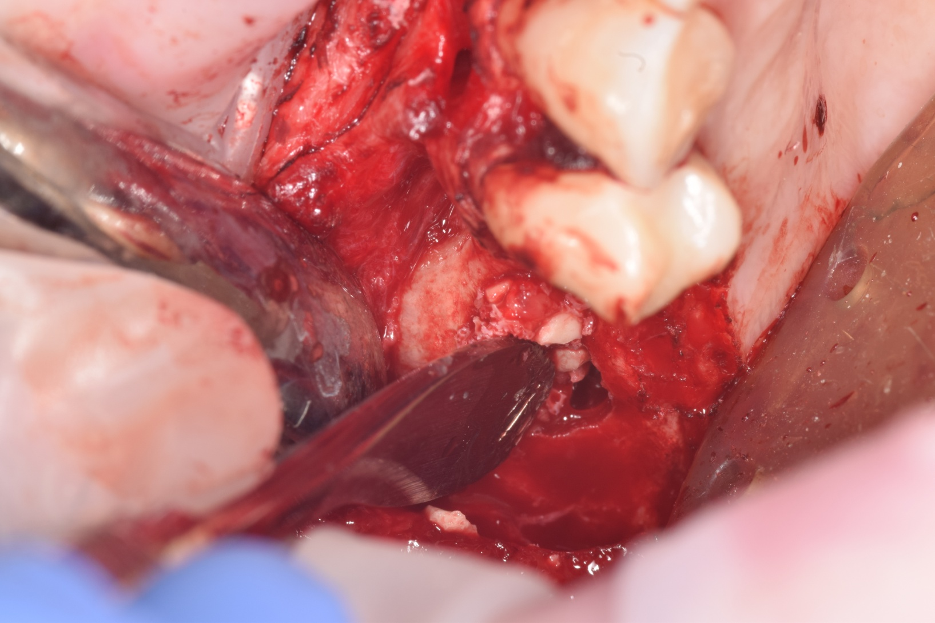
Packing Bone

Slide 35
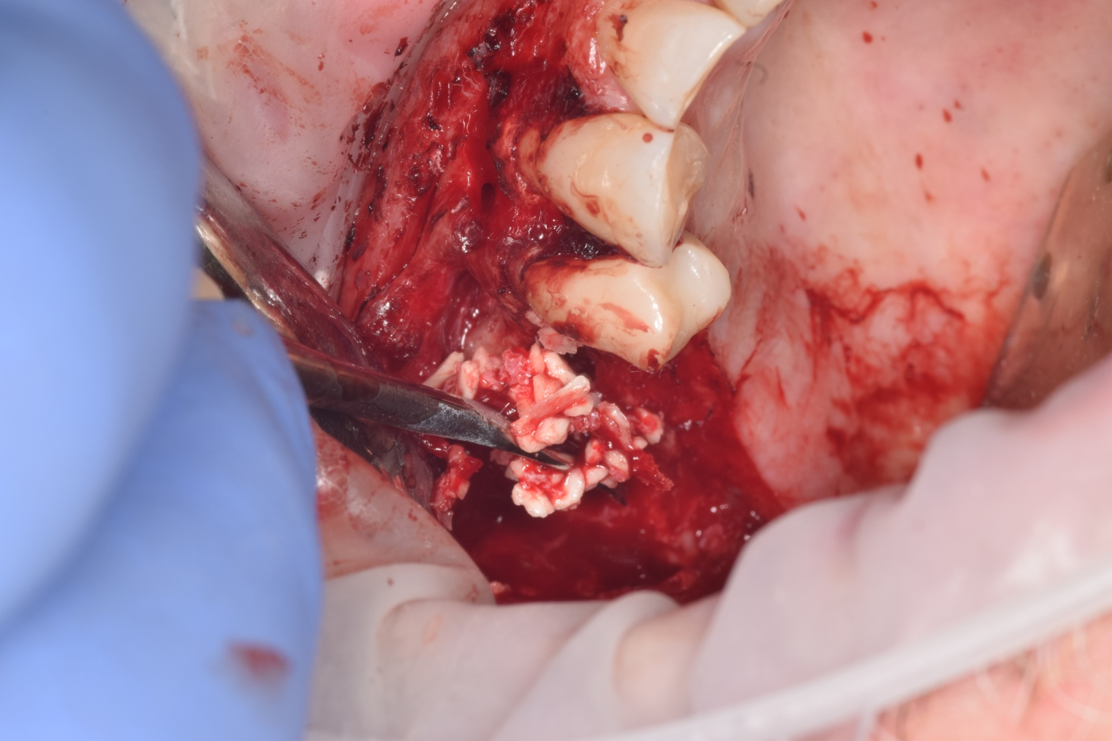
Bone

Slide 36
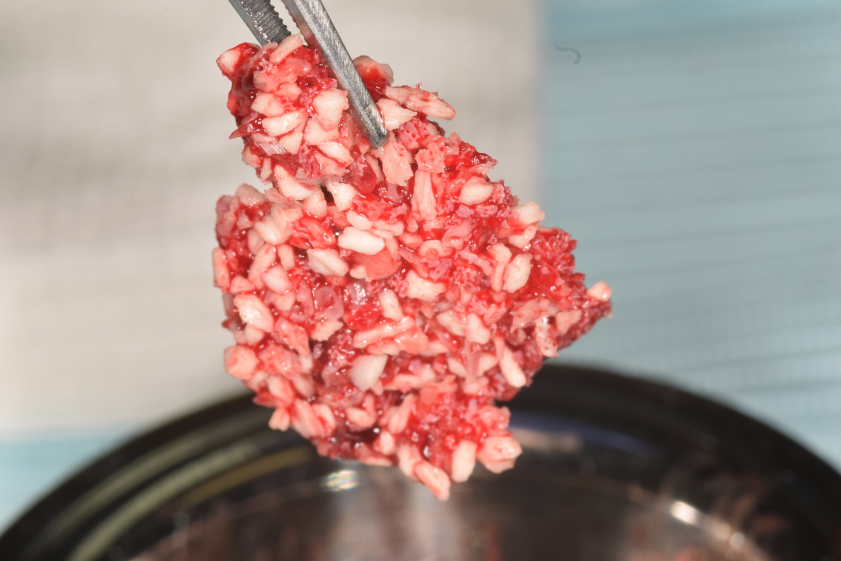
Sticky Bone

Slide 37
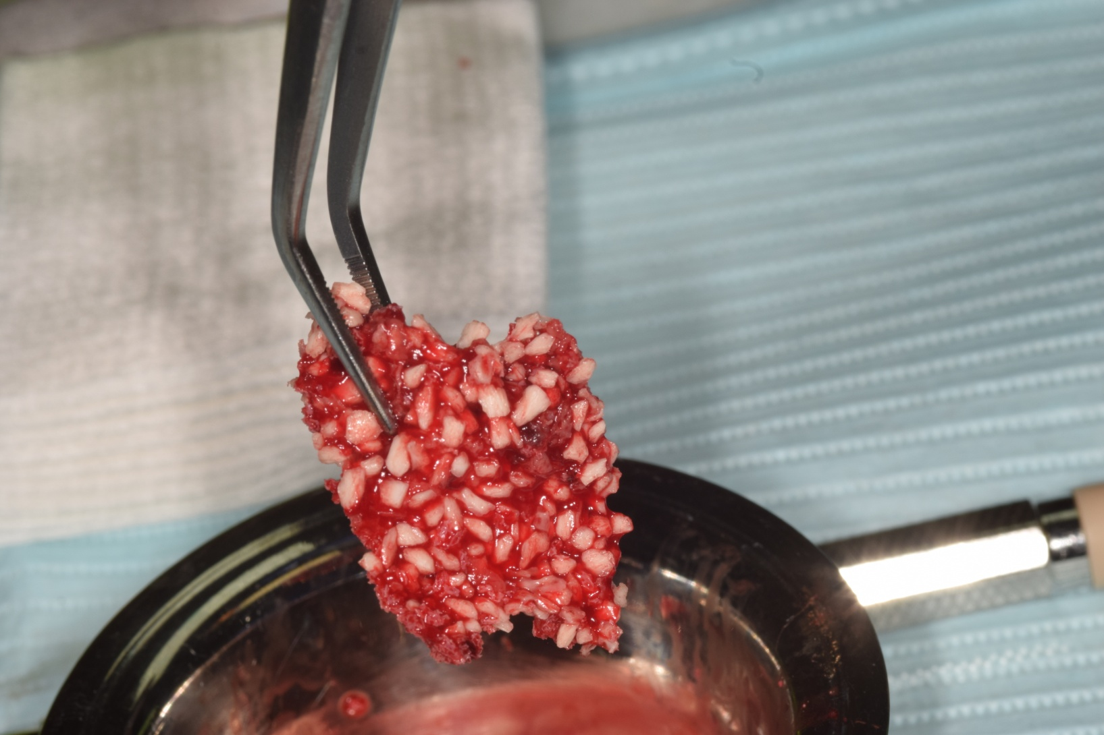
Sticky Bone

Slide 38
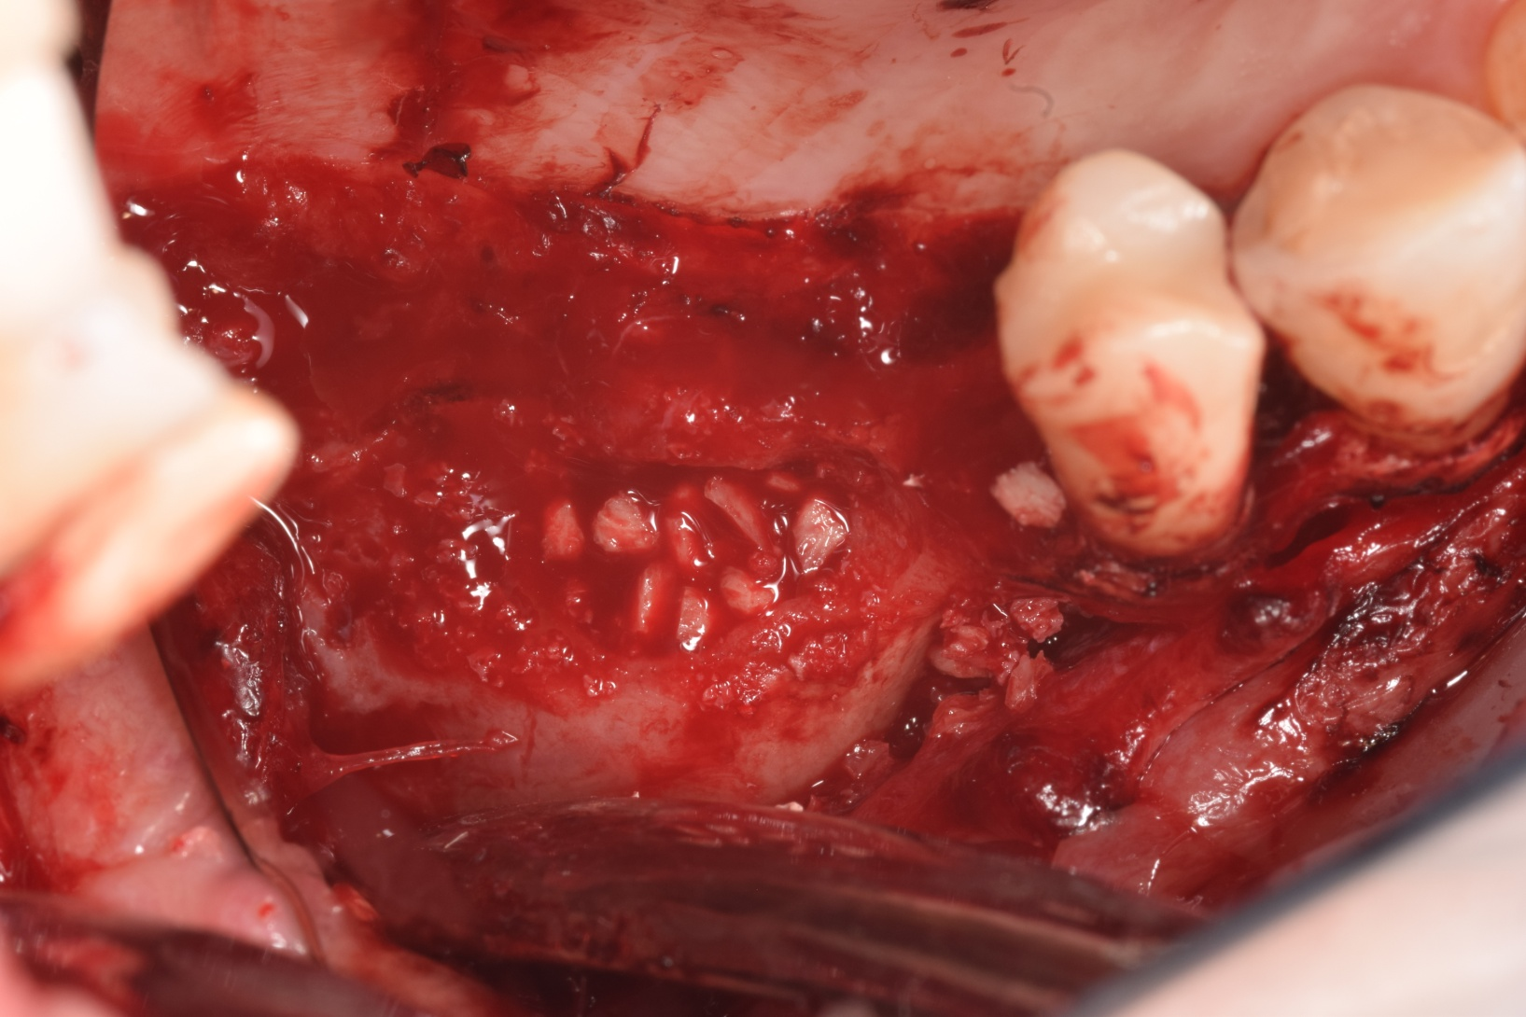
Bone Placement

Slide 39
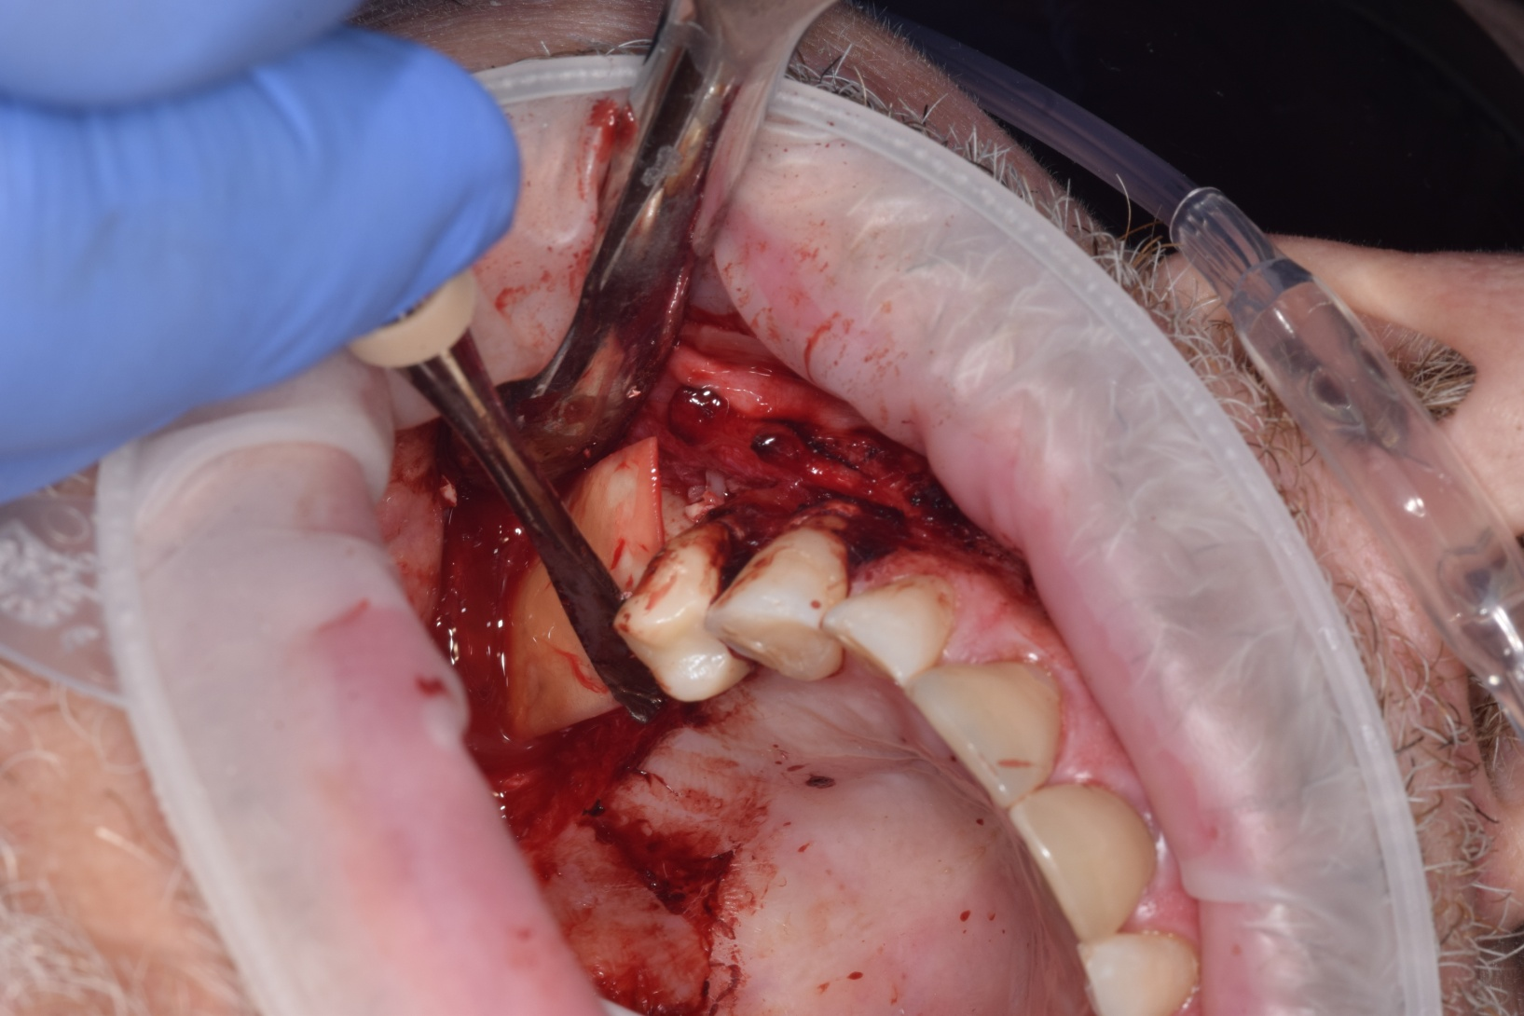
Collagen Membrane

Slide 40
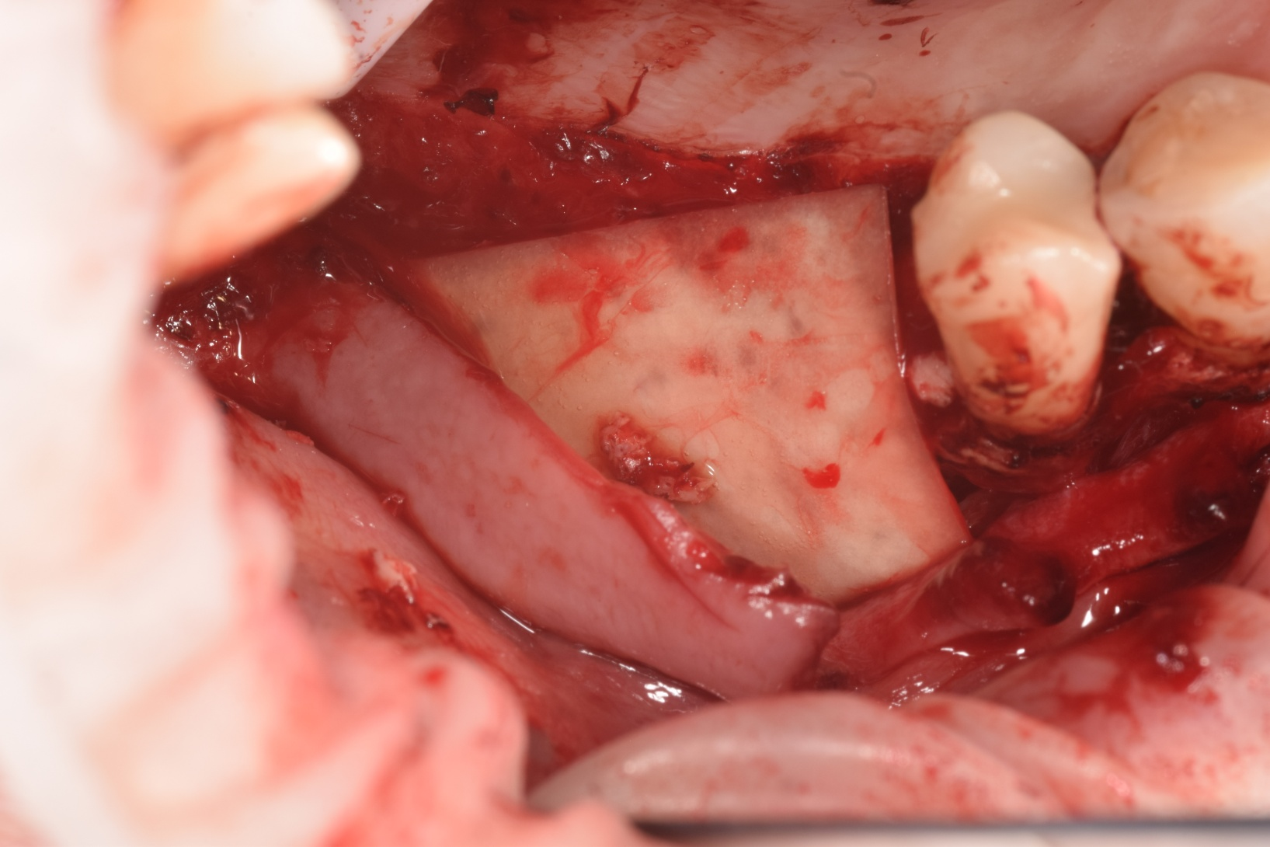
Membrane

Slide 41
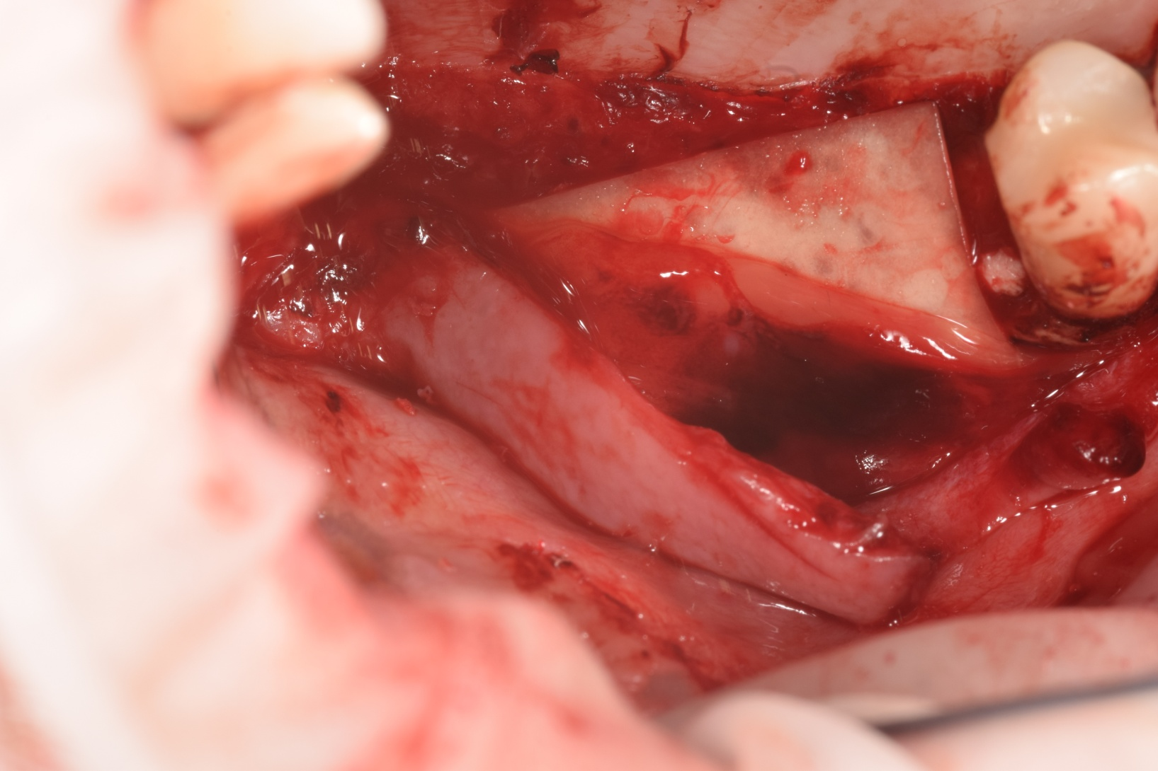
Biologics Membrane over Collagen membrane

Slide 42
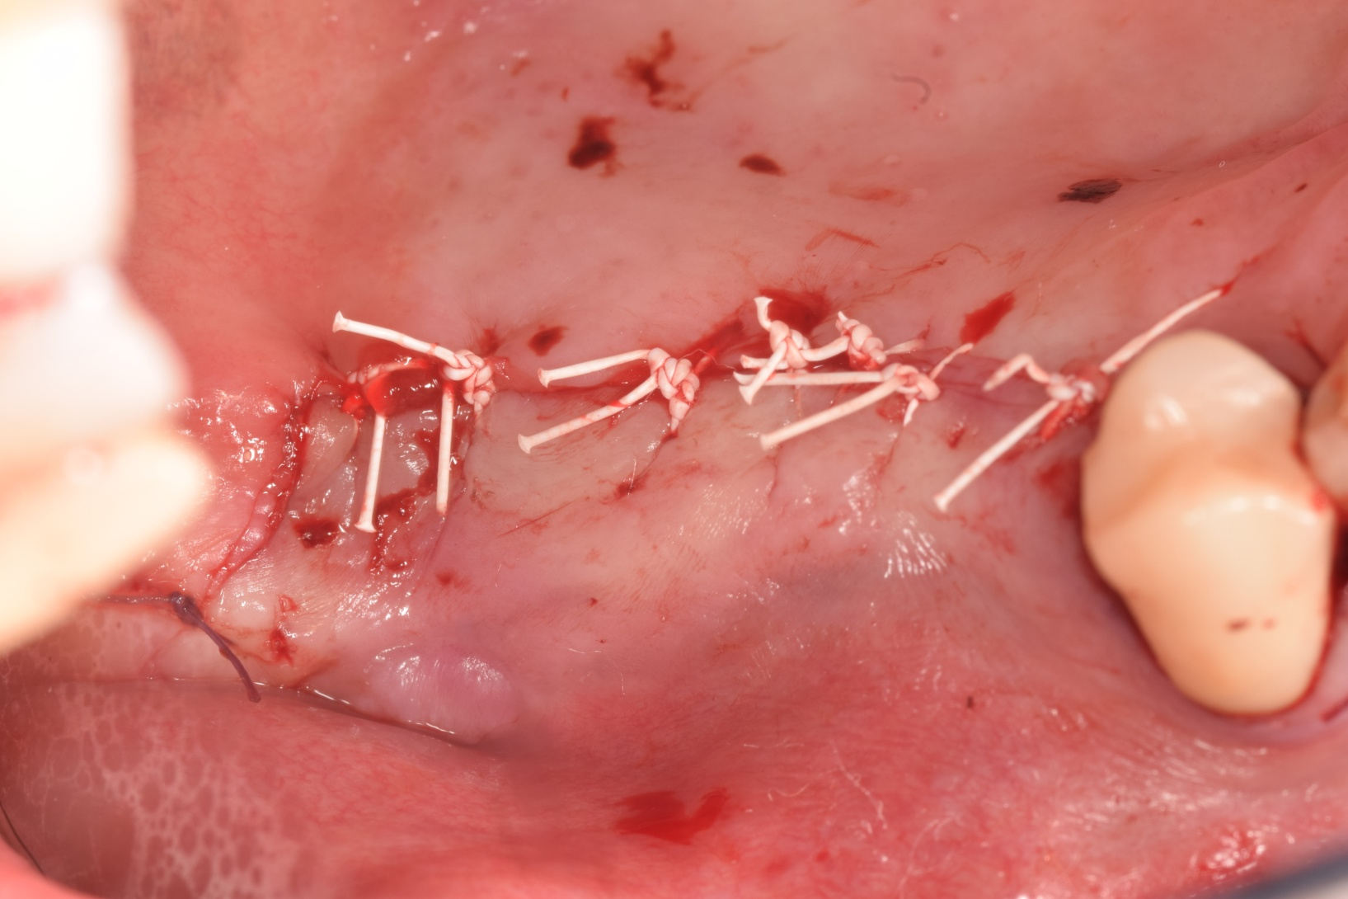
Sutured

Slide 43
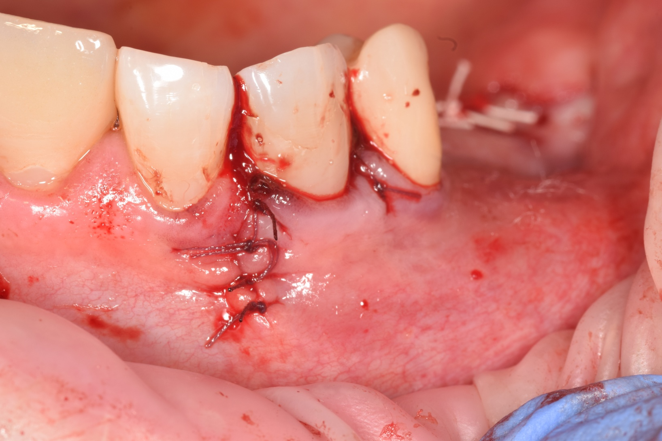
Sutured

Slide 44
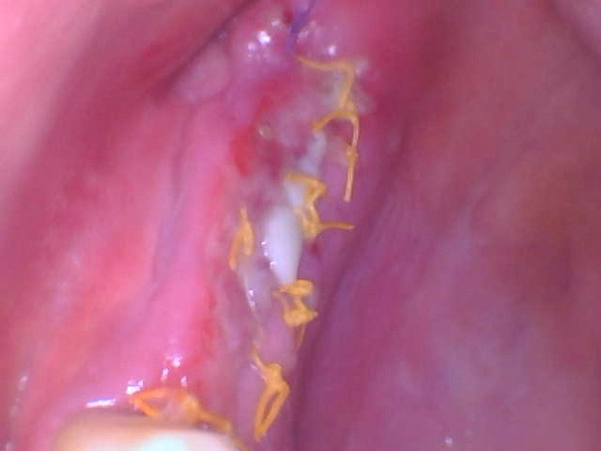
5-18-2021 Follow up

Slide 45
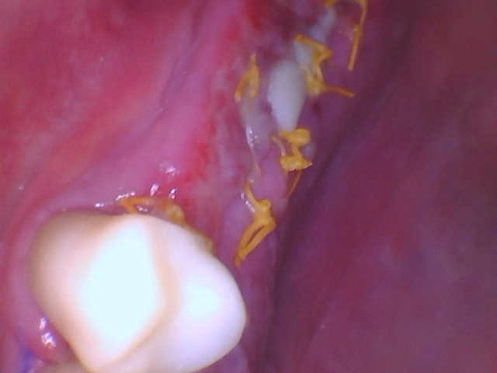
5-18-2021 Follow up

Slide 46
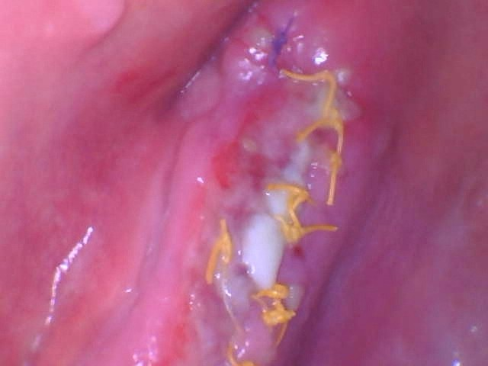
5-18-2021 Follow up

Slide 47
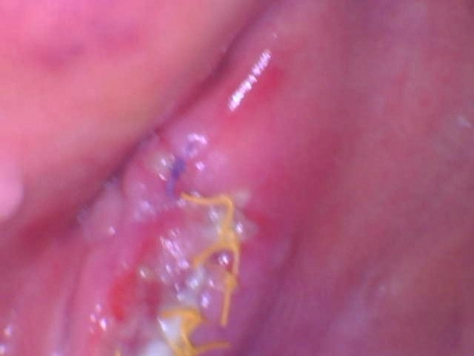
5-18-2021

Slide 48
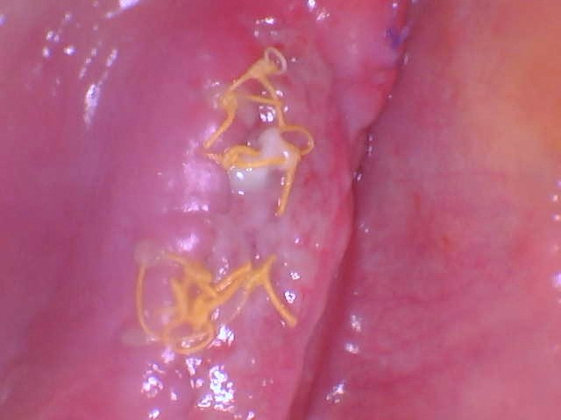
5-18-2021

Slide 49
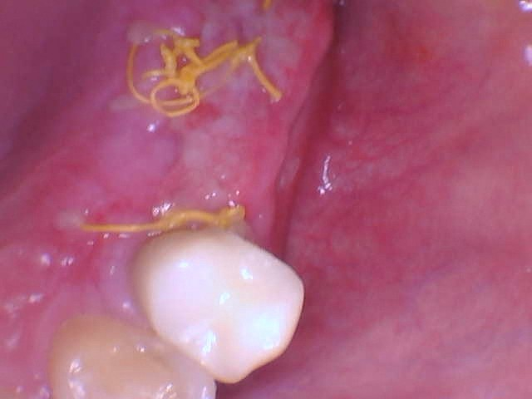
5-18-2021

Slide 50
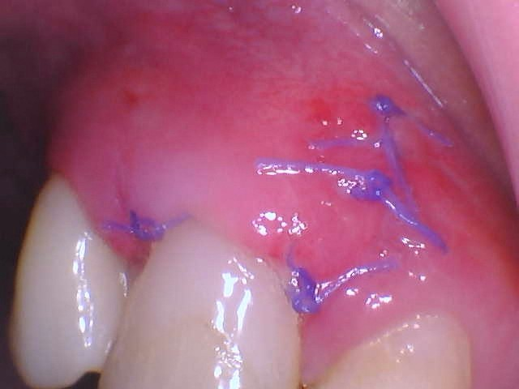
5-18-2021

Slide 51
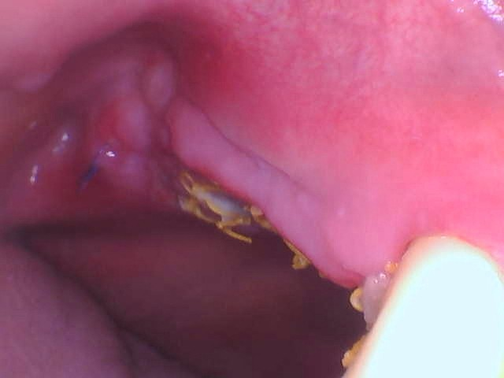
5-18-2021

Slide 52
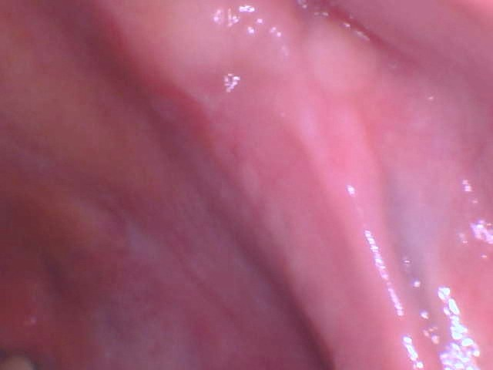
6-20-2021

Slide 53

6-20-2021

Slide 54

UR Post 4 Month OP 9-8-2021

Slide 55

UR 7 Month Post OP 12-20-2021

Slide 56

UR 7 Month Post OP 12-20-2021

Slide 57

UR 7 Month Post OP 12-20-2021

Slide 58

UR 7 Month Post OP 12-20-2021

Slide 59

UR Implants #3 #4 Plan

Slide 60

UR Implants #3 Plan

Slide 61

UR Implants #4 Plan

Slide 62

UR Implants #3 #4 Plan

Slide 63

Implant Pre-op UR

Slide 64

Surgical Guide

Slide 65

Surgical Guide UR

Slide 66

Laser Osteotomy Site

Slide 67

Guided Drills

Slide 68

Drills in Place

Slide 69

Verification X-Ray #3 #4

Slide 70

4.5 x 10.0 AB Dental Implants

Slide 71

Implant Placement

Slide 72

#3 Implant

Slide 73

#4 Implant

Slide 74

#3 #4 Implants

Slide 75

Implants

Slide 76

Implants

Slide 77

Surgical Guide Kit

Slide 78

Blood Draw for Biologics

Slide 79

Blood Draw

Slide 80

Biologics Fluid

Slide 81

Implants Post OP

Slide 82

#3 Implants Post OP

Slide 83

#3 Implants Post OP

Slide 84

#3 Implants Post OP

Slide 85

#4 Implants Post OP

Slide 86

#4 Implants Post OP

Slide 87

#4 Implants Post OP

Slide 88

Implants Post OP

