Slide 1
Dental Ergonomics
Inland Empire Periodontal Study Club 2022
Victoria Hardwick, DDS

Slide 2
Reasons for Early Retirement among Dentists¹
Musculoskeletal disorders (29.5%)
Cardiovascular disease (21.2%)
Neurotic symptoms (16.5%)
Tumors (7.6%)
Diseases of the nervous system (6.1%)

Slide 3
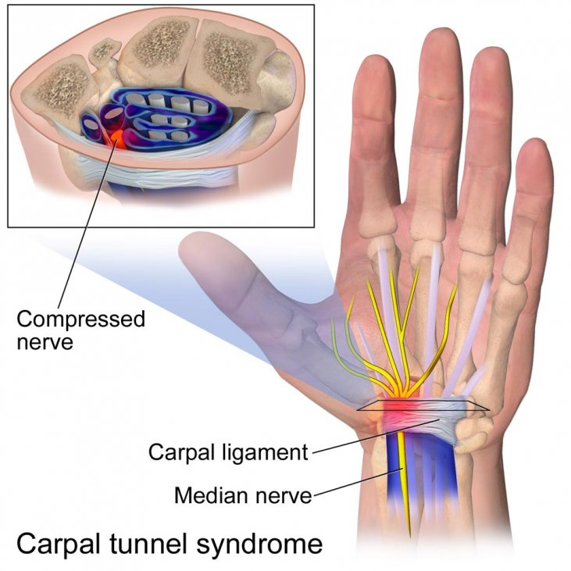
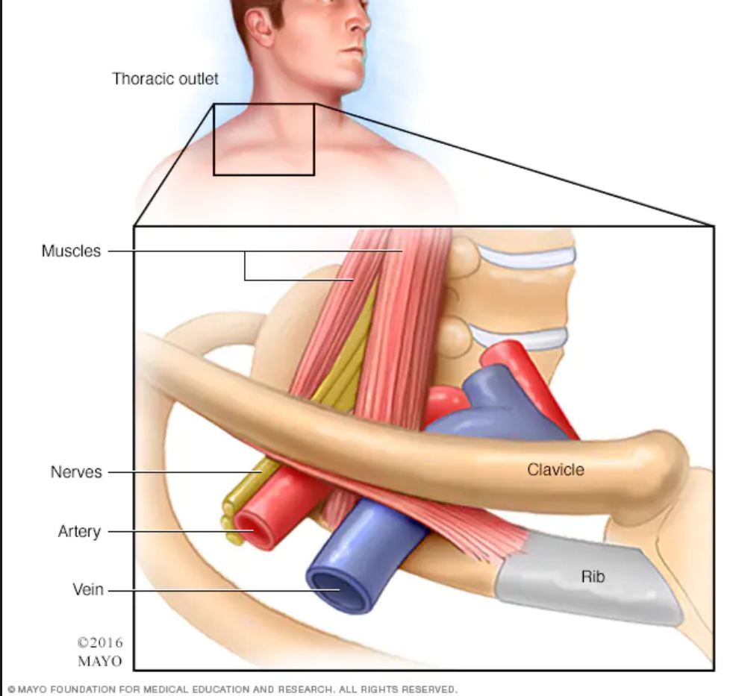
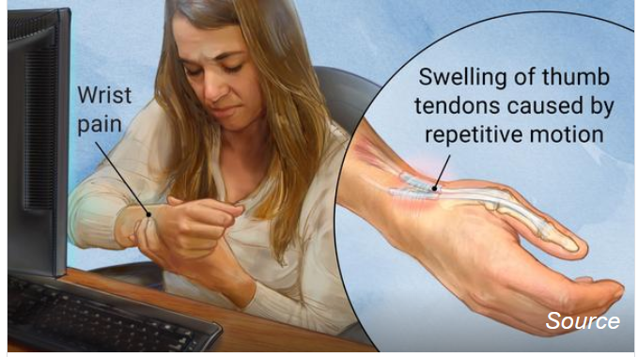
Common Musculoskeletal Disorders in Dentistry
Low back, neck and shoulder pain
  Muscle imbalance
  Derangements of the cervical and lumbar spine
Carpal Tunnel is caused by pressure on the median nerve. The carpal tunnel is a narrow passageway surrounded by bones and ligaments on the palm side of the hand. When the median nerve is compressed, symptoms can include numbness, tingling, and weakness in the hand and arm.
DeQuervain’s (radial styloid tenosynovitis) is a painful condition affecting the tendons on the thumb side of the wrist. Repetitive hand or wrist movements can make the condition worse. The main symptoms are the pain and tenderness in the wrist, often below the base of the thumb.
Thoracic Outlet Syndrome is a group of disorders that occur when blood vessels or nerves in the space between your collarbone and your first rib (thoracic outlet) are compressed. This can cause shoulder and neck pain and numbness in your fingers
DeQuevain’s Tenosynovitis

Slide 4
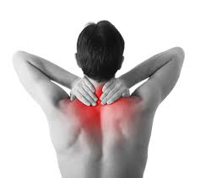
Signs of Musculoskeletal Disorders in Dentistry
Pain or excessive fatigue in shoulders and neck
Tingling or burning in the arms
Weak grip, clumsiness or cramping of hands
Low back pain
Frequent headaches
Decreased ROM in a joint
Gravityworks.com

Slide 5
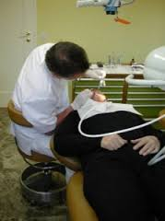
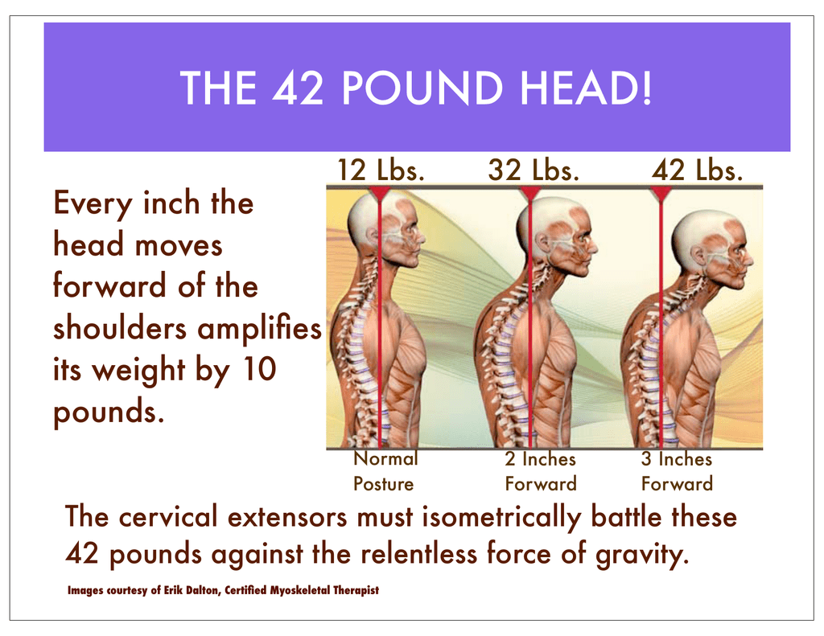
Why do I hurt?
Prolonged static postures
  Muscular/neural Ischemia
Trigger points
Muscle imbalances
Cumulative Trauma
https://encrypted-tbn3.gstatic.com/images?q=tbn:ANd9GcQj6dI8aT2vSaAjd5mLqtbRiTacn02acjlt3tFZSxJ-jcXN6cGk
https://studylib.net/doc/18424080/the-42-pound-head-

Slide 6
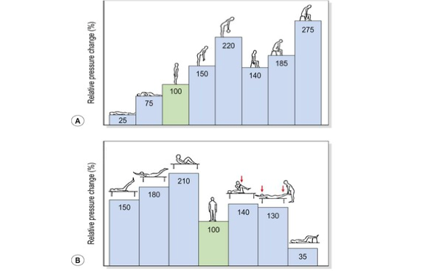
http://musculoskeletalkey.com/wp-content/uploads/2016/09/B9780702034732000174_f013-006-9780702034732.jpg

Slide 7
Improper Posture²
Working with neck overly flexed or tilted to one side
Shoulders elevated
Side bending left or right
Excessive forward bending
  Loops - (WD: too short? Magnification: not enough?)
Excessive twisting
Elbows flexed greater than 90 degrees
Wrists flexed/deviated during grasp
Hyperextension of the thumb
Prolonged poor posture

Slide 8
Tips for Good Posture^{2,5}
Maintain an Erect posture
Keep close to the patient
Avoid excessive bending forward (~20*)
Keep feet flat on the floor
Keep your head from flexing too far forward (~20*)
Use an adjustable chair with back support
Work close to your body to prevent overreaching
Elbows, hips, knees and ankles at 90*
Alternate work positions
  Sitting (Clock positions), Standing, Switching sides
Adjust the height of your chair and the patient’s chair to a comfortable level
  https://www.youtube.com/watch?v=J4EBKtGgNNk (adec video)
Move the patient chair to correct bad posture
Good position of the overhead light to avoid straining to see in the patient’s mouth

Slide 9
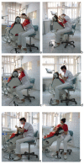
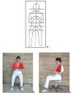
The Good
The Bad, and the Ugly

Slide 10
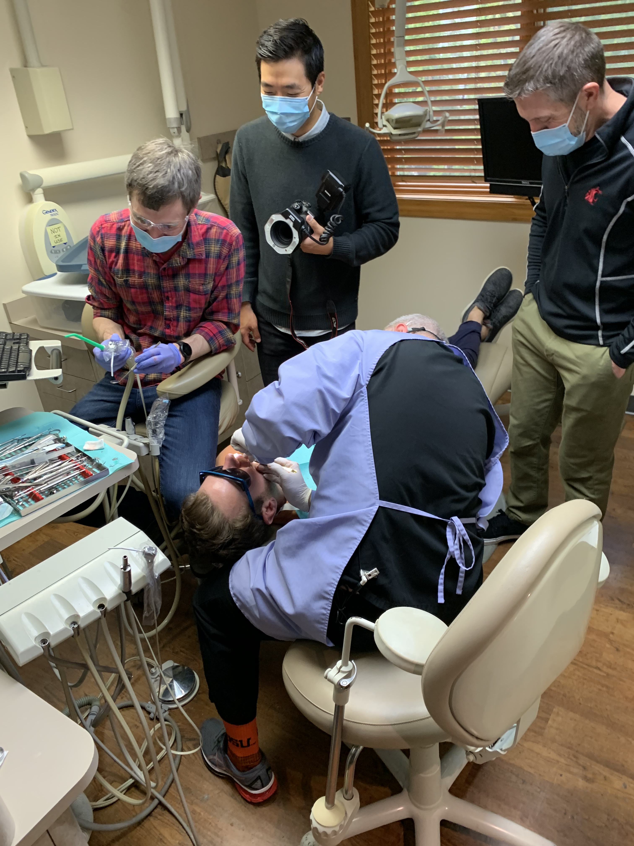
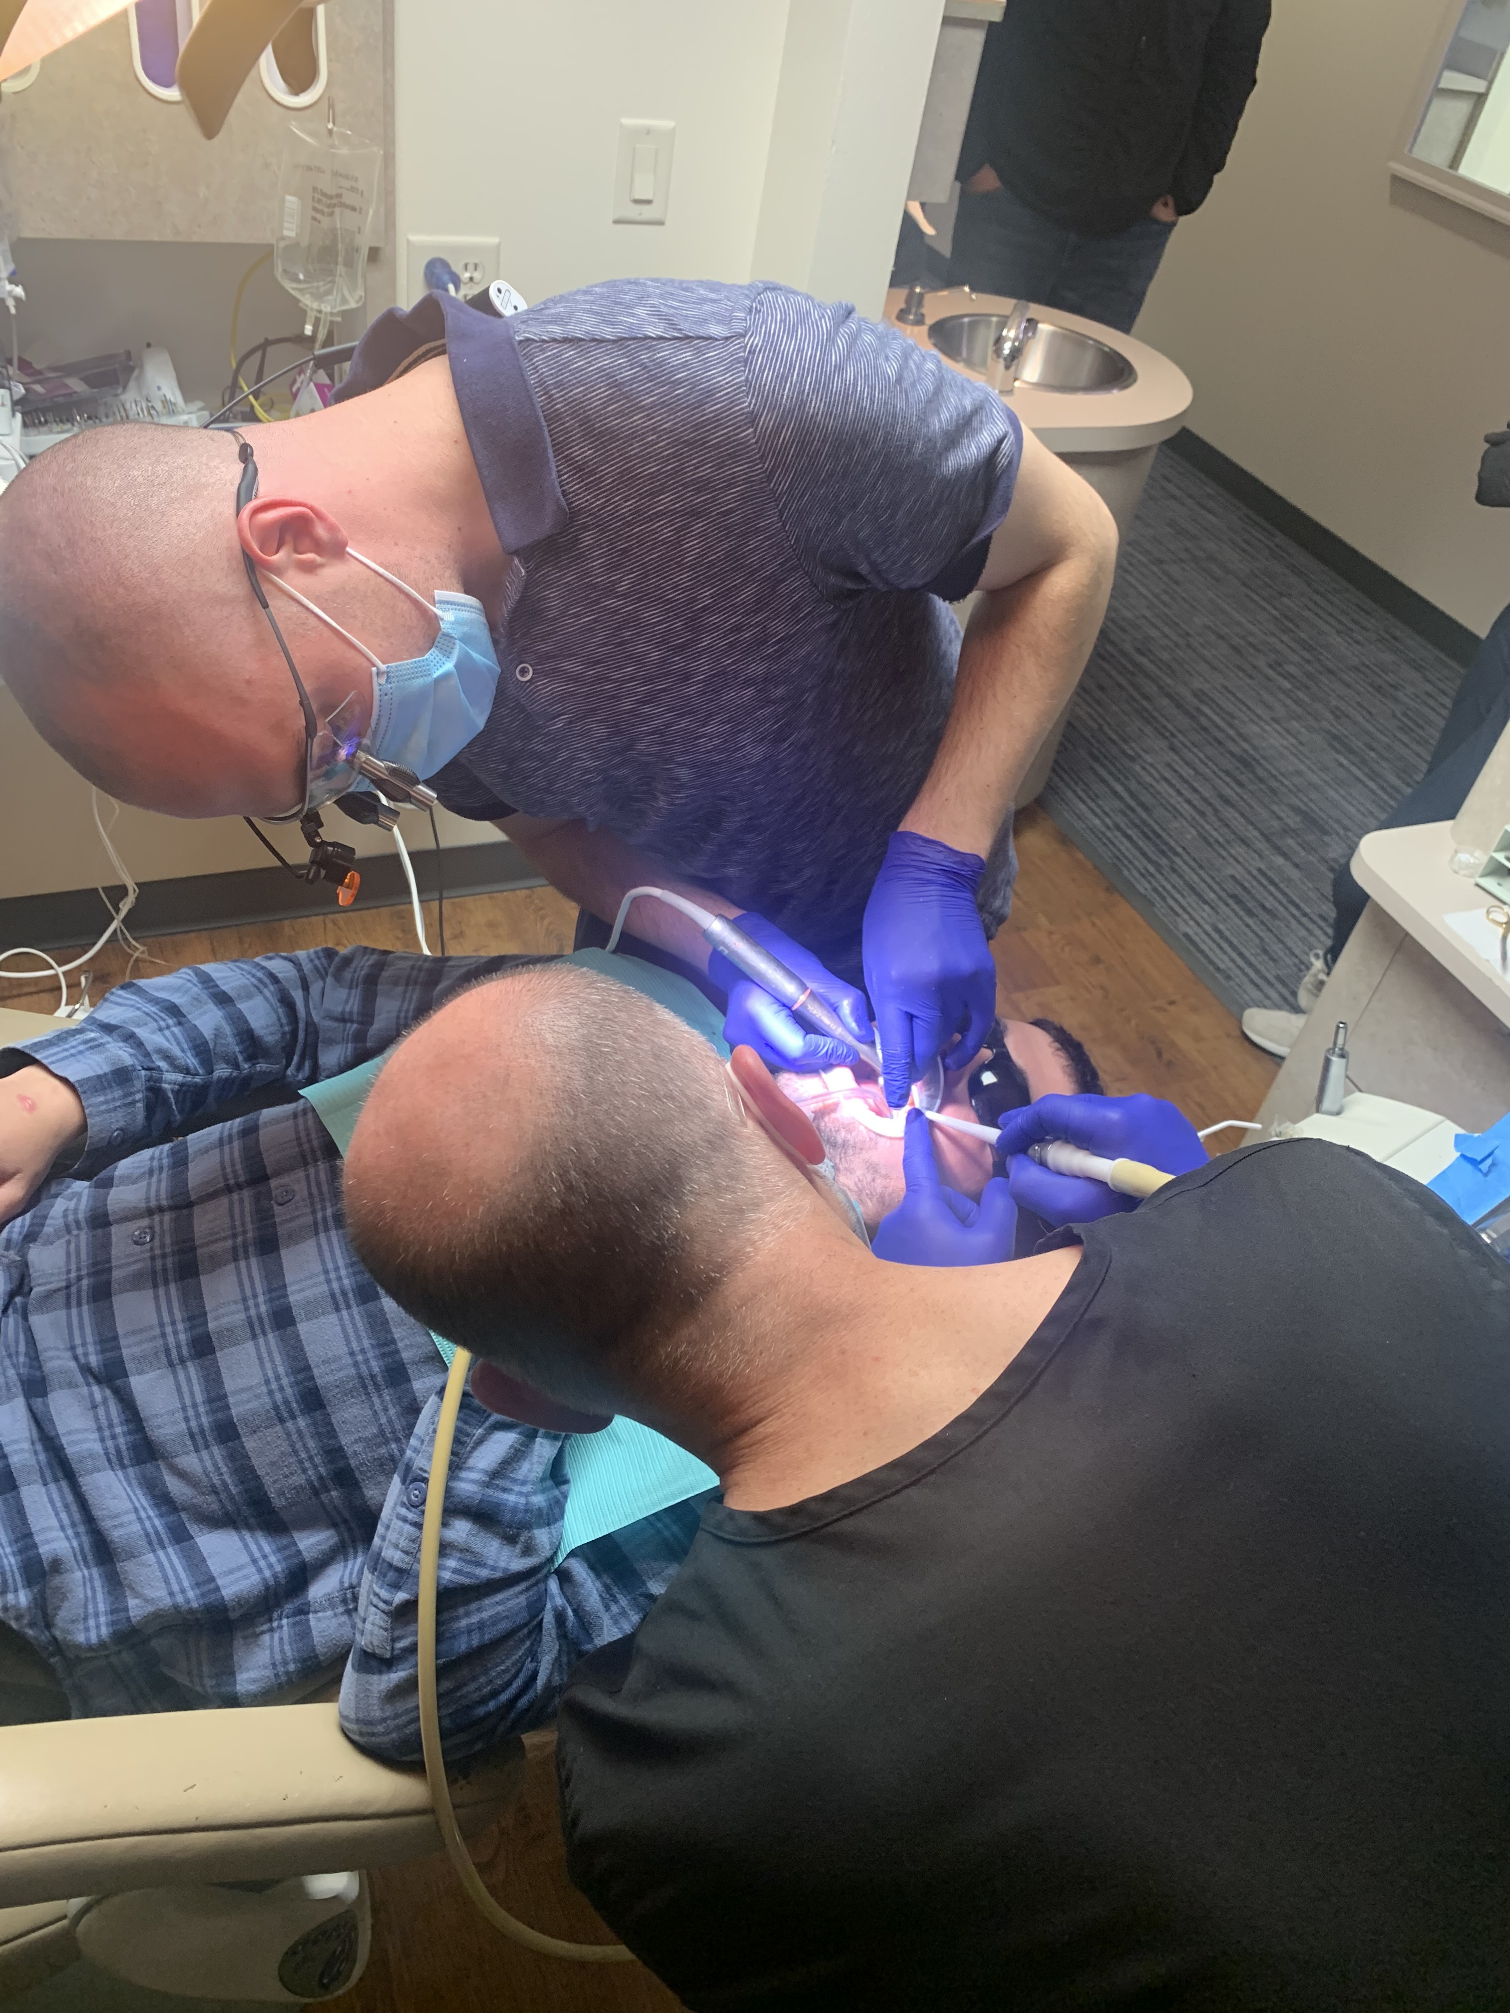
Today’s Surgeries (posture)

Slide 11
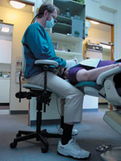
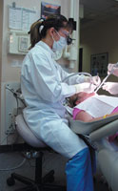
Seating is a big deal
60,000 hours of sitting!!!(30 yr)
Should be:
Easily adjustable
Easily moves
Provides back support
Seat pan tilts
Less than 5’4” tall
Consider saddle stool
http://www.dentistrytoday.com/ergonomics/1116--sp-858836667
http://www.dentistrytoday.com/ergonomics/1116--sp-858836667

Slide 12
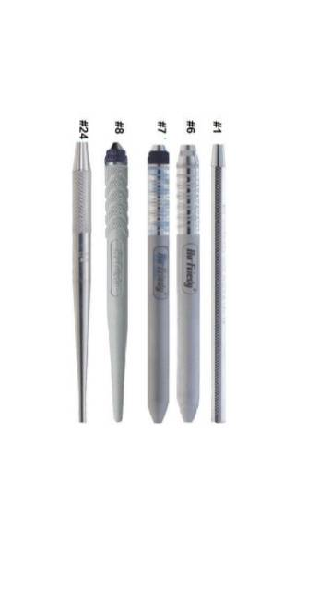

Instruments
Use large diameter instruments if able
  Round better than hexagonal
  Serrations for increase traction
Well balanced
Keep instruments sharp
Alternate type of grasp
Intra and extraoral fulcrums
  Substantially decrease grip force
Use least amount of force required

Slide 13
Instrument cont.
Harmful positions⁴
End range wrist flexion/extension, ulnar deviation, forearm rotation
Repetitive grasping with thumb and fingers
Excessive finger movements
Firm grasp/excessive force needed to hold instruments
Thumb hyperextension
Pressure from instrument edges on fingers
Vibration damage from vibrating instruments
Tight gloves that constrict wrist/fingers

Slide 14
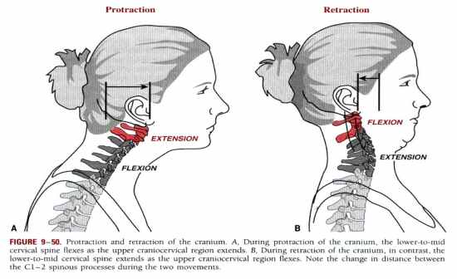
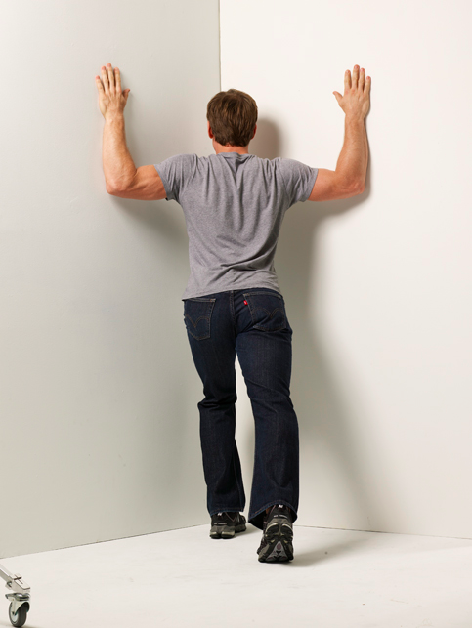
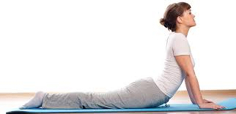
Stretches and Exercises
ADA Ergonomic Tips : Neck Stretch –> https://www.youtube.com/watch?v=Z32EdHiOBaE
https://i.stack.imgur.com/YyOrh.jpg
Ninja Dentist – Wall Slides (40 sec) – Shoulders/Upper Back stretch https://www.youtube.com/watch?v=ggK4iPhxVFU
https://www.google.com/imgres?imgurl=http%3A%2F%2Fcdn2.stylecraze.com

Slide 15
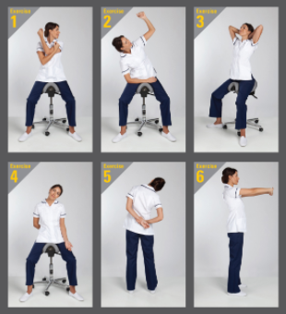
Stretches and Exercises cont.
http://www.bambach.co.uk/assets/images/dental/centre-exercises.jpg

Slide 16
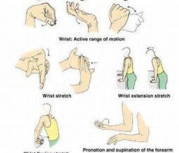
Stretches and Exercises cont.
Hold one hand straight in front of you with the palm facing up.
With opposite hand, gently hold all fingers of outstretched hand downward, causing palm to face away from your body.
Gently stretch.
Hold for a few seconds, release.
Repeat 3-5 times.
Repeat with the other hand.
https://cdn.shopify.com/s/files/1/0368/6065/articles/Carpal_Tunnel_Exercises_large.png?v=1458840097

Slide 17
Take home points
Reverse the curves
Take breaks often
Make posture part of your routine

Slide 18
References
Murphy DC. Ergonomics and dentistry. NY State Dent J. 1997 Aug-Sep;63(7):30–34.
Gupta A. Ergonomic in dentistry. Review Article. Int J Clin Pediatr Dent. 2014 Jan-Apr; 7(1): 30–34
Valachi B. Operator Seating The Tall and Short of It. 2005.http://www.dentistrytoday.com/ergonomics/1116--sp-858836667.
Graham C. Ergonomics in Dentistry, Part 2. 2002. http://www.dentistrytoday.com/ergonomics/1111--sp-523290991.
Pirvu C. The dentist’s operating posture – ergonomics aspects. J Med Life. 2014 Jun 15; 7(2): 177–182. Published online 2014 Jun 25. https://www.ncbi.nlm.nih.gov/pmc/articles/PMC4151237/

