Slide 1
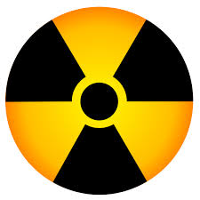
Oral Health Management of Head and Neck Radiation Patients
Dan Hughes DDS
IEPSC Member Presentation
11/20/15

Slide 2
Pretreatment Protocol
OHI
Encouragement of noncariogenic diet
Calculus removal
Prophylaxis and fluoride treatment
Elimination of all sources of irritation and infection

Slide 3
Pretreatment Protocol
Reduction in radiation exposure to noncancerous tissues with lead-lined stents should be discussed w/ patient and oncologist.
Anticholinergic or parasympathomimetic during and after radiation therapy should also be discussed.
Non restorable teeth w/ poor or hopeless prognosis, acutely infected teeth, or teeth w/ severe periodontal disease should be extracted.
Could lead to complications such as sepsis or ORN.

Slide 4
Extraction Indications
Pocket depths 6mm or greater, mobility is excessive, purulence is seen on probing.
PA inflammation is noted
Tooth is non-restorable, nonfunctional, or partially erupted; patient is non compliant w/ hygiene measures
Patient has no interest in saving teeth
Pericoronitis

Slide 5
Extraction Guidelines
At least 2 weeks before initiation of radiation
Ideally 3 weeks.
Trim bone at wound margins/ eliminate sharp edges.
Obtain primary closure
Avoid intra-alveolar hemostatic packing agents that can serve as a site for microbial growth.
Blood Transfusion if platelets below 50k/mm^3
Delay if WBC is less that 2k/mm^3 or neutrophil is less than 1000/mm^3

Slide 6
Complications
Nausea and Vomitting
Mucositis (40% of patients)
Taste alteration
Xerstomia
Secondary Infection
Radiation Caries (delayed onset)
Hypersensitive teeth (acute and delayed onset)
Muscular Disfunction
Perform daily stretching/excercises
Apply warm moist heat
Osteoradionecrosis
Pulpal Pain and necrosis

Slide 7
Tissue Effects of Radiation
Radiation therapy affects cells primarily by affecting their DNA/RNA synthesis during replication (especially in cells that have a high turn-over/replication rate such as in cancer). Cancer cells, vascular/endothelial cells, and fibroblasts that play a role in tissue-healing are most affected by the radiation. These damaged cells are subsequently not replaced by their daughter cells
Epithelial atrophy, mucositis, vascular changes w/ intimal thickening, luminal stenosis, obliteration, decreased blood flow.
Muscle fibrosis
Decreased number of osteocytes and osteoblasts in bone w/ decreased blood flow.
Salivary Glands-Atrophy of acini, vascular changes, fibrosis.
Pulp-necrosis (orthovoltage)

Slide 8
Mucositis
Eliminate Infection and irritation
Mouth Rinse (magic mouthwash, chlorhexidine, salt and sodium bicarbonate)
Avoid tobacco, alcohol, and carbonated drinks
Soft diet, maintain hydration
Use humidifier or vaporizer
Consider topical and systemic antimicrobials.
Dentures should not be worn until the acute phase of mucosits has resolved. Dentures should be cleaned and stored in antimicrobial solution daily.

Slide 9
Xerostomia and Radiation Caries
Recommend sugarless lemon drops, sorbitol-based chewing gum, and/or salivary substitutes.
Educate and motivate patient for oral hygiene
Daily application of fluoride w/ custom trays that are soft. Trays hold 5-10 drops of 1% to 2% acidulated fluoride gel should be applied for 5 minutes each day. If acidulated causes tissue irritation use .5% neutral sodium fluoride. A single application of 5000 ppm fluoride may be more effective for some patients. This also relieves patient sensitivity.
Restore Early carious lesions
Ensure frequent dental recall (3-4 months)
Confirm patient compliance

Slide 10
Carotid Atheroma
Head and neck radiation patients are more likely to develop carotid artery atheroma.
Calcified atherosclerotic plaques
Detected with panoramic radiography.
Warrants referral to physician for evaluation of stroke risk.

Slide 11
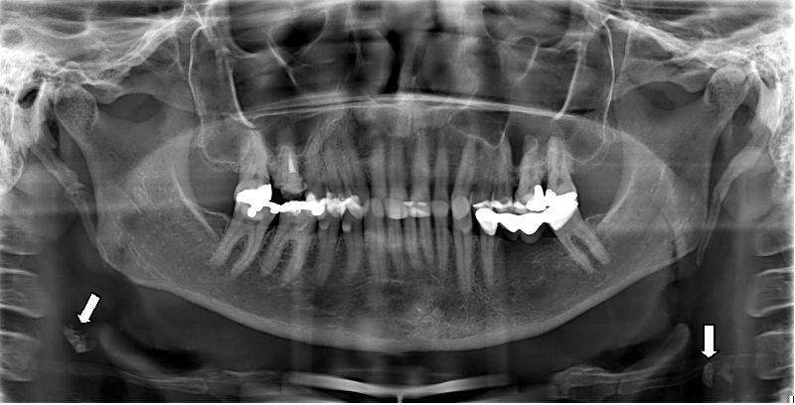
Carotid Atheroma

Slide 12
More Complications
Loss of Taste
Provide Zinc supplementation- 220mg-twice daily
Taste will return 3-4 months after therapy after villi on tastebuds regenerate.
Secondary Infections
Use culture, cytologic study, antibiotics, antifungal agents, and antiviral agents.

Slide 13
Osteoradionecrosis (ORN)
Condition in which exposed bone fails to heal for a period of 6 months or more after high-dose of radiation to the jaws.
ORN is a result of hypocellularity, hypovascularity, and ischemia of the jaws.
Most cases result from damage to the tissues overlying the bone rather than direct damage to the bone itself. Soft tissue necrosis precedes the ORN.
Higher risk in posterior mandible, treated with 6500cGy, who continue to smoke, and who have undergone a traumatic procedure.
One other thing Dr. Marx would tell us, as a crude estimator of the patient’s risk is the patient’s ability to grow facial hair. If a patient can grow a beard, then typically the teeth behind that beard are safe for extraction and the tissues will generally heal. (expert opinion not founded or supported by research)

Slide 14
Osteoradionecrosis of the mandible: A ten year single-center retrospective study.
The purpose of this study was to investigate the factors that are linked to the severity of mandibular ORN.
A total of 115 patients with 153 osteonecrosis lesions were included in the study. Twenty-three cases were of stage I, 31 were of stage II and 99 were of stage III. The initial tumors were predominantly located in the floor of the mouth, the tongue or the pharynx. Diabetes mellitus (OR: 4.955, 95% Cl: 1.965-12.495), active smoking (OR: 13.542, 95% Cl: 2.085-87.947), excessive alcohol consumption (OR: 5.428, 95% Cl: 1.622-18.171) and dental treatment and/or local pathological conditions (OR: 0.237, 95% Cl: 0.086-0.655) were significant predictors for stage III necrosis.
J Craniomaxillofac Surg. 2015 Jul;43(6):837-46. doi: 10.1016/j.jcms.2015.03.024. Epub 2015 Apr 1.

Slide 15
Rat Study ORN
Ten animals were irradiated with a single 35- or 50-Gy dose. Three weeks later, the second left mandibular molar was extracted from three animals in each group.
This study demonstrates that a single 50-Gy dose associated with molar extraction is necessary for ORN development.
J Craniomaxillofac Surg. 2015 Nov;43(9):1829-36. doi: 10.1016/j.jcms.2015.08.016. Epub 2015 Sep 8.

Slide 16
ORN rates w/ RT
6500-7000- 5-15%
7000-7500- 15-50-%
7500 and above- greater than 50%

Slide 17
ORN
Risk is greater for dentate patient than for edentulous.
Periodontal disease enhances risk.
Nonsurgical procedures that are traumatic including curettage can result in ORN.
Vasoconstrictors can reduce blood supply and can result in ORN.
ORN can be spontaneous.
The risk continues throughout the patients life.
Before you take a tooth out on a patient, place an implant, perform a bone-graft, or do any form of surgery, you absolutely must inquire whether a patient has had any radiation therapy to the head or neck, and if so, when, for how long, and how much radiation was received.

Slide 18
ORN Risk reduction
RCTs instead of extractions.
Extract teeth w/ questionable and hopeless prognosis before radiation.
No or low epinephrine in LA
Atraumatic surgical procedures if surgery is necessary
Avoid periosteal elevation
Limit extractions to two teeth per quadrant per appointment
Irrigate with saline, obatin primary closure, eliminate bone edges or spicules
Hyperbaric oxygen therapy- before and after invasive procedures

Slide 19
ORN Staging
Stage I-Superficial involvement of the mandible w/ minimal soft tissue ulceration; only exposed cortical bone is necrotic
Stage II-Both the exposed cortical bone and the underlying medullary bone are necrotic. Nonvital bone is removed w/ transalveolar sequestrectomy and the labial and lingual mucoperiosteal flaps are closed in 3 layers over a base of bleeding bone. If dehisces→ Stage 3.
Stage III-Full diffuse involvement of the mandible , including a full thickness segment of bone. Typically involve pathological fractures, inferior mandibular border involved and have orocutaneous fistula.

Slide 20
ORN Management
Conservative management.
Exposed bone irrigated with gentle irrigation with saline or antibiotic solution. Patient should also instructed to use oral irrigating devices.
Bony sequestra removed for epithelialization.
RX broadspectrum antibiotics if swelling or suppuration are present.
Hyperbaric oxygen therapy for 20-30 dives.
Cases that don’t respond may require surgical resection of involved bone.

Slide 21
Intensity-modulated radiation therapy (IMRT)
IMRT uses multiple small photon or proton beams of varying intensities to precisely irradiate a tumor. The radiation intensity of each beam is controlled, and the beam shape changes throughout each treatment.
A total of 43 articles between 1990 and 2008 were reviewed. The weighted prevalence for ORN included conventional radiotherapy (RT) = 7.4%, intensity modulated RT (IMRT) = 5.1%, chemoradiotherapy (CRT) = 6.8%, and brachytherapy = 5.3%. Hyperbaric oxygen may contribute a role in management of ORN. However, no clear guideline recommendations could be established for the prevention or treatment of ORN based on the literature reviewed.
New cancer treatment modalities such as IMRT and concomitant CRT have had minimal effect on prevalence of ORN. No studies to date have systematically addressed impact of ORN on either quality of life or cost of care.
Support Care Cancer. 2010 Aug;18(8):1089-98. doi: 10.1007/s00520-010-0898-6. Epub 2010 Jun 6.

Slide 22
Intensity-modulated radiation therapy (IMRT) compared with radiation therapy (RT)
Historical cohort study
In total, 158 patients at a single VA hospital who were treated with RT or IMRT between 2003 and 2011 were identified. A complete dental evaluation was performed prior to radiation treatment, including periodontal probing, tooth profile, cavity check, and mobility. The dental treatment plan was formulated to eliminate current and potential dental disease. The rates of dental extractions, infections, caries, mucositis, xerostomia, and osteoradionecrosis (ORN) were analyzed, and a comparison was made between patients treated with IMRT and those treated with RT.

Slide 23
RT vs IMRT Resutls
Of the 158 patients, 99 were treated with RT and 59 were treated with IMRT. Compared with those treated with IMRT, significantly more patients treated with RT exhibited xerostomia (46.5% vs 16.9%; P < .001; odds ratio [OR], 0.24; 95% confidence interval [CI], 0.11-0.52), mucositis (46.5% vs 16.9%; P < .001; OR, 0.24; 95% CI, 0.11-0.52), and ORN (10.1% vs 0%; P = .014; OR, 0.07; 95% CI, 0.00-1.21). However, significantly more patients treated with IMRT were edentulous by the conclusion of radiation treatment (32.2% vs 11.1%; P = .002; OR, 3.8; 95% CI, 1.65-8.73).
Patients who were treated with IMRT had fewer instances of dental disease, more salivary flow, and fewer requisite posttreatment extractions compared with those treated with RT. The number of posttreatment extractions has been reduced with the advent of IMRT and more so with a complete dental evaluation prior to treatment.

Slide 24
Hyperbaric Oxygen Therapy
HBO is provided at a “depth” of 2.4 atmospheres, breathing 100% oxygen
Oxygen dissolves in physical solution in the interstitial tissues and blood.
This permits oxygen delivery to the tissues beyond the normal hemoglobin delivery mechanism.
Oxygen gradients are improved. This helps the wound-healing macrophages to migrate into the affected tissue. Macrophages secrete enzymes and cytokines which stimulates capillary angiogenesis and thereby improving the blood supply to the area. Marx’ studies showed an increase in vascularity from 25-30% pre-HBO to 70-75% post-HBO.

Slide 25
HBOT
Once the bone is dead, its dead forever. Nothing will make the bone heal. HBO does not heal dead bone. HBO plays a role in improving blood supply to help which in turn helps to heal the injured, but not dead tissue.
No exposed bone , requiring oral/periodontal surgery- 20 Pre-Op Sessions followed by 10 Post-Op Sessions. Total of 30 sessions of HBO.
Exposed Bone… 30 Pre-Op sessions followed by 10 Post-Op Sessions. Total of 40 sessions of HBO.

Slide 26
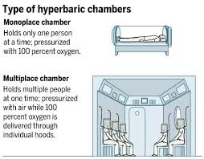
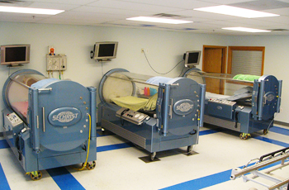
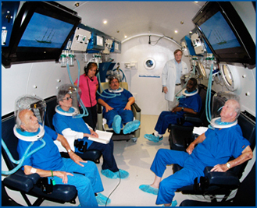
Hyperbaric Oxygen Therapy

Slide 27
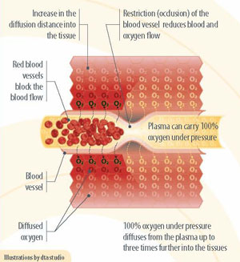
HBOT

Slide 28
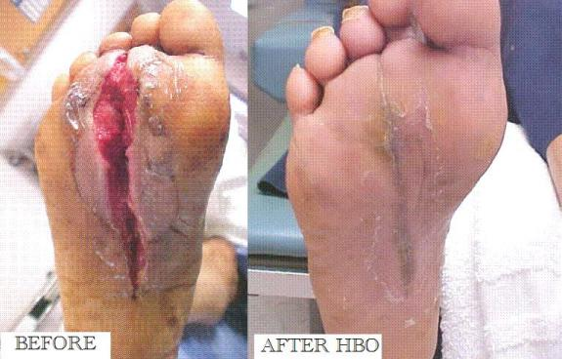
HBOT

Slide 29
HBOT
After HBOT dives, the maximum effect will be gained and no further HBOT within the patients lifetime will improve healing or oxygen delivery.

Slide 30
Lifetime
Effects of radiation do not get better with time and only get worse as the patient ages.

Slide 31
Bibliography
Dental Management of the Medically Compromised Patient, 7th edition, J. Little, D. Falace, Craig Miller et al, 2008

